Slide 1
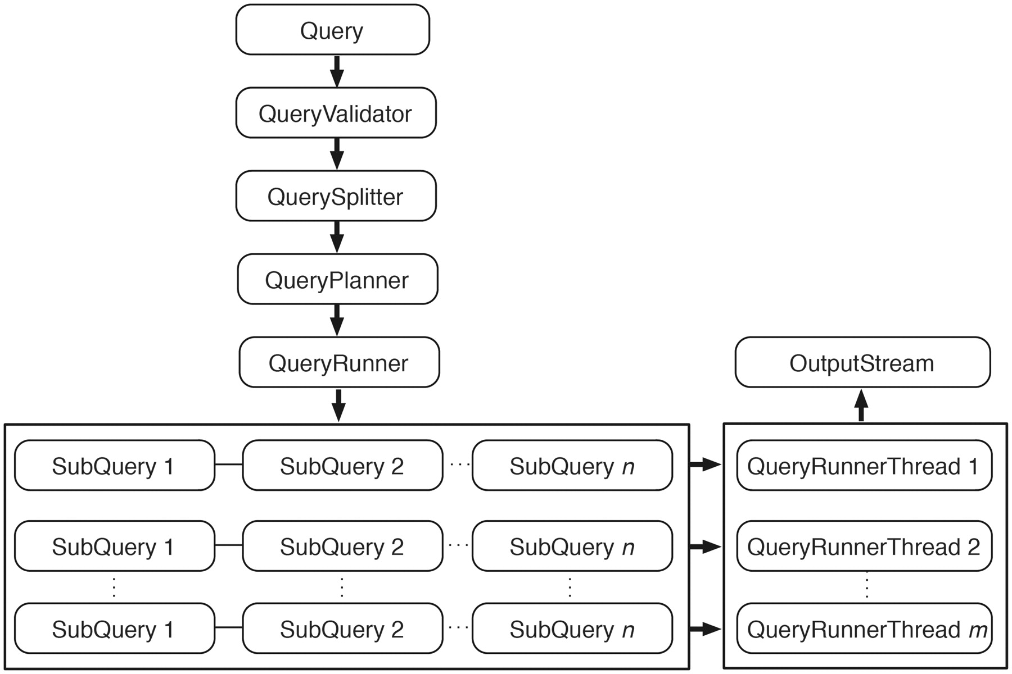
Figure 5. Query engine. An incoming query is first passed to QueryValidator to ensure the requested resources exist. ...
Notes:
Figure 5. Query engine. An incoming query is first passed to QueryValidator to ensure the requested resources exist. Once validated, this original query is split into smaller subqueries if it involves attributes or filters from multiple data sets. QueryPlanner then decides the optimal order in which the subqueries should be executed; this involves checking whether a relevant link index exists (and consulting it if it does) and determining which subqueries have filters applied. After the optimal execution order is decided, subqueries are passed to QueryRunner for execution. When the query involves a data set that is partitioned, QueryRunner will create one QueryRunnerThread for each partition to maximize the query performance by concurrently executing independent queries. Query results are streamed to OutputStream as they are produced from any of the QueryRunnerThreads.
Unless provided in the caption above, the following copyright applies to the content of this slide: © The Author(s) 2011. Published by Oxford University Press.This is Open Access article distributed under the terms of the Creative Commons Attribution Non-Commercial License (http://creativecommons.org/licenses/by-nc/2.5), which permits unrestricted non-commercial use, distribution, and reproduction in any medium, provided the original work is properly cited.

