Slide 1
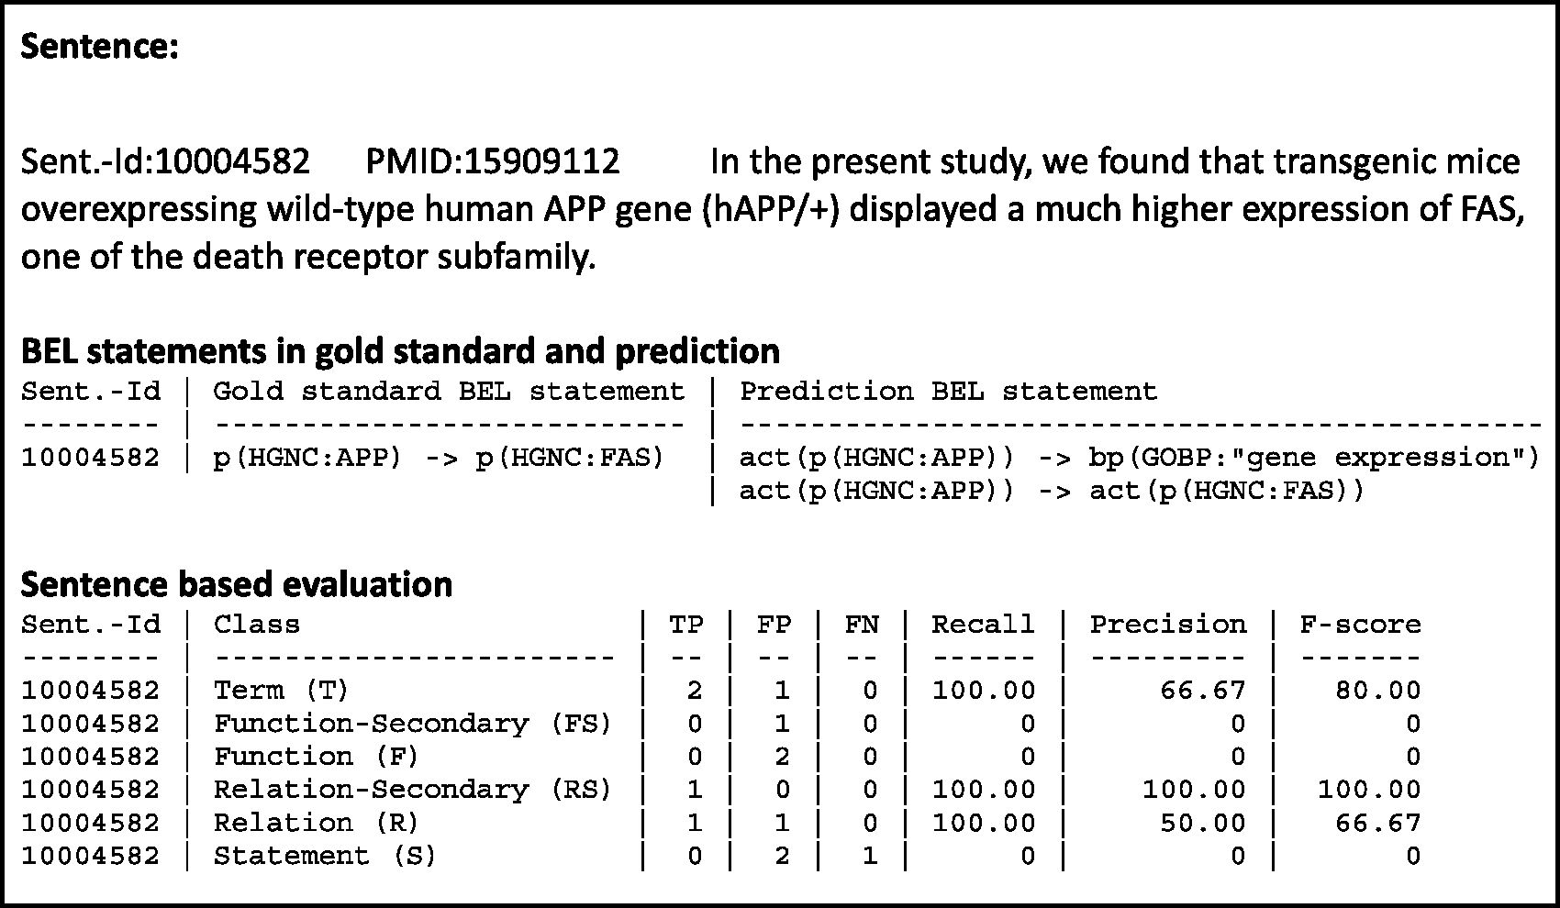
Figure 6 An example result page of a candidate evaluation. The example shows the candidate sentence, with the gold ...
Notes:
Figure 6 An example result page of a candidate evaluation. The example shows the candidate sentence, with the gold standard and the predicted BEL statements. The evaluation scores are shown for all primary and secondary levels.
Unless provided in the caption above, the following copyright applies to the content of this slide: © The Author(s) 2016. Published by Oxford University Press. This is an Open Access article distributed under the terms of the Creative Commons Attribution License ( http://creativecommons.org/licenses/by/4.0/ ), which permits unrestricted reuse, distribution, and reproduction in any medium, provided the original work is properly cited.

