Slide 1
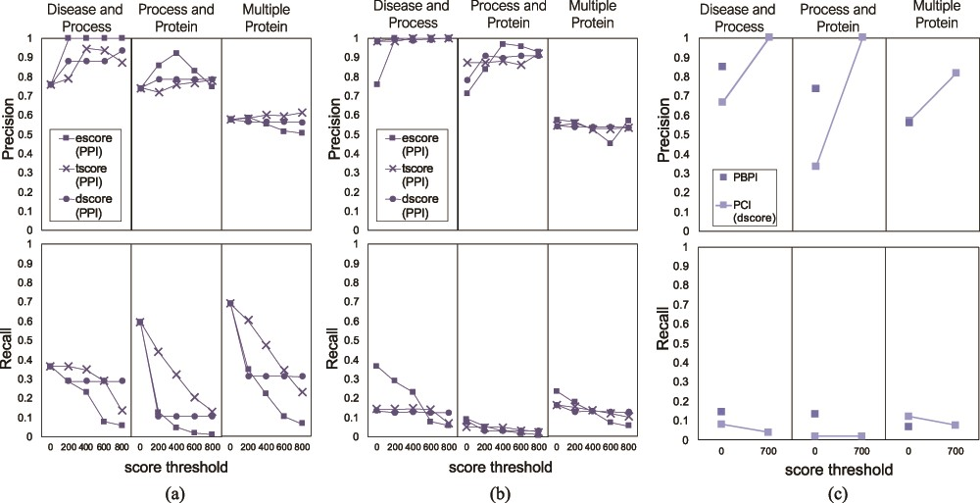
Figure 9 Precision and recall of FLUTE, compared to human judging, and the sensitivity of precision and recall to the ...
Notes:
Figure 9 Precision and recall of FLUTE, compared to human judging, and the sensitivity of precision and recall to the scores, for the three different queries: (a) precision and recall when filtering PPIs with only one subscore at a time, (b) average precision and recall when filtering PPIs for all possible subscore combinations and (c) precision and recall when filtering PBPI and PCIs.
Unless provided in the caption above, the following copyright applies to the content of this slide: © The Author(s) 2020. Published by Oxford University Press.This is an Open Access article distributed under the terms of the Creative Commons Attribution License (http://creativecommons.org/licenses/by/4.0/), which permits unrestricted reuse, distribution, and reproduction in any medium, provided the original work is properly cited.

