Slide 1
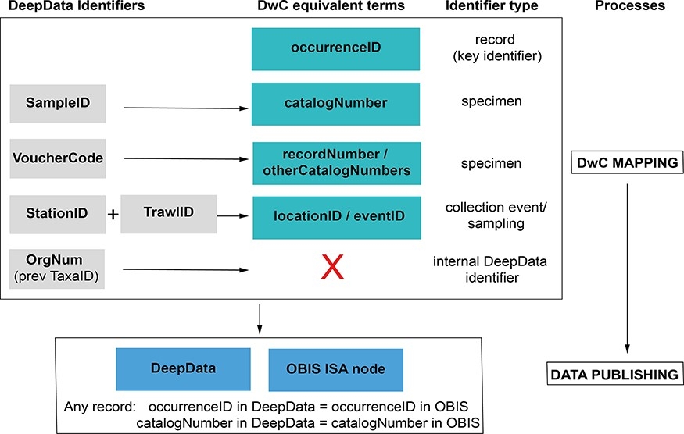
Figure 4. Identifier fields in DeepData, and recommended revision of usage and mapping to equivalent DwC terms. ...
Notes:
Figure 4. Identifier fields in DeepData, and recommended revision of usage and mapping to equivalent DwC terms. Currently, there is no unique record identifier (occurrenceID) in DeepData or a requirement to include one in the current (2022) environmental data template. This key identifier is needed for the data template, database export and within the database itself. SampleID, a specimen identifier, is currently the key identifier in DeepData and used as a proxy record identifier (although it is neither unique nor persistent) and currently mapped to occurrenceID (as recorded in the ISA DwC guidance; File S5B), but catalogNumber is in fact the equivalent DwC term. VoucherCode instead is currently mapped to catalogNumber but would be correctly mapped to recordNumber (or otherCatalogNumber). Many other non-identifier DeepData fields not shown could be better mapped to DwC terms with less ambiguity and more precision, for example ‘Morphotype’ in the template replaced with ‘taxonConceptID’ (see Recommendations: Darwin Core and usage of identifiers).
Unless provided in the caption above, the following copyright applies to the content of this slide: © The Author(s) 2023. Published by Oxford University Press.This is an Open Access article distributed under the terms of the Creative Commons Attribution License (https://creativecommons.org/licenses/by/4.0/), which permits unrestricted reuse, distribution, and reproduction in any medium, provided the original work is properly cited.

