Slide 1
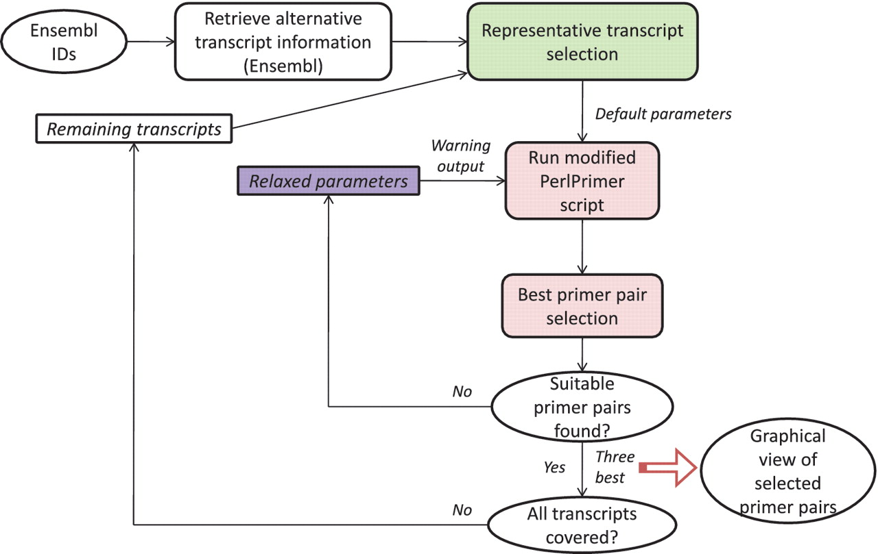
Figure 1. Overall primer design pipeline. The overall workflow is depicted. The green box is explained in Figure 2. The ...
Notes:
Figure 1. Overall primer design pipeline. The overall workflow is depicted. The green box is explained in Figure 2. The pink and purple boxes are explained in more detail in Figures 3 and 4, respectively. For more details, please see main text.
Unless provided in the caption above, the following copyright applies to the content of this slide: © The Author(s) 2011. Published by Oxford University Press.This is Open Access article distributed under the terms of the Creative Commons Attribution Non-Commercial License (http://creativecommons.org/licenses/by-nc/2.5), which permits unrestricted non-commercial use, distribution, and reproduction in any medium, provided the original work is properly cited.

