Slide 1
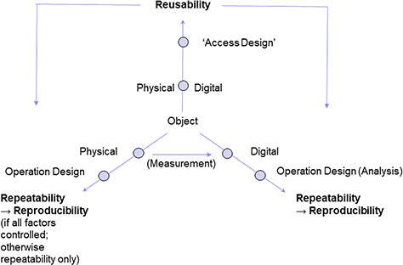
Figure 6 FAIR++: Reusability of physical and digital objects in a research setup is preconditional for the ...
Notes:
Figure 6 FAIR++: Reusability of physical and digital objects in a research setup is preconditional for the repeatability of operation designs on the respective object type. Analysis of digital objects (according to a certain design), entails the reproducibility of the operation results. Reproducibility of operations on physical objects, however, depends on whether or not environmental parameters are fully controlled. If not, a study setup can be repeated, but results may turn out to be different from the initial ones.
Unless provided in the caption above, the following copyright applies to the content of this slide: © The Author(s) 2020. Published by Oxford University Press.This is an Open Access article distributed under the terms of the Creative Commons Attribution License (http://creativecommons.org/licenses/by/4.0/), which permits unrestricted reuse, distribution, and reproduction in any medium, provided the original work is properly cited.

