Slide 1
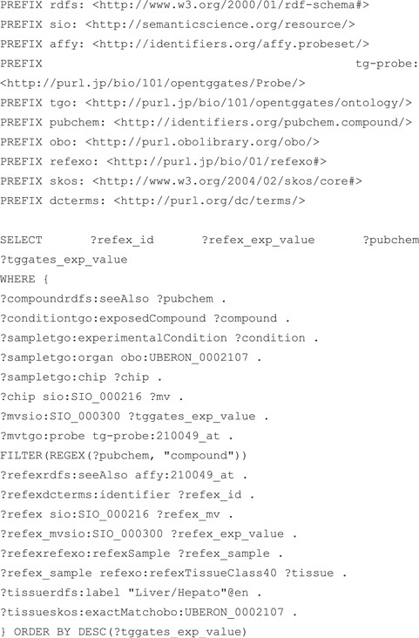
Figure 6 SPARQL query that performs an integrated search of the RefEx and KERO RDFs. Both RefEx and Open TG-GATEs RDF ...
Notes:
Figure 6 SPARQL query that performs an integrated search of the RefEx and KERO RDFs. Both RefEx and Open TG-GATEs RDF include transcriptome data measured using the same GeneChip technology and use the RDF model defined in guideline 11 to describe measured numerical data.
Unless provided in the caption above, the following copyright applies to the content of this slide: © The Author(s) 2018. Published by Oxford University Press. All rights reserved. For Permissions, please email: journals.permissions@oup.comThis article is published and distributed under the terms of the Oxford University Press, Standard Journals Publication Model (https://academic.oup.com/journals/pages/open_access/funder_policies/chorus/standard_publication_model)

