Slide 1
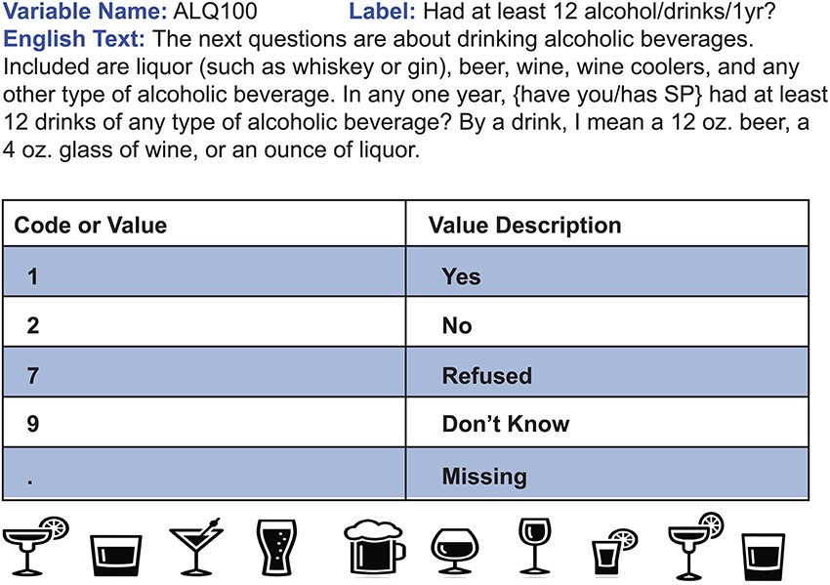
Figure 2. Sample CDE. This question is an example of a CDE from the NHANES 1999–2000 questionnaire. In this instance, ...
Notes:
Figure 2. Sample CDE. This question is an example of a CDE from the NHANES 1999–2000 questionnaire. In this instance, survey participants were inquired about alcohol consumption throughout the year and their responses were standardized using the corresponding code/value pair. Usage of this CDE in a separate survey, such as a future year of NHANES, will allow data from both surveys to be directly comparable.
Unless provided in the caption above, the following copyright applies to the content of this slide: © The Author(s) 2021. Published by Oxford University Press.This is an Open Access article distributed under the terms of the Creative Commons Attribution License (http://creativecommons.org/licenses/by/4.0/), which permits unrestricted reuse, distribution, and reproduction in any medium, provided the original work is properly cited.

