Slide 1
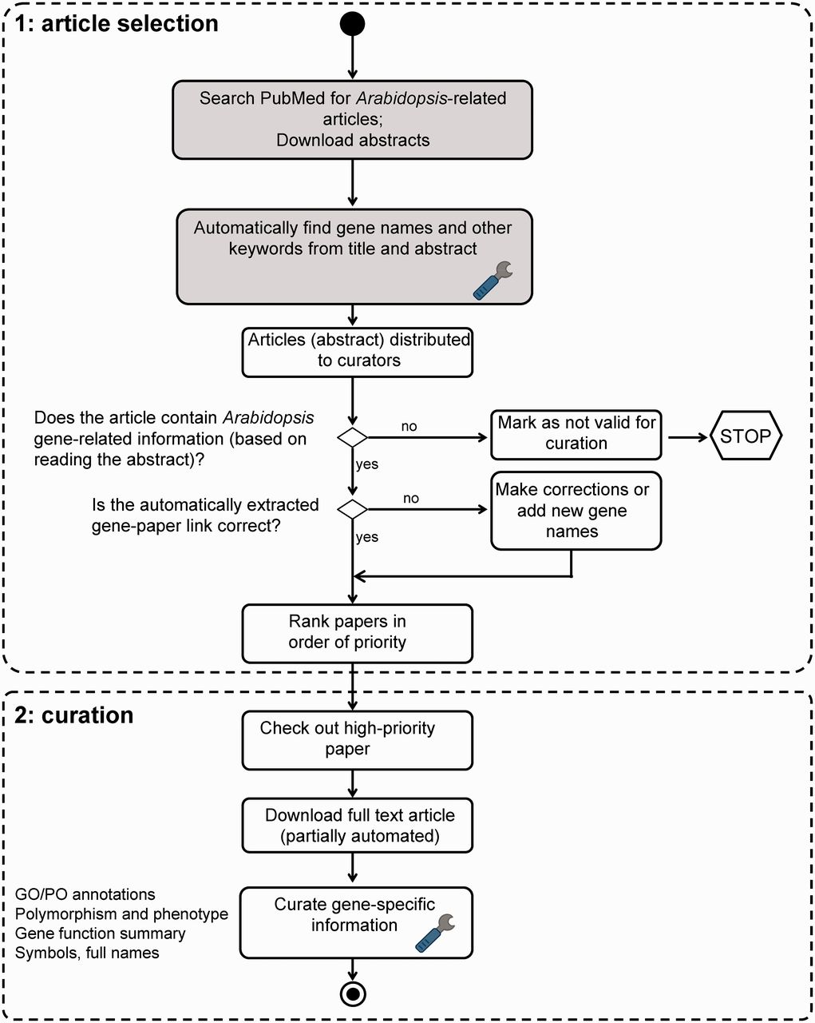
Figure 1 TAIR literature curation workflow. The curation process consists of both automated (shaded boxes) and manual ...
Notes:
Figure 1 TAIR literature curation workflow. The curation process consists of both automated (shaded boxes) and manual steps. Full text PDF download is partially automated. PubSearch automatically downloads PDFs from selected journals, other articles not retrieved by PubSearch are manually downloaded by curators. Potentially curatable papers are identified by searching PubMed for ‘Arabidopsis’. Gene names are automatically identified from abstracts, then manually verified by curators. Articles that contain Arabidopsis gene-related information are flagged by curators for manual curation. Paper ranking is based on a combination of journal impact factor and manual prioritization. Papers describing previously uncharacterized genes are given the highest priority. Curators then proceed to extract comprehensive gene-specific information from high-priority papers. Steps that involve text mining are indicated by the wrench icon.
Unless provided in the caption above, the following copyright applies to the content of this slide: © The Author(s) 2012. Published by Oxford University Press.This is an Open Access article distributed under the terms of the Creative Commons Attribution License (http://creativecommons.org/licenses/by-nc/3.0/), which permits non-commercial reuse, distribution, and reproduction in any medium, provided the original work is properly cited. For commercial re-use, please contact journals.permissions@oup.com.

