Slide 1
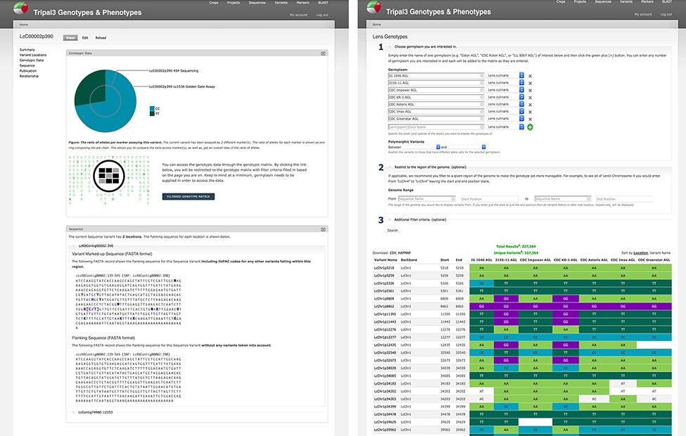
Figure 5. Genotypic data visualization on a generic Tripal site. The left panel shows the distribution of alleles for ...
Notes:
Figure 5. Genotypic data visualization on a generic Tripal site. The left panel shows the distribution of alleles for the current variant as a pie chart (top), a link to the genotype matrix (middle) and the flanking sequence for the variant with known additional variants indicated by their IUPAC codes (bottom). The right panel shows the genotype matrix tool with the allele consensus for seven user-selected germplasm displayed in a variant by germplasm accession table. This table can be further filtered by pairwise polymorphism, genomic region as well as additional filter criteria.
Unless provided in the caption above, the following copyright applies to the content of this slide: © The Author(s) 2021. Published by Oxford University Press.This is an Open Access article distributed under the terms of the Creative Commons Attribution License (http://creativecommons.org/licenses/by/4.0/), which permits unrestricted reuse, distribution, and reproduction in any medium, provided the original work is properly cited.

