Slide 1
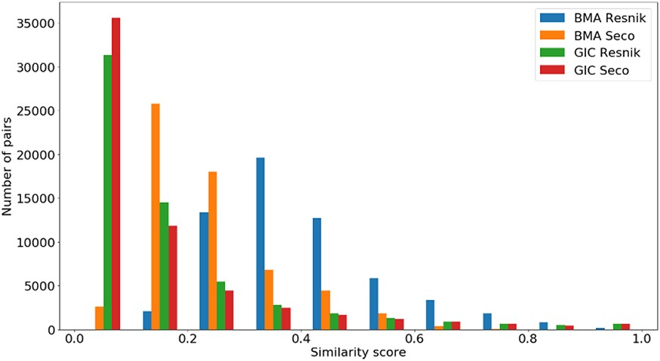
Figure 6. Distribution of all semantic similarity metrics ($BM{A_{Resnik}}$, $BM{A_{Seco}}$, $simGI{C_{Resnik}}$ and ...
Notes:
Figure 6. Distribution of all semantic similarity metrics ($BM{A_{Resnik}}$, $BM{A_{Seco}}$, $simGI{C_{Resnik}}$ and $simGI{C_{Seco}}$) values across all species’ protein pairs in the protein–protein interaction data sets.
Unless provided in the caption above, the following copyright applies to the content of this slide: © The Author(s) 2020. Published by Oxford University Press.This is an Open Access article distributed under the terms of the Creative Commons Attribution License (http://creativecommons.org/licenses/by/4.0/), which permits unrestricted reuse, distribution, and reproduction in any medium, provided the original work is properly cited.

