Slide 1
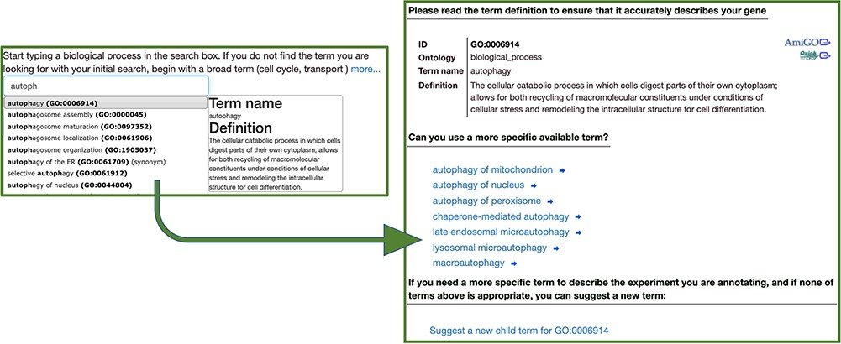
Figure 1 The Canto annotation tool. A user-friendly step-by-step annotation workflow guides new users through finding ...
Notes:
Figure 1 The Canto annotation tool. A user-friendly step-by-step annotation workflow guides new users through finding ontology terms and completing annotations.
Unless provided in the caption above, the following copyright applies to the content of this slide: © The Author(s) 2020. Published by Oxford University Press.This is an Open Access article distributed under the terms of the Creative Commons Attribution License (http://creativecommons.org/licenses/by/4.0/), which permits unrestricted reuse, distribution, and reproduction in any medium, provided the original work is properly cited.

Slide 2
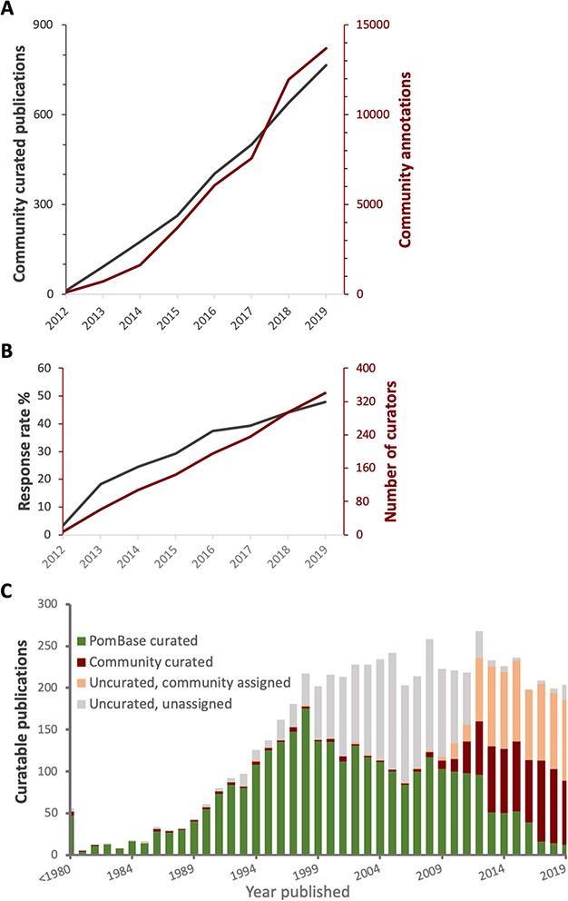
Figure 2 Curation statistics. A. Cumulative numbers of publications curated (grey) and annotations added (red) bythe ...
Notes:
Figure 2 Curation statistics. A. Cumulative numbers of publications curated (grey) and annotations added (red) bythe community over time. B. Cumulative number of new participants (red) and invitation response rate (grey) over time. C. The proportion of curatable fission yeast literature curated by PomBase staff and community, or as yet uncurated, by year published. Uncurated publications are subdivided into ‘uncurated community’ (invitation sent, no response) and ‘uncurated unassigned’ (no invitation sent—we do not send invitations for publications predating 2012).
Unless provided in the caption above, the following copyright applies to the content of this slide: © The Author(s) 2020. Published by Oxford University Press.This is an Open Access article distributed under the terms of the Creative Commons Attribution License (http://creativecommons.org/licenses/by/4.0/), which permits unrestricted reuse, distribution, and reproduction in any medium, provided the original work is properly cited.

Slide 3
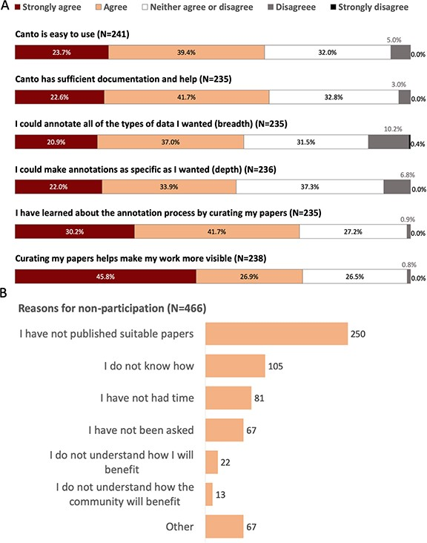
Figure 3 Community perception of Canto curation from 2019 PomBase user survey. A. Responses to questions evaluating ...
Notes:
Figure 3 Community perception of Canto curation from 2019 PomBase user survey. A. Responses to questions evaluating Canto usability. Note: 30% of respondents (189/632) reported having used Canto. B. Reasons given for not participating in community curation. Free text responses from respondents selecting ‘other’ indicate that many intend to participate in the future, or found that their papers had already been curated by other lab members.
Unless provided in the caption above, the following copyright applies to the content of this slide: © The Author(s) 2020. Published by Oxford University Press.This is an Open Access article distributed under the terms of the Creative Commons Attribution License (http://creativecommons.org/licenses/by/4.0/), which permits unrestricted reuse, distribution, and reproduction in any medium, provided the original work is properly cited.

Slide 4
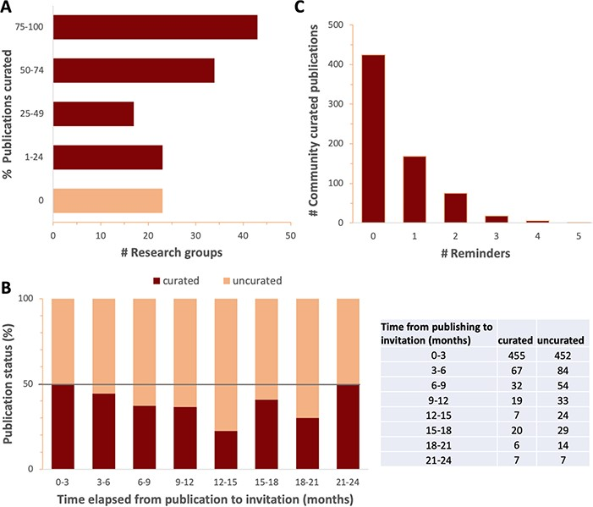
Figure 4 Response to curation invitations. A. Percent of publications curated per research group for all groups that ...
Notes:
Figure 4 Response to curation invitations. A. Percent of publications curated per research group for all groups that have received four or more curation invitations. Research groups with fewer than 4 relevant publications were omitted to focus on research groups dedicated to fission yeast. B. Percent (graph) and number (table) of curated and uncurated publications as a function of the time elapsed between PubMed indexing and the date that the first invitation to curate was sent, in 3-month intervals. The increase in response rate seen in later time intervals could either reflect the increased number of reminders received, or simply be an artefact of the smaller sample sizes. C. The number of community curated publications versus the number of reminders.
Unless provided in the caption above, the following copyright applies to the content of this slide: © The Author(s) 2020. Published by Oxford University Press.This is an Open Access article distributed under the terms of the Creative Commons Attribution License (http://creativecommons.org/licenses/by/4.0/), which permits unrestricted reuse, distribution, and reproduction in any medium, provided the original work is properly cited.

