Slide 1
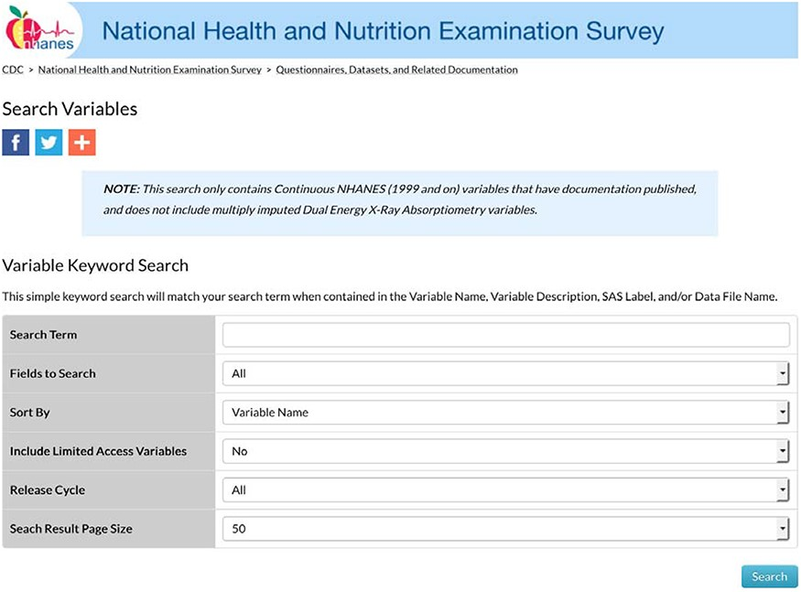
Figure 1. NHANES variable search landing page.
Notes:
Figure 1. NHANES variable search landing page.
Unless provided in the caption above, the following copyright applies to the content of this slide: © The Author(s) 2020. Published by Oxford University Press.This is an Open Access article distributed under the terms of the Creative Commons Attribution License (http://creativecommons.org/licenses/by/4.0/), which permits unrestricted reuse, distribution, and reproduction in any medium, provided the original work is properly cited.

Slide 2
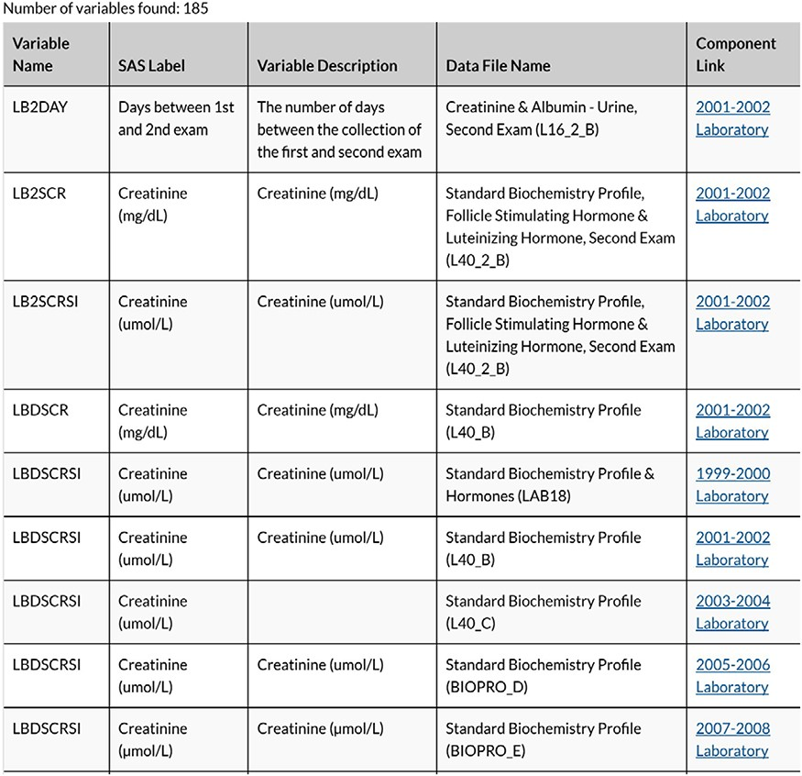
Figure 2. Snapshot of variable search results for creatinine.
Notes:
Figure 2. Snapshot of variable search results for creatinine.
Unless provided in the caption above, the following copyright applies to the content of this slide: © The Author(s) 2020. Published by Oxford University Press.This is an Open Access article distributed under the terms of the Creative Commons Attribution License (http://creativecommons.org/licenses/by/4.0/), which permits unrestricted reuse, distribution, and reproduction in any medium, provided the original work is properly cited.

Slide 3
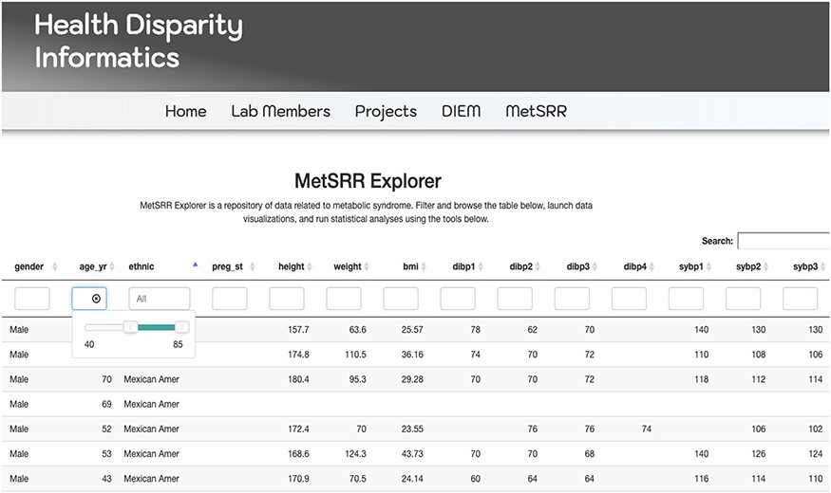
Figure 3. Image only reflects a fraction of the MetSRR Explorer. Observations too numerous to capture in a single ...
Notes:
Figure 3. Image only reflects a fraction of the MetSRR Explorer. Observations too numerous to capture in a single image.
Unless provided in the caption above, the following copyright applies to the content of this slide: © The Author(s) 2020. Published by Oxford University Press.This is an Open Access article distributed under the terms of the Creative Commons Attribution License (http://creativecommons.org/licenses/by/4.0/), which permits unrestricted reuse, distribution, and reproduction in any medium, provided the original work is properly cited.

Slide 4
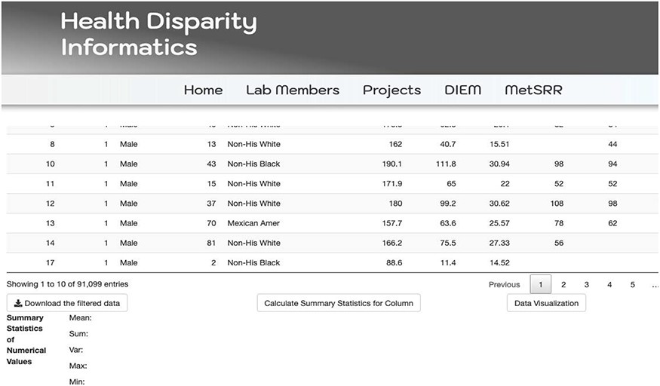
Figure 4. Illustration of MetSRR Explorer features including download capability.
Notes:
Figure 4. Illustration of MetSRR Explorer features including download capability.
Unless provided in the caption above, the following copyright applies to the content of this slide: © The Author(s) 2020. Published by Oxford University Press.This is an Open Access article distributed under the terms of the Creative Commons Attribution License (http://creativecommons.org/licenses/by/4.0/), which permits unrestricted reuse, distribution, and reproduction in any medium, provided the original work is properly cited.

Slide 5
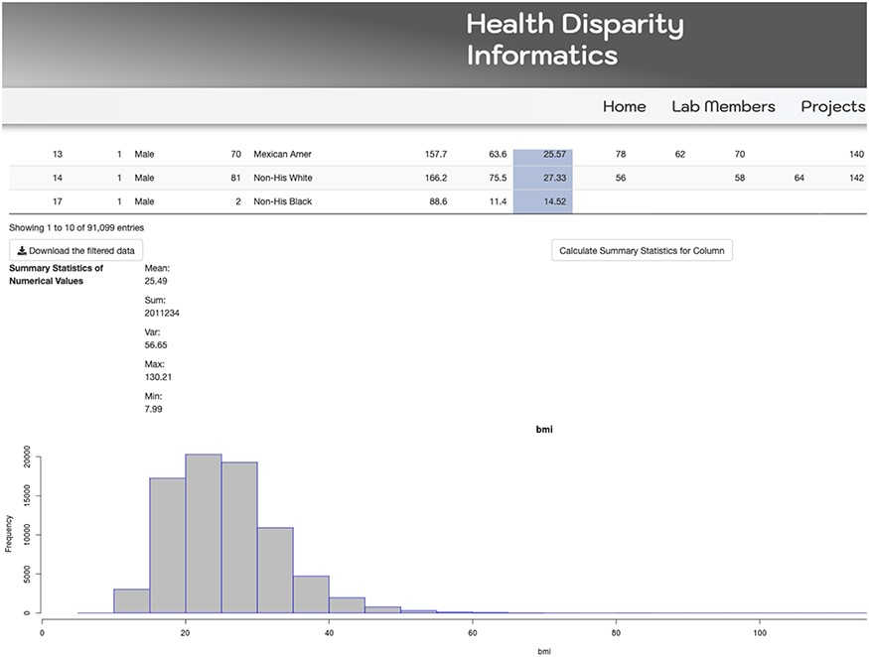
Figure 5. MetSRR visualization of the distribution of the BMI variable.
Notes:
Figure 5. MetSRR visualization of the distribution of the BMI variable.
Unless provided in the caption above, the following copyright applies to the content of this slide: © The Author(s) 2020. Published by Oxford University Press.This is an Open Access article distributed under the terms of the Creative Commons Attribution License (http://creativecommons.org/licenses/by/4.0/), which permits unrestricted reuse, distribution, and reproduction in any medium, provided the original work is properly cited.

Slide 6
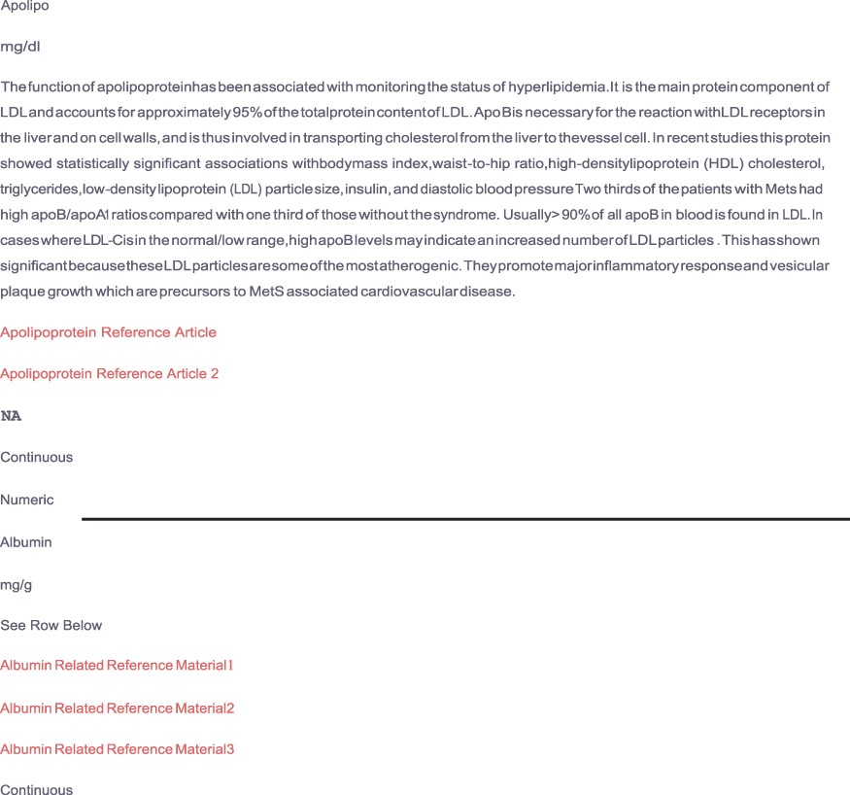
Figure 6. Depicts supplemental material provided by the MetSRR database. The live links allow users to access journal ...
Notes:
Figure 6. Depicts supplemental material provided by the MetSRR database. The live links allow users to access journal articles supporting the inclusion of selected variables.
Unless provided in the caption above, the following copyright applies to the content of this slide: © The Author(s) 2020. Published by Oxford University Press.This is an Open Access article distributed under the terms of the Creative Commons Attribution License (http://creativecommons.org/licenses/by/4.0/), which permits unrestricted reuse, distribution, and reproduction in any medium, provided the original work is properly cited.

