Slide 1
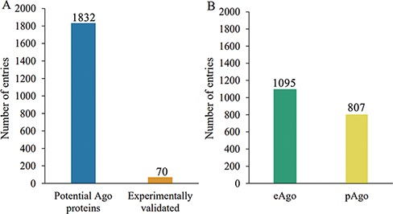
Figure 2. Schematic of Ago protein entries at various categories in the AGODB database. (A) Number of potential and ...
Notes:
Figure 2. Schematic of Ago protein entries at various categories in the AGODB database. (A) Number of potential and experimentally validated Ago proteins. (B) Number of eAgo and pAgo proteins.
Unless provided in the caption above, the following copyright applies to the content of this slide: © The Author(s) 2022. Published by Oxford University Press.This is an Open Access article distributed under the terms of the Creative Commons Attribution-NonCommercial License (https://creativecommons.org/licenses/by-nc/4.0/), which permits non-commercial re-use, distribution, and reproduction in any medium, provided the original work is properly cited. For commercial re-use, please contact journals.permissions@oup.com

