Slide 1
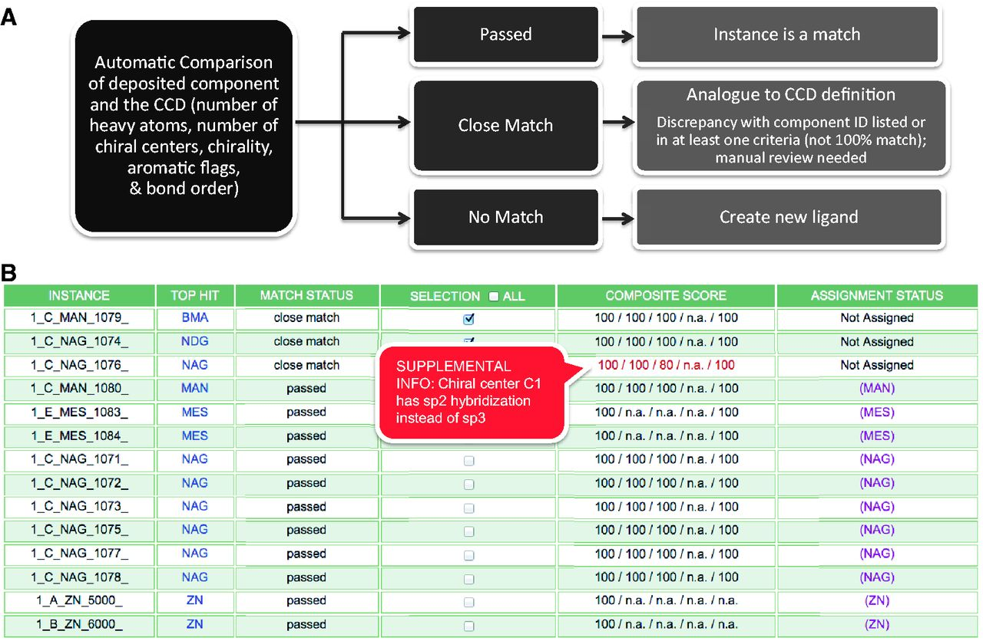
Figure 2. Batch Search Results Report for an entry that contains multiple chemical components (Step 2.1 of Figure 1). ...
Notes:
Figure 2. Batch Search Results Report for an entry that contains multiple chemical components (Step 2.1 of Figure 1). (A) The CCA Tool identifies and compares deposited ligands with the CCD in a batch mode, and reports the status (passed, close match or no match) of the comparison, which results in corresponding annotator action. (B) An example search results report that provides immediate information to the annotator about each chemical component instance found in the entry, and the closest match found in the CCD, as named in the ‘Top Hit’ column. In this example, the deposited entry has 14 chemical components, including two instances of alpha-d-mannose (MAN), eight instances of N-acetyl-beta-d-glucosamine (NAG), two instances of 2-(N-morpholino)-ethanesulfonic acid (MES) and two instances of zinc ions (ZN) as listed in the first column. The second column displays closest component matches found in the CCD. The report shown indicates that only the first three instances require further inspection, as the other instances in the deposited entry have corresponding definitions in the CCD. Matches that are similar but not identical can be initially evaluated with the use of the Composite Score column that represents the comparison of the instance with its Top Hit match in five categories: number of heavy atoms, number of chiral centers (independent of handedness), handedness of the chiral centers, number of aromatic atoms and bond order. In each category, each atom in the instance is compared against the Top Hit match in a binary way (match or no match). Then the number of matching atoms is divided by the number of total possible matches (i.e. the number of eligible atoms in the category) and is expressed as a percentage. Mousing over the Composite Score displays additional information in a pop-up window. In this example, the Composite Score does not reveal any chemical differences for the first two instances listed, which means that the only difference between the deposited instance and the top hit match is the CCD ID used. The annotator will then update the CCD ID used in the deposited entry. The third instance listed, 1_C_NAG_1076, has a score of 80% for the chiral center comparison, as one of the five chiral centers in NAG (chiral center C1) has sp2 hybridization rather than sp3 in the experimental coordinates.
Unless provided in the caption above, the following copyright applies to the content of this slide: © The Author(s) 2013. Published by Oxford University Press.This is an Open Access article distributed under the terms of the Creative Commons Attribution License (http://creativecommons.org/licenses/by/3.0/), which permits unrestricted reuse, distribution, and reproduction in any medium, provided the original work is properly cited.

