Slide 1
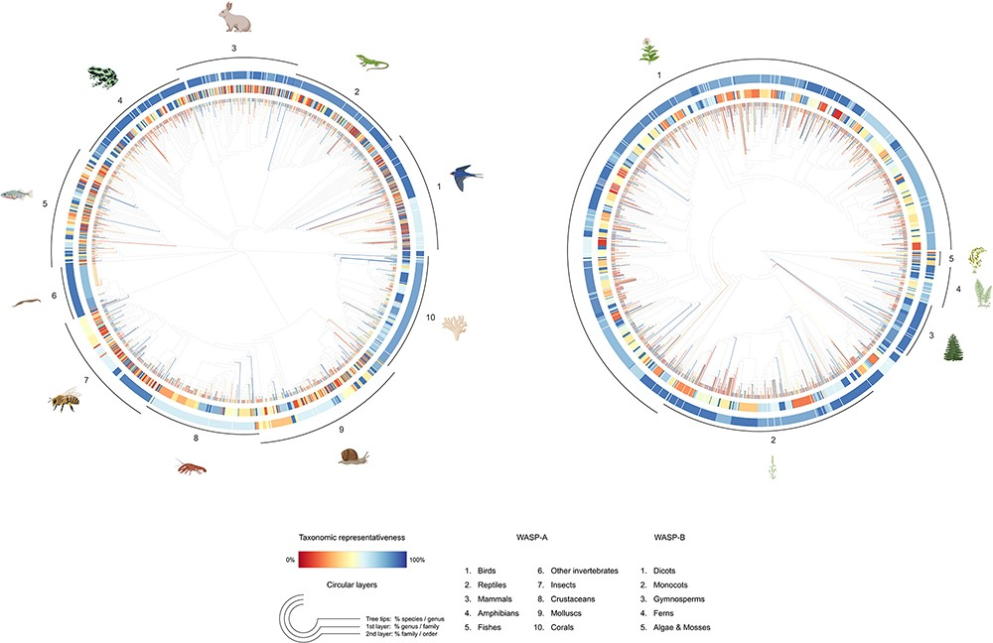
Figure 7. Tree-like structure illustrating the taxonomic representativeness of the WASP-A (left) and WASP-B (right) ...
Notes:
Figure 7. Tree-like structure illustrating the taxonomic representativeness of the WASP-A (left) and WASP-B (right) species samples. Color scale explains the taxonomic representativeness (in percentage covered) compared to the IUCN Red List species. Colored tree tips show the percentage of species covered in our species sample, by genus; the first (inner) and second (outer) circular layers represent the genus-coverage by family and family-coverage by order, respectively. The synthetic tree–like structure was generated from the Open Tree of Life, using the R package ‘rotl’.
Unless provided in the caption above, the following copyright applies to the content of this slide: © The Author(s) 2023. Published by Oxford University Press.This is an Open Access article distributed under the terms of the Creative Commons Attribution License (https://creativecommons.org/licenses/by/4.0/), which permits unrestricted reuse, distribution, and reproduction in any medium, provided the original work is properly cited.

