Slide 1
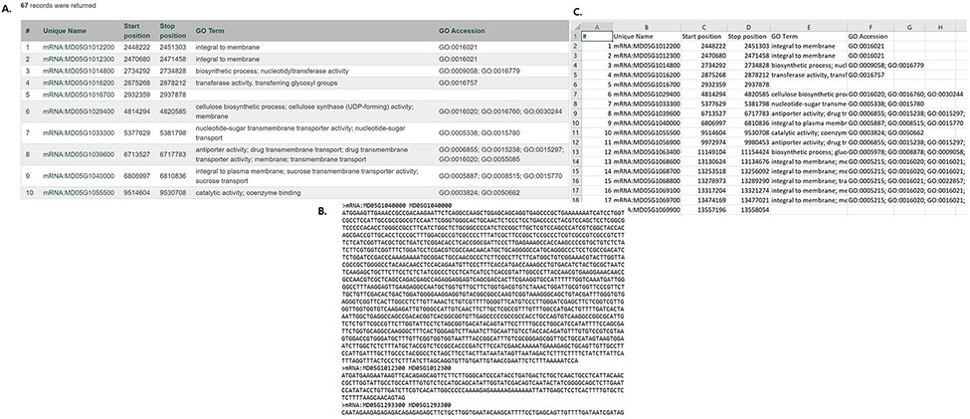
Figure 2. Examples of result table and downloaded files from MegaSearch (A). A result table with the chosen data fields ...
Notes:
Figure 2. Examples of result table and downloaded files from MegaSearch (A). A result table with the chosen data fields is displayed with hyperlinks to appropriate pages such as JBrowse and gene/transcript page (B). A downloaded FASTA file for the data types with sequences, such as gene/transcript and marker (C). A CSV file that with the chosen data fields.
Unless provided in the caption above, the following copyright applies to the content of this slide: © The Author(s) 2021. Published by Oxford University Press.This is an Open Access article distributed under the terms of the Creative Commons Attribution License (http://creativecommons.org/licenses/by/4.0/), which permits unrestricted reuse, distribution, and reproduction in any medium, provided the original work is properly cited.

