Slide 1
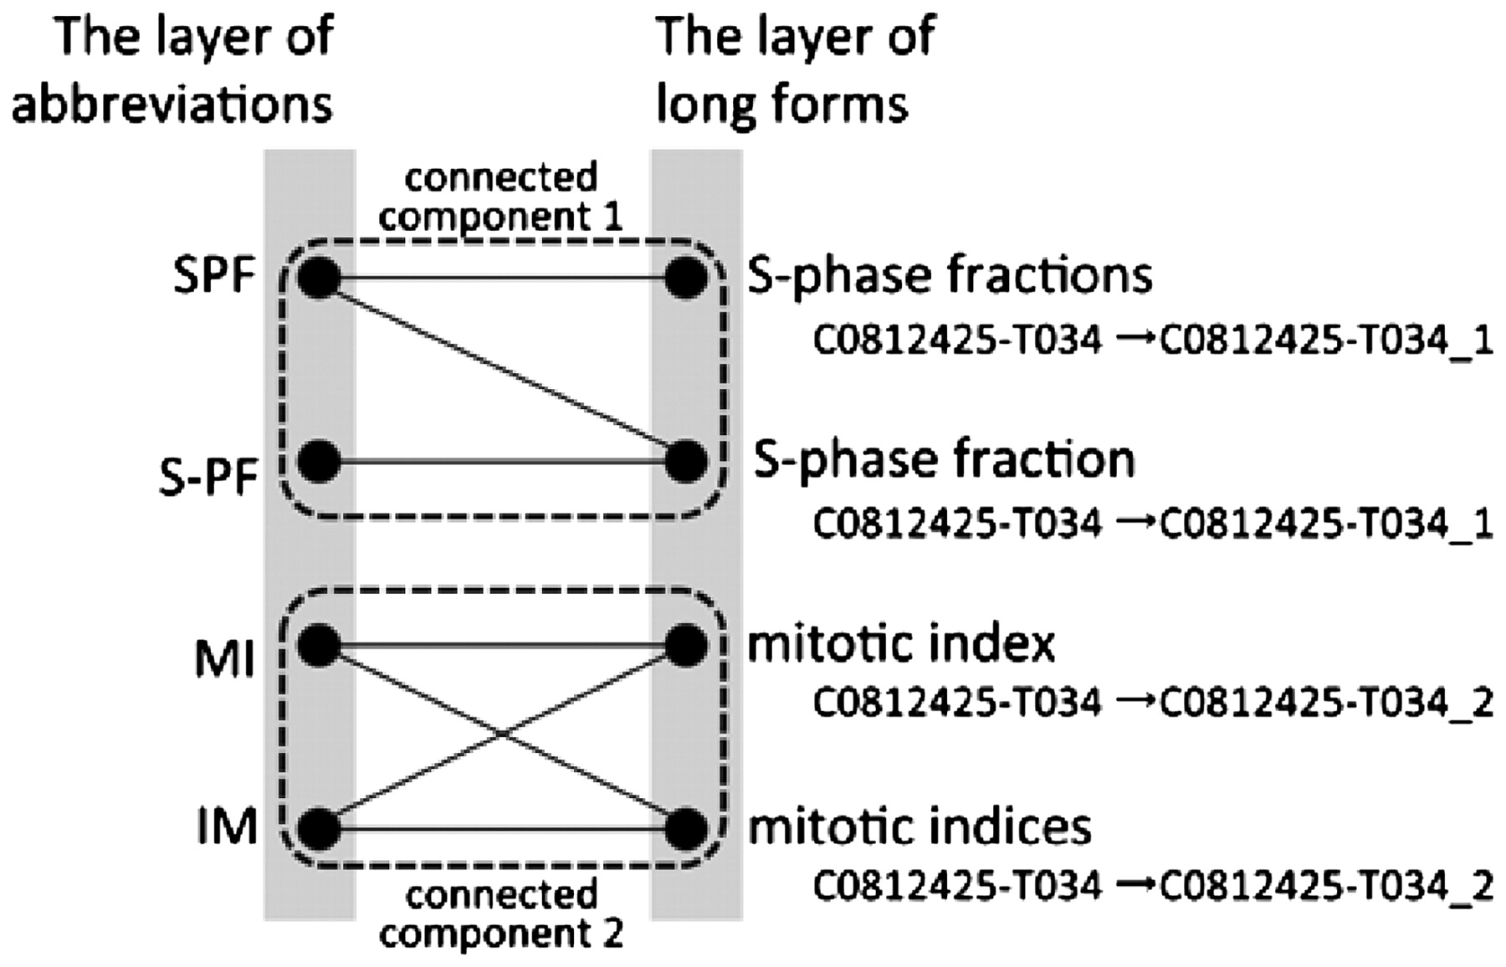
Figure 1. A part of a bipartite graph used in Allie. GENA gives the concept ID ‘C0812425-T034’ to ‘S-phase fractions’, ...
Notes:
Figure 1. A part of a bipartite graph used in Allie. GENA gives the concept ID ‘C0812425-T034’ to ‘S-phase fractions’, ‘S-phase fraction’, ‘mitotic index’ and ‘mitotic indices’. Allie changes the ID to one that corresponds to each cluster using connected components of the graph.
Unless provided in the caption above, the following copyright applies to the content of this slide: © The Author(s) 2011. Published by Oxford University Press.This is Open Access article distributed under the terms of the Creative Commons Attribution Non-Commercial License (http://creativecommons.org/licenses/by-nc/2.5), which permits unrestricted non-commercial use, distribution, and reproduction in any medium, provided the original work is properly cited.

