Slide 1
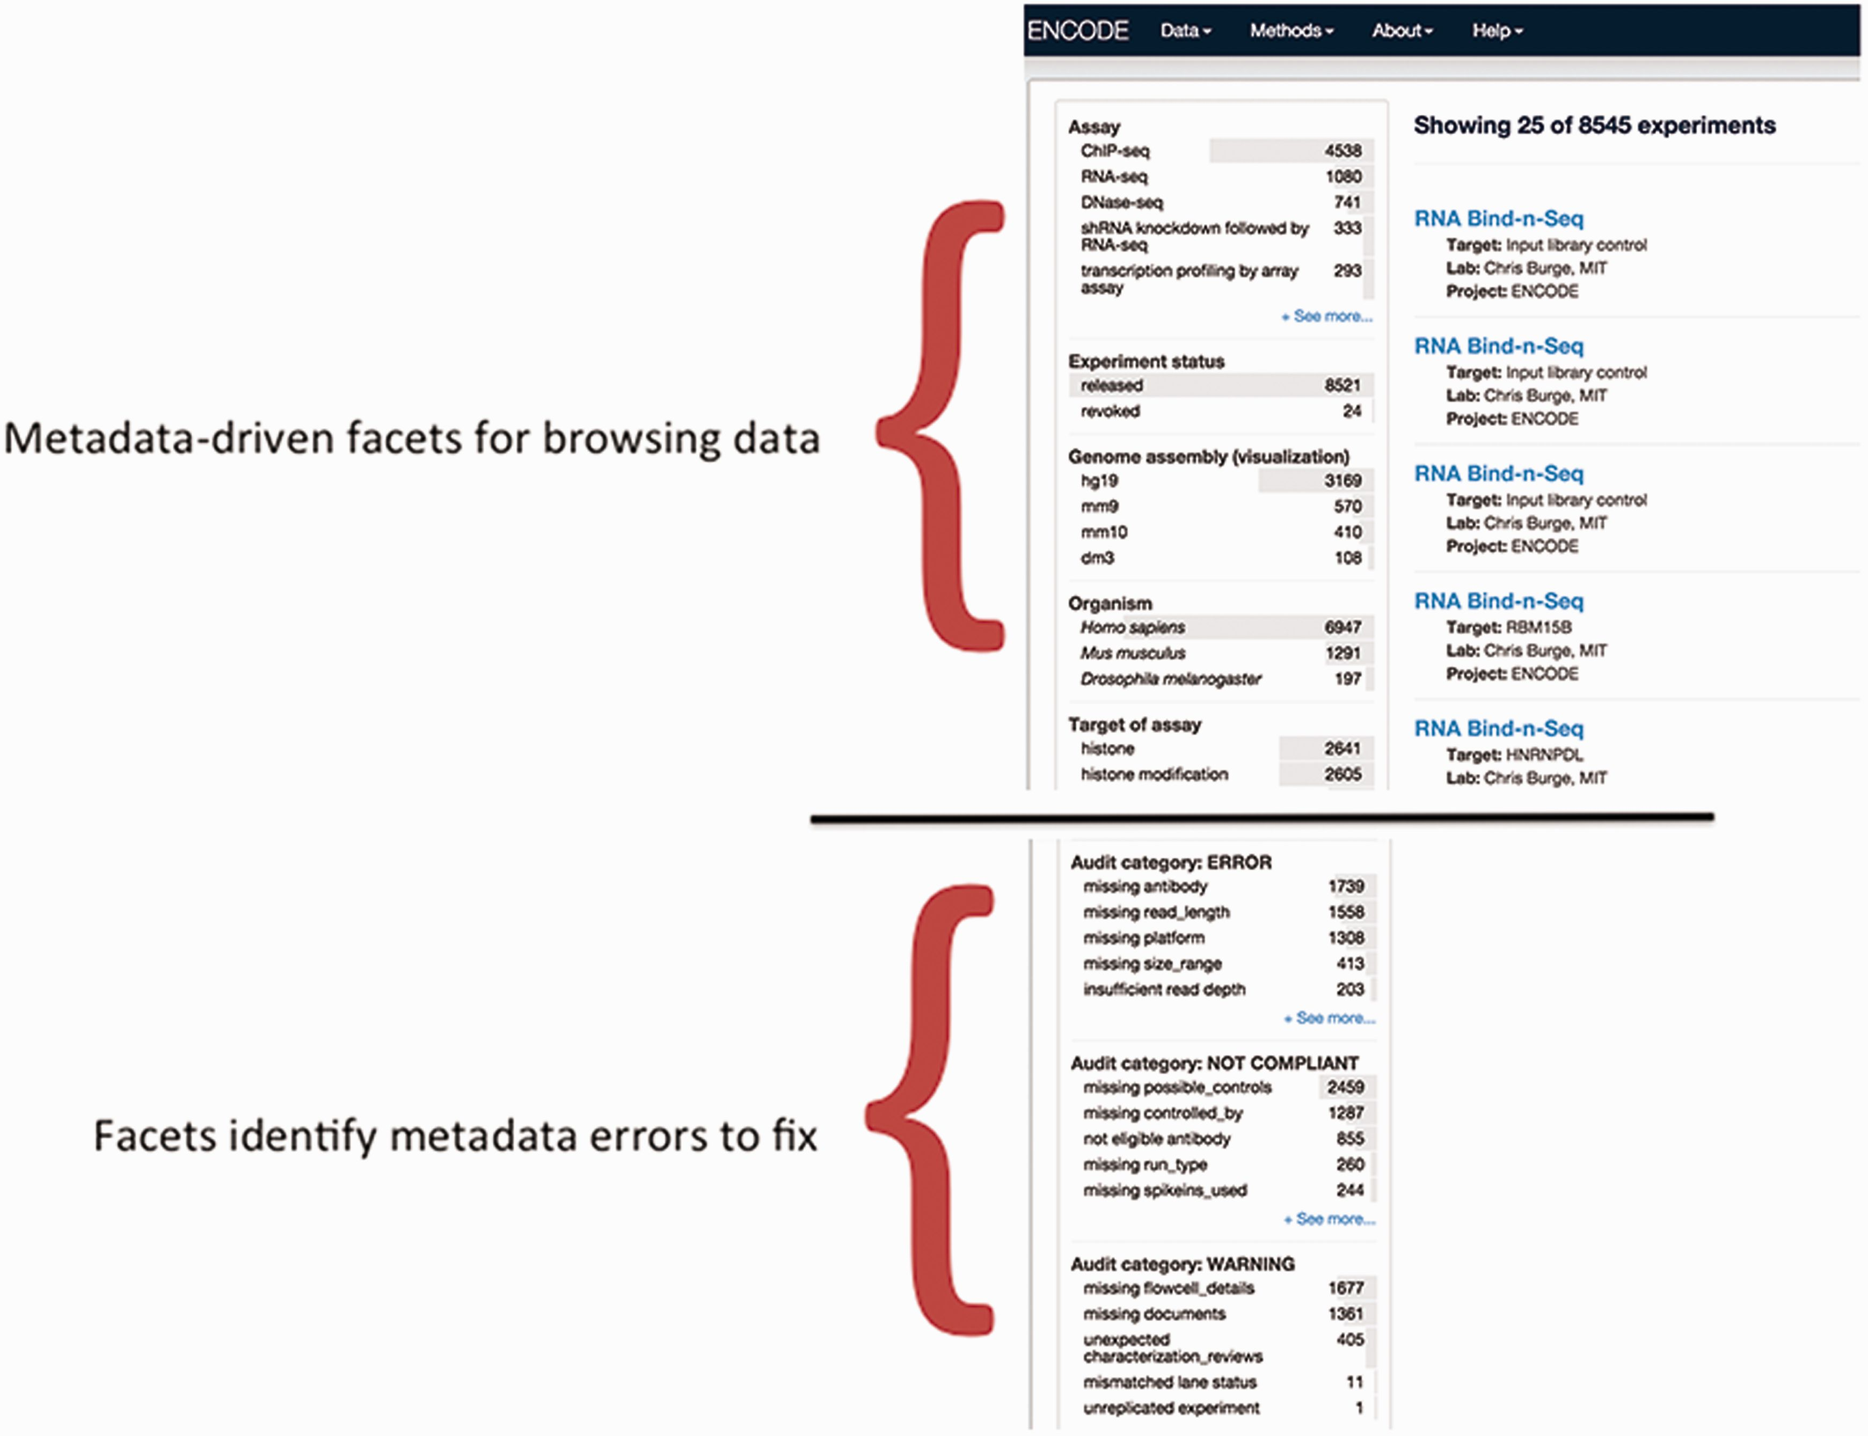
Figure 7 Validation of metadata using audits. The top half of the panel is a screenshot of the metadata-drive facets ...
Notes:
Figure 7 Validation of metadata using audits. The top half of the panel is a screenshot of the metadata-drive facets that can be used for browsing data. The bottom panel is a screenshot of a data audit that is visible to data submitters and the DCC. It includes a list of queries that are performed for inconsistent or incorrect metadata. These audits ensure that the metadata are accurate before data release.
Unless provided in the caption above, the following copyright applies to the content of this slide: © The Author(s) 2016. Published by Oxford University Press. This is an Open Access article distributed under the terms of the Creative Commons Attribution License ( http://creativecommons.org/licenses/by/4.0/ ), which permits unrestricted reuse, distribution, and reproduction in any medium, provided the original work is properly cited.

