Slide 1
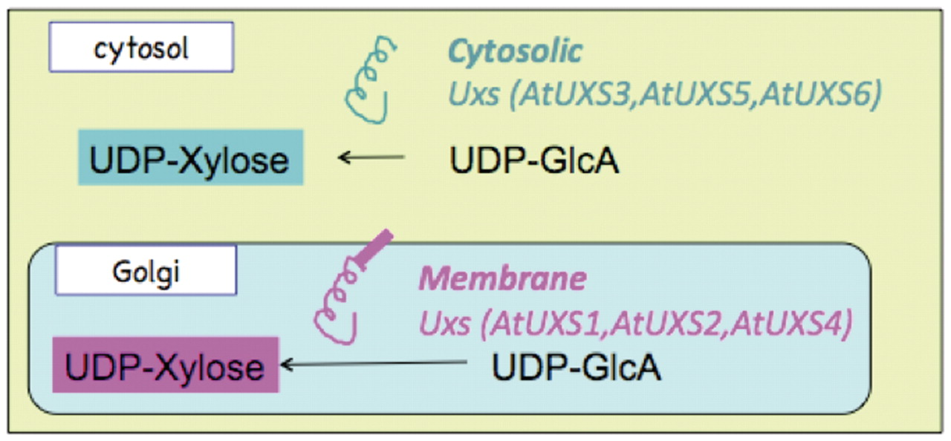
Figure 1. Schematic representation of the sub-cellular localization and catalytic domain orientation of cytosolic and ...
Notes:
Figure 1. Schematic representation of the sub-cellular localization and catalytic domain orientation of cytosolic and Golgi Arabidopsis UDP-xylose synthase enzyme isoforms.
Unless provided in the caption above, the following copyright applies to the content of this slide: © The Author(s) 2012. Published by Oxford University Press.This is an Open Access article distributed under the terms of the Creative Commons Attribution Non-Commercial License (http://creativecommons.org/licenses/by-nc/3.0), which permits unrestricted non-commercial use, distribution, and reproduction in any medium, provided the original work is properly cited.

Slide 2
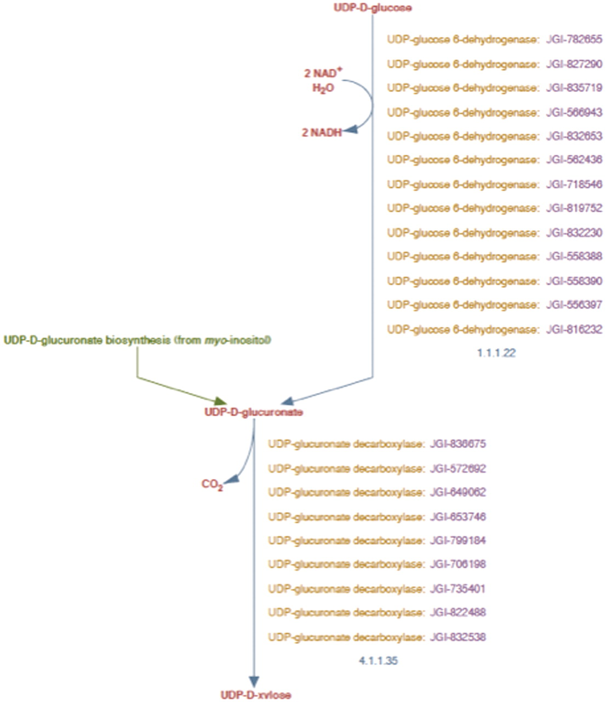
Figure 2. UDP-d-xylose biosynthesis pathway representation in PoplarCyc 1.0. Note that the pathway does not distinguish ...
Notes:
Figure 2. UDP-d-xylose biosynthesis pathway representation in PoplarCyc 1.0. Note that the pathway does not distinguish cytosolic reaction with EC # 4.1.1.35 from the corresponding reaction catalyzed by membrane-bound and Golgi-localized enzymes.
Unless provided in the caption above, the following copyright applies to the content of this slide: © The Author(s) 2012. Published by Oxford University Press.This is an Open Access article distributed under the terms of the Creative Commons Attribution Non-Commercial License (http://creativecommons.org/licenses/by-nc/3.0), which permits unrestricted non-commercial use, distribution, and reproduction in any medium, provided the original work is properly cited.

Slide 3
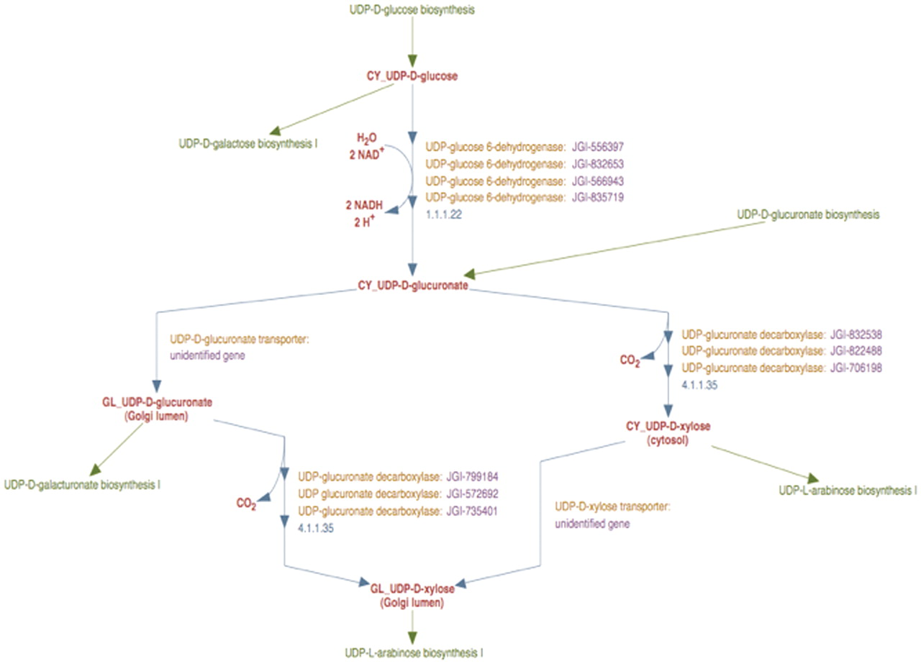
Figure 3. The enhanced representation of UDP-d-xylose biosynthesis pathway in prototype P. trichocarpa PGDB. In this ...
Notes:
Figure 3. The enhanced representation of UDP-d-xylose biosynthesis pathway in prototype P. trichocarpa PGDB. In this representation the sub-cellular localization of each metabolite in the pathway is specified by a two-letter prefix (Table 3). Note that Figure 2 shows 12 genes annotated as UDP-glucose dehydrogenases and 9 genes annotated as UDP-glucuronate decarboxylase. Manual curation yields only four UDP-glucose dehydrogenase enzymes and six UDP-glucuronate decarboxylase enzymes in Populus. Also note that genes encoding Golgi-localized membrane-bound UDP-glucuronic acid decarboxylase (UXS) can now be distinguished from the same enzyme activity residing in the cytosol.
Unless provided in the caption above, the following copyright applies to the content of this slide: © The Author(s) 2012. Published by Oxford University Press.This is an Open Access article distributed under the terms of the Creative Commons Attribution Non-Commercial License (http://creativecommons.org/licenses/by-nc/3.0), which permits unrestricted non-commercial use, distribution, and reproduction in any medium, provided the original work is properly cited.

Slide 4
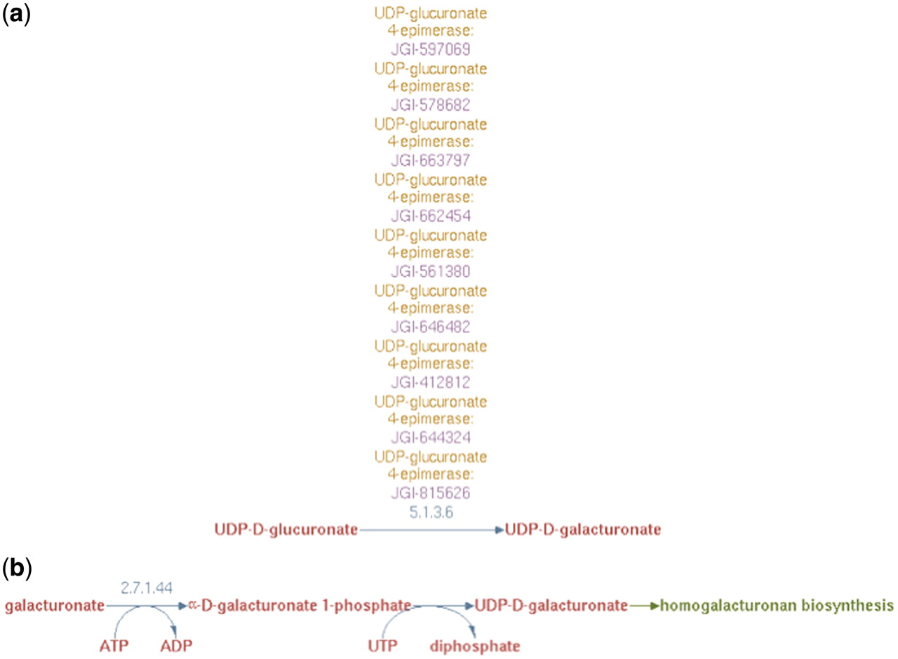
Figure 4. (a) UDP-d-galacturonate biosynthesis I (from UDP-d-glucuronate) pathway representation in PoplarCyc 1.0. Note ...
Notes:
Figure 4. (a) UDP-d-galacturonate biosynthesis I (from UDP-d-glucuronate) pathway representation in PoplarCyc 1.0. Note that no information is available to evaluate the source of UDP-glucuronate and how it becomes available to the UDP-glucuronate 4-epimerase (b) UDP-d-galacturonate biosynthesis II (from d-galacturonate) pathway representation in AraCyc 6.0.1 Note a pathway with a missing EC number for the conversion of galacturonate-1-P to UDP-galacturonate. For both parts (a) and (b), no information is available where these cellular processes occur in the cell.
Unless provided in the caption above, the following copyright applies to the content of this slide: © The Author(s) 2012. Published by Oxford University Press.This is an Open Access article distributed under the terms of the Creative Commons Attribution Non-Commercial License (http://creativecommons.org/licenses/by-nc/3.0), which permits unrestricted non-commercial use, distribution, and reproduction in any medium, provided the original work is properly cited.

Slide 5
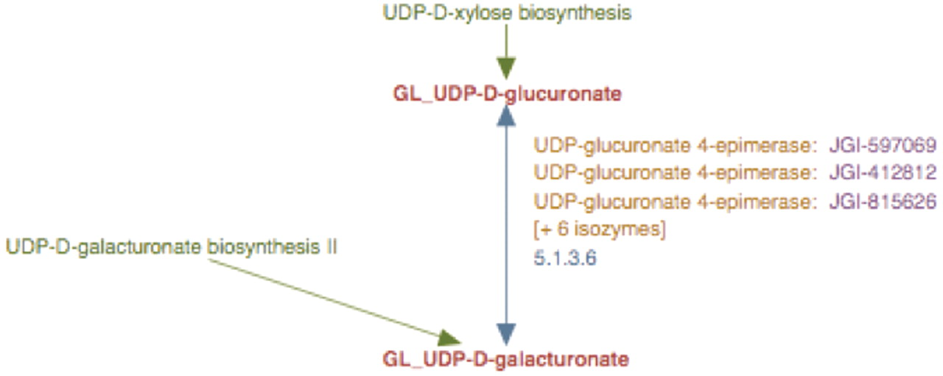
Figure 5. The enhanced representation of UDP-d-galacturonate biosynthesis I pathway starting from UDP-d-glucuronate in ...
Notes:
Figure 5. The enhanced representation of UDP-d-galacturonate biosynthesis I pathway starting from UDP-d-glucuronate in prototype Populus PGDB. The two metabolites in this pathway are linked by green arrows to two other pathways, UDP-d-xylose biosynthesis and UDP-d-galacturonate biosynthesis II.
Unless provided in the caption above, the following copyright applies to the content of this slide: © The Author(s) 2012. Published by Oxford University Press.This is an Open Access article distributed under the terms of the Creative Commons Attribution Non-Commercial License (http://creativecommons.org/licenses/by-nc/3.0), which permits unrestricted non-commercial use, distribution, and reproduction in any medium, provided the original work is properly cited.

Slide 6
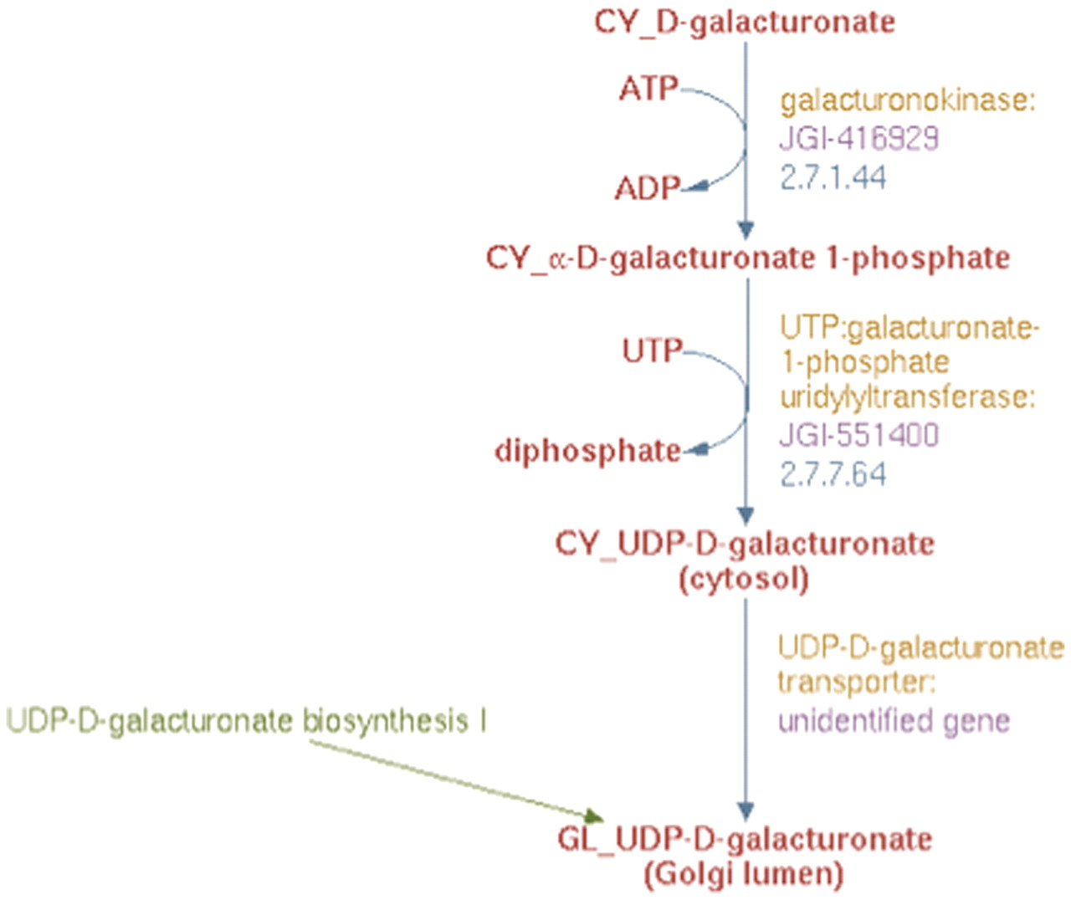
Figure 6. The enhanced representation of UDP-d-galacturonate biosynthesis II starting from d-galacturonate in prototype ...
Notes:
Figure 6. The enhanced representation of UDP-d-galacturonate biosynthesis II starting from d-galacturonate in prototype Populus PGDB.
Unless provided in the caption above, the following copyright applies to the content of this slide: © The Author(s) 2012. Published by Oxford University Press.This is an Open Access article distributed under the terms of the Creative Commons Attribution Non-Commercial License (http://creativecommons.org/licenses/by-nc/3.0), which permits unrestricted non-commercial use, distribution, and reproduction in any medium, provided the original work is properly cited.

Slide 7
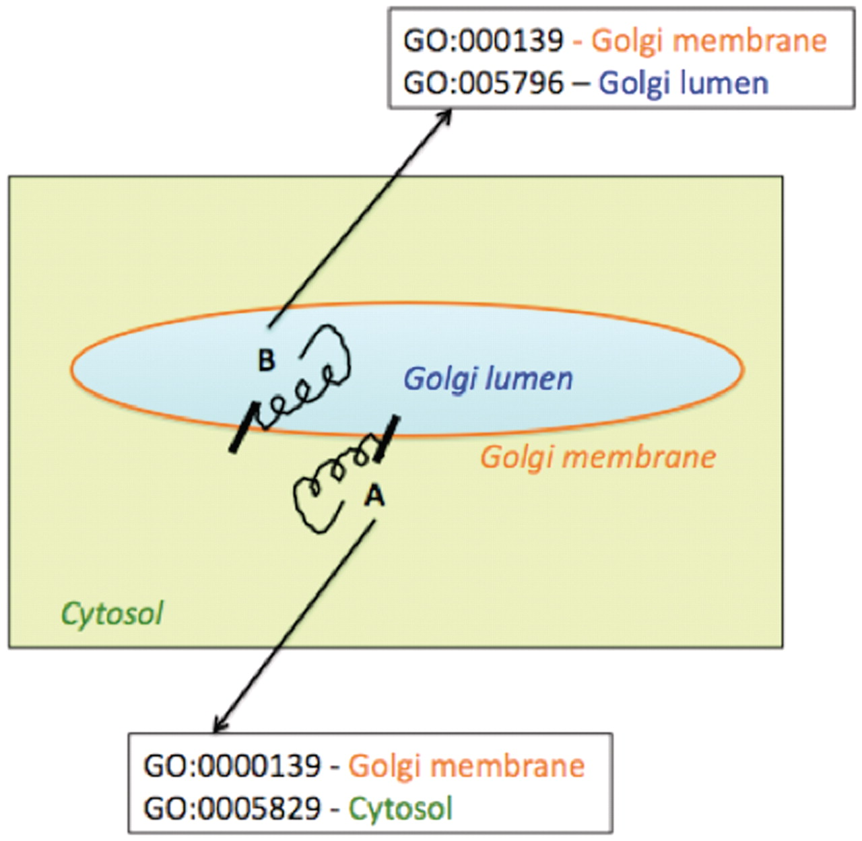
Figure 7. Schematic representation of association of multiple Cellular Component Gene Ontology terms with two ...
Notes:
Figure 7. Schematic representation of association of multiple Cellular Component Gene Ontology terms with two differentially oriented Golgi membrane enzymes.
Unless provided in the caption above, the following copyright applies to the content of this slide: © The Author(s) 2012. Published by Oxford University Press.This is an Open Access article distributed under the terms of the Creative Commons Attribution Non-Commercial License (http://creativecommons.org/licenses/by-nc/3.0), which permits unrestricted non-commercial use, distribution, and reproduction in any medium, provided the original work is properly cited.

Slide 8
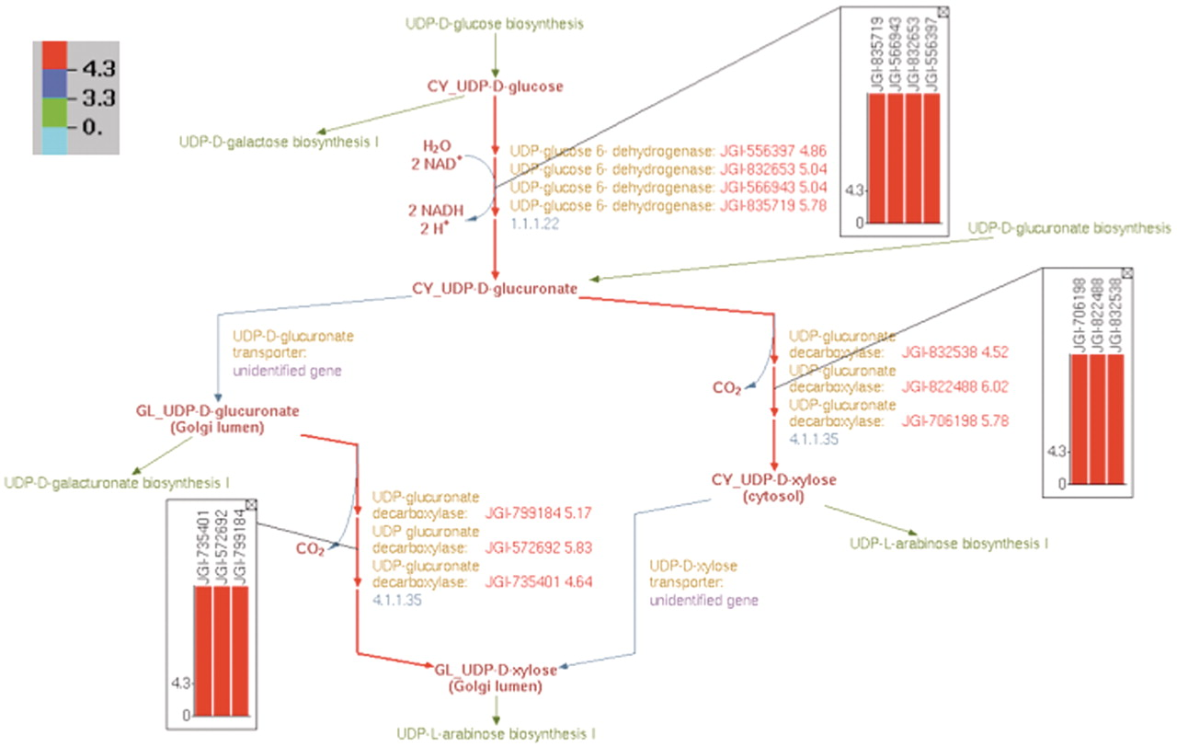
Figure 10. Overlay of log₂-transformed SNP abundance for genes in the UDP-d-xylose biosynthesis pathway. ...
Notes:
Figure 10. Overlay of log2-transformed SNP abundance for genes in the UDP-d-xylose biosynthesis pathway. Individual reaction representations are highlighted using the color code at the top left corner. The numbers in the color code define the ranges of the log2(SNP abundance) values of the genes in such a way that red, blue and green colors correspond to genes with high, medium and low SNP values, respectively. The reaction arrows for UDP-d-glucuronate formation, and for both the cytosolic and intra-Golgi conversions of UDP-d-glucuronate to UDP-d-xylose are highlighted in red since all the corresponding genes have high log2(SNP abundance). The color-coded log2(SNP abundance) values for the transcriptome genes encoding the enzymes catalyzing each reaction can be exhibited using pop-up bar diagrams, shown as inset figures. The absolute log2(SNP abundance) values for the genes that explicitly appear on the pathway diagram occur next to the corresponding gene locus tags and are color coded as well.
Unless provided in the caption above, the following copyright applies to the content of this slide: © The Author(s) 2012. Published by Oxford University Press.This is an Open Access article distributed under the terms of the Creative Commons Attribution Non-Commercial License (http://creativecommons.org/licenses/by-nc/3.0), which permits unrestricted non-commercial use, distribution, and reproduction in any medium, provided the original work is properly cited.

Slide 9
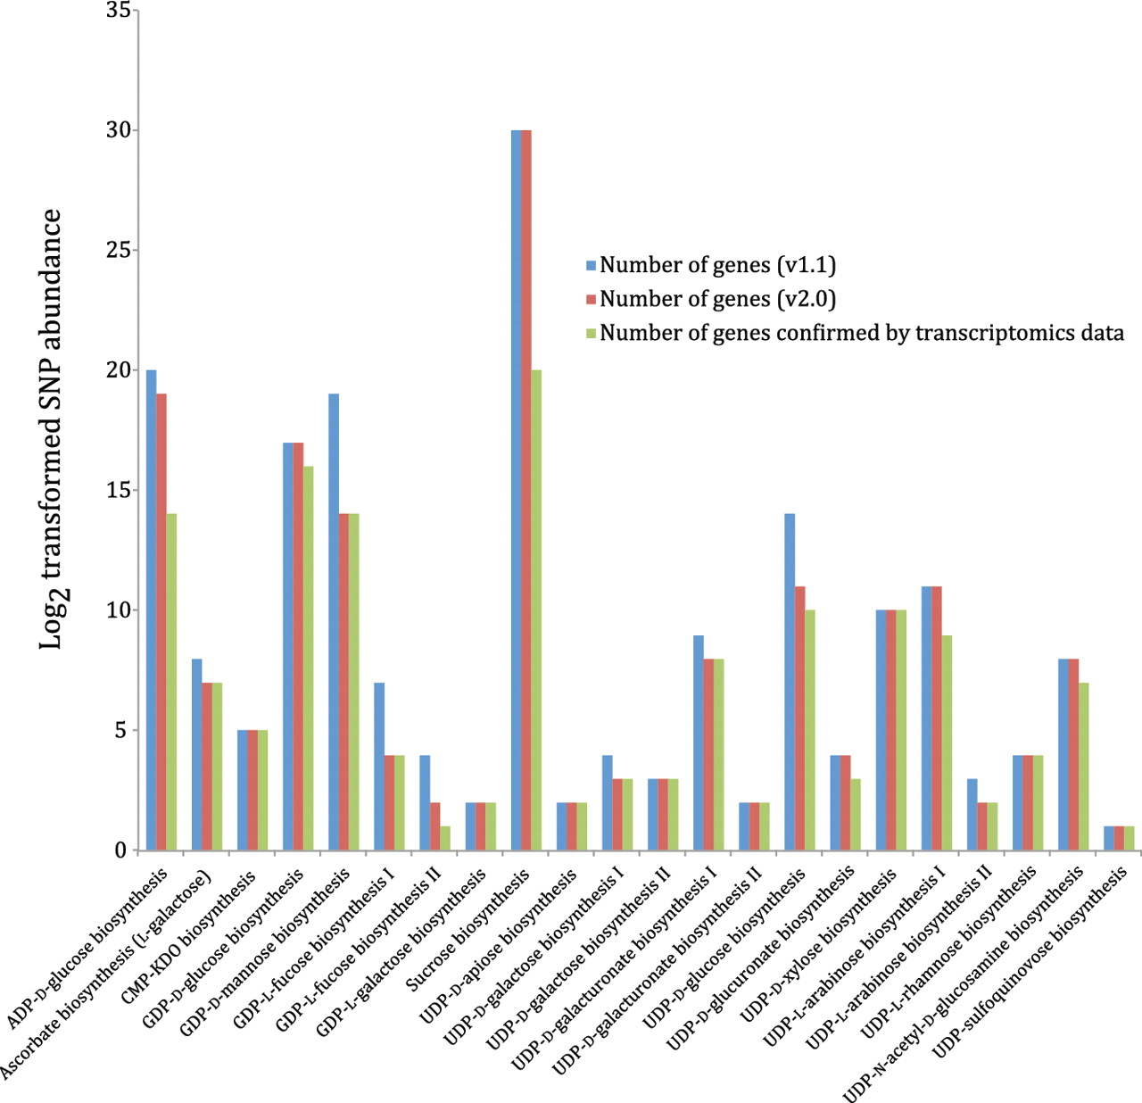
Figure 9. Nucleotide-sugar biosynthetic genes expressed in xylem tissue from 20 different Populus trees with different ...
Notes:
Figure 9. Nucleotide-sugar biosynthetic genes expressed in xylem tissue from 20 different Populus trees with different wood properties. Log2 transformed SNP abundance data for individual Populus nucleotide-sugar biosynthetic genes are overlaid with the curated nucleotide-sugar biosynthetic pathways in the prototype Populus PGDB. Genes that exhibit at least one SNP are considered expressed, whereas the status of genes lacking SNPs cannot be ascertained. UDP-L-arabinose synthesis I (from UDP-D-xylose, catalyzed by UDP-arabinose 4-epimerase) is currently represented in the PGDB as occurring in the cytosol and two different organelles—ER and Golgi, based on sequence analyses of UDP-arabinose 4-epimerase isoforms. The localization of any UDP-arabinose 4-epimerase isoform to the ER is yet to be validated by experimental data.
Unless provided in the caption above, the following copyright applies to the content of this slide: © The Author(s) 2012. Published by Oxford University Press.This is an Open Access article distributed under the terms of the Creative Commons Attribution Non-Commercial License (http://creativecommons.org/licenses/by-nc/3.0), which permits unrestricted non-commercial use, distribution, and reproduction in any medium, provided the original work is properly cited.

Slide 10
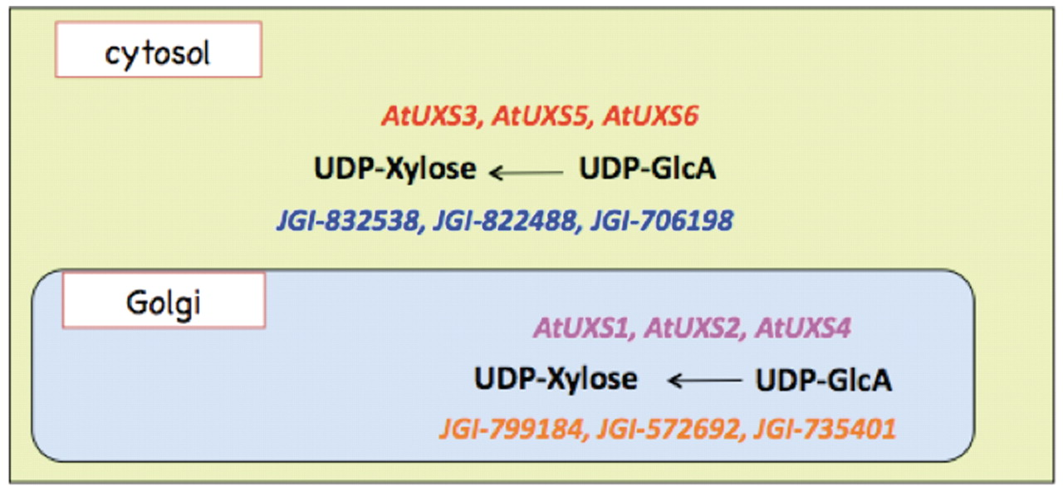
Figure 8. Cytosolic and Golgi isoforms of Arabidopsis and Populus UDP-xylose synthase. The cytosolic isoforms of the ...
Notes:
Figure 8. Cytosolic and Golgi isoforms of Arabidopsis and Populus UDP-xylose synthase. The cytosolic isoforms of the Arabidopsis and Populus enzymes are color coded in red and blue, respectively. The Golgi isoforms of Arabidopsis and Populus UDP-d-xylose species are color-coded in pink and orange, respectively.
Unless provided in the caption above, the following copyright applies to the content of this slide: © The Author(s) 2012. Published by Oxford University Press.This is an Open Access article distributed under the terms of the Creative Commons Attribution Non-Commercial License (http://creativecommons.org/licenses/by-nc/3.0), which permits unrestricted non-commercial use, distribution, and reproduction in any medium, provided the original work is properly cited.

