Slide 1
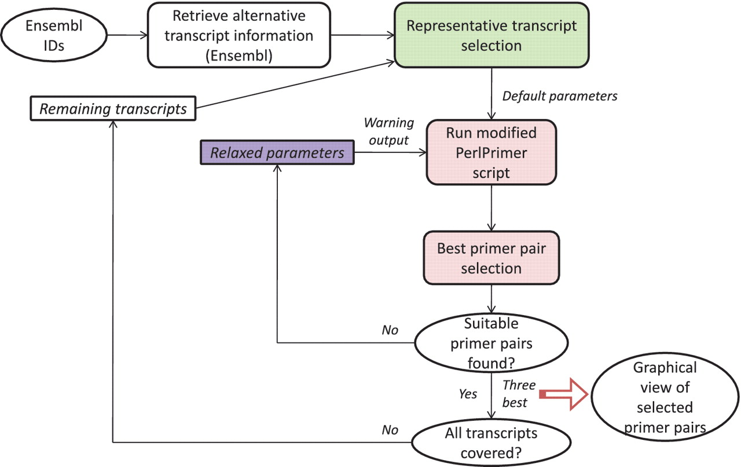
Figure 1. Overall primer design pipeline. The overall workflow is depicted. The green box is explained in Figure 2. The ...
Notes:
Figure 1. Overall primer design pipeline. The overall workflow is depicted. The green box is explained in Figure 2. The pink and purple boxes are explained in more detail in Figures 3 and 4, respectively. For more details, please see main text.
Unless provided in the caption above, the following copyright applies to the content of this slide: © The Author(s) 2011. Published by Oxford University Press.This is Open Access article distributed under the terms of the Creative Commons Attribution Non-Commercial License (http://creativecommons.org/licenses/by-nc/2.5), which permits unrestricted non-commercial use, distribution, and reproduction in any medium, provided the original work is properly cited.

Slide 2
Figure 2. Visualization of the junction score algorithm concept for gene- or transcript-specific primer design. A ...
Notes:
Figure 2. Visualization of the junction score algorithm concept for gene- or transcript-specific primer design. A schematic representation of a gene with three alternative transcripts is depicted. The blue boxes represent exons, the lines represent introns. Each transcript contains a subset of exons A–D and A′. The junction score (N) constitutes the number of transcripts containing the respective splice junction. To design gene-specific primers, the sum of the junction scores, represented by S, is calculated for each transcript and the transcript with the highest S-value that contains the junction with the highest N-score is selected (here t1). Then, the gene-specific primers are preferentially designed so that one of the primers spans the exon junction with the highest N-score within the selected transcript (t1), as indicated by the dark blue arrows.
Unless provided in the caption above, the following copyright applies to the content of this slide: © The Author(s) 2011. Published by Oxford University Press.This is Open Access article distributed under the terms of the Creative Commons Attribution Non-Commercial License (http://creativecommons.org/licenses/by-nc/2.5), which permits unrestricted non-commercial use, distribution, and reproduction in any medium, provided the original work is properly cited.

Slide 3
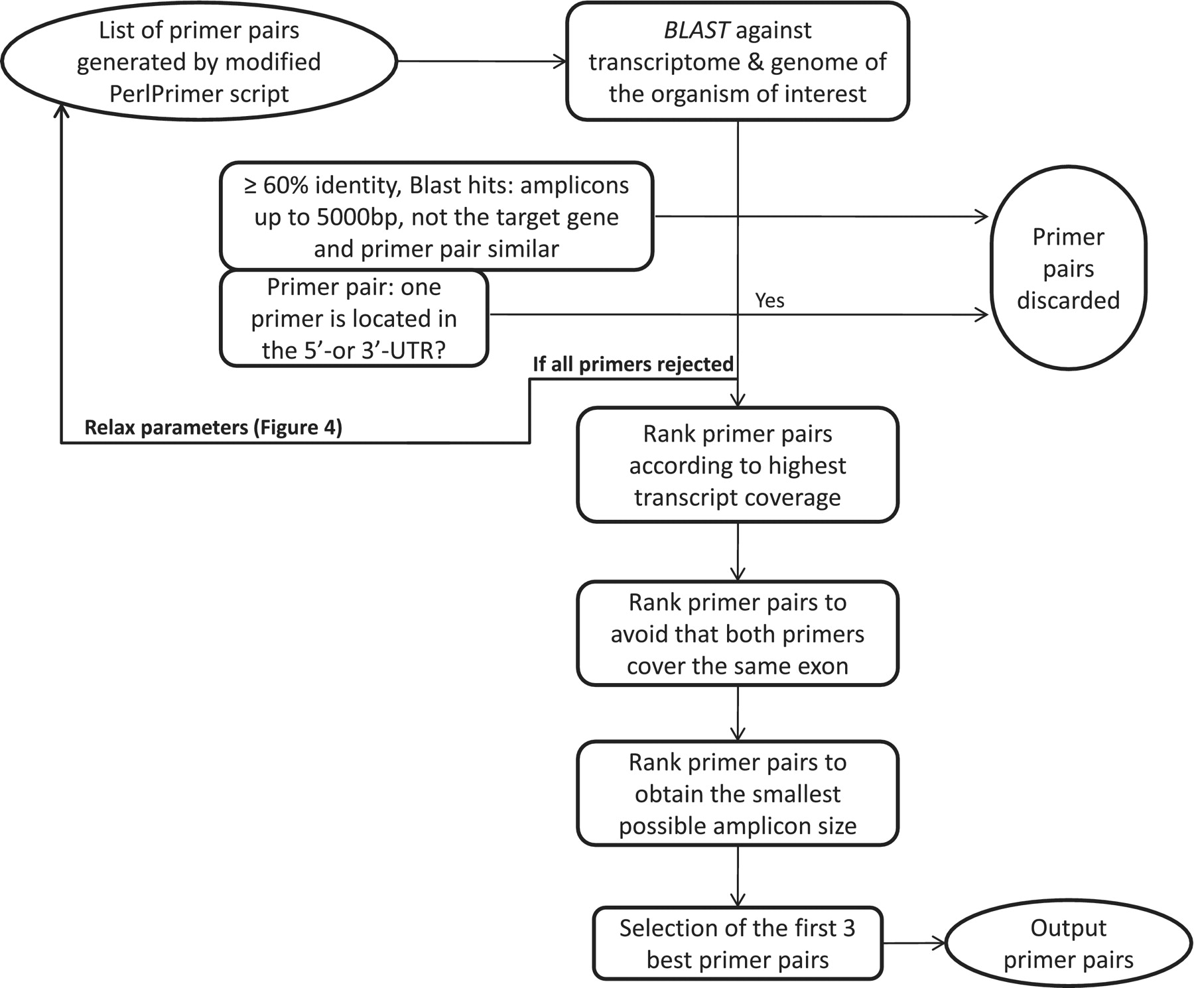
Figure 3. Workflow to select the best primer pairs. The selection of the best primer pairs is automated according to ...
Notes:
Figure 3. Workflow to select the best primer pairs. The selection of the best primer pairs is automated according to these hierarchical criteria. First, each primer pair is blasted and potentially discarded as described in the Figure and in the main text. Then, with the remaining primer pairs, pairs are discarded if at least one primer spans the 5′- or 3′-UTR. After these two stringent filtering steps, the remaining primers are ranked according to (i) highest transcript coverage, (ii) whether the primers are located within the same exon (not desirable) or not (desirable) and (iii) smallest amplicon size which has shown to be more optimal for qPCR efficiency and experimental variation (35).
Unless provided in the caption above, the following copyright applies to the content of this slide: © The Author(s) 2011. Published by Oxford University Press.This is Open Access article distributed under the terms of the Creative Commons Attribution Non-Commercial License (http://creativecommons.org/licenses/by-nc/2.5), which permits unrestricted non-commercial use, distribution, and reproduction in any medium, provided the original work is properly cited.

Slide 4
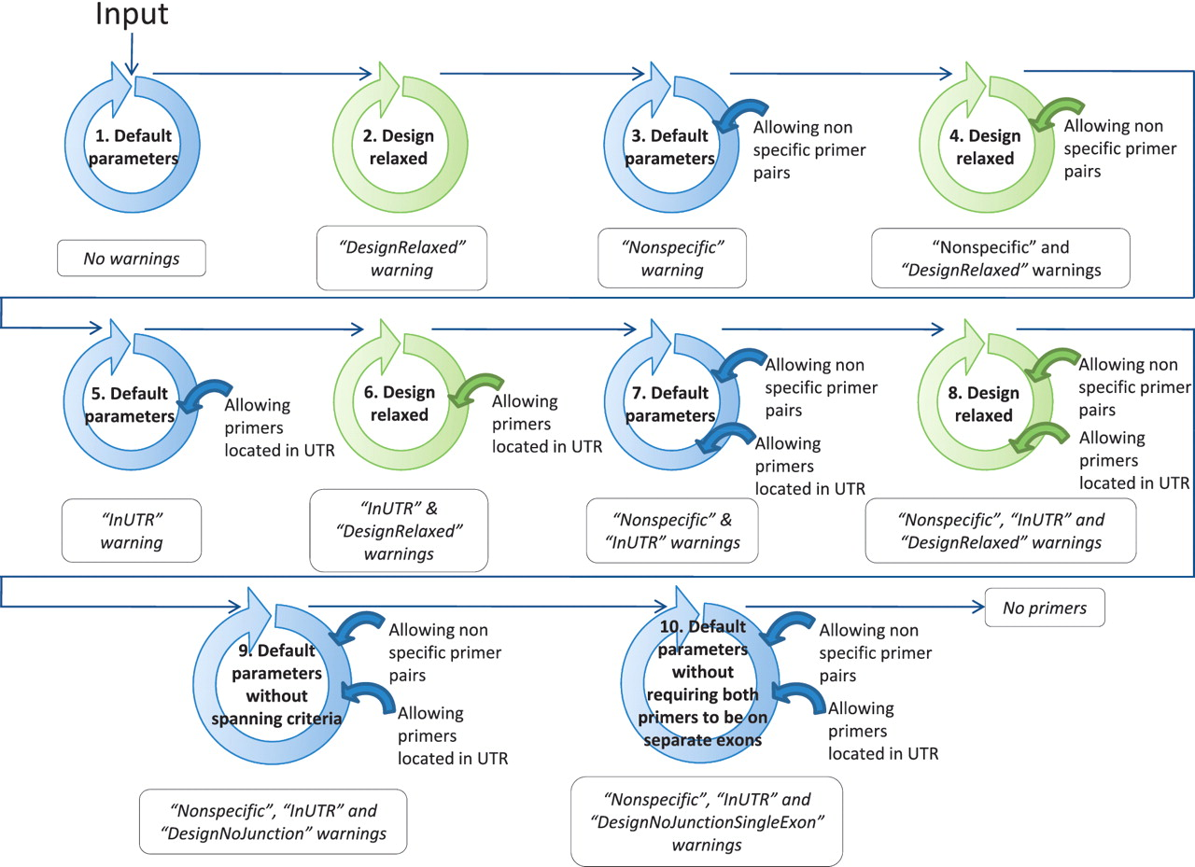
Figure 4. Workflow to find at least one suitable primer pair by relaxing the primer design parameters. The circles ...
Notes:
Figure 4. Workflow to find at least one suitable primer pair by relaxing the primer design parameters. The circles schematize the run of the modified PerlPrimer script and the workflow of the best primer selection indicated in Figure 1. The relaxation of the parameters within the modified PerlPrimer script and the allowed options in the selection of the best primer pairs are depicted in the center and on the right of the circles, respectively. Blue and green circles represent the default parameters and the relaxed design parameters, respectively (Table 2). The arrows symbolize the logical flow. If no primers are found with either set of parameters, the program reports ‘No primers’.
Unless provided in the caption above, the following copyright applies to the content of this slide: © The Author(s) 2011. Published by Oxford University Press.This is Open Access article distributed under the terms of the Creative Commons Attribution Non-Commercial License (http://creativecommons.org/licenses/by-nc/2.5), which permits unrestricted non-commercial use, distribution, and reproduction in any medium, provided the original work is properly cited.

Slide 5
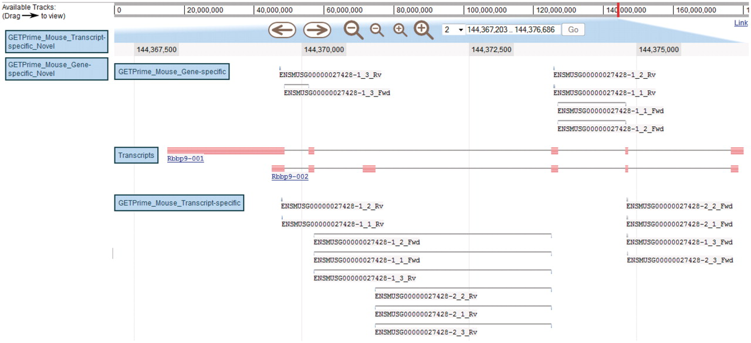
Figure 5. JBrowse-based graphical view of GETPrime primer pairs targeting the Rbbp9 mouse gene. The blue boxes on the ...
Notes:
Figure 5. JBrowse-based graphical view of GETPrime primer pairs targeting the Rbbp9 mouse gene. The blue boxes on the left are the available tracks that can be dragged in the JBrowse genome view (23). In this example, the transcripts, the gene-specific primers (covering the majority of splice variants if possible) and the transcript-specific primers (covering a single splice variant, when possible) have been dragged into the browser. The upper part of the figure shows tools to zoom, to move to up- or downstream of the genome location, and to enter another chromosome, another position on the chromosome or also an Ensembl ID. Each primer is annotated by its Ensembl ID, its iteration in GETPrime (e.g. −1), its ranking (e.g. _3) and its primer type (forward and reverse primers are abbreviated Fwd and Rv, respectively). The blue box for each primer represents the respective alignment to the transcripts and sometimes a thin line between two blue boxes is used to bridge an intron region for primers spanning two exons. The primer pairs in the gene-specific track cover both transcripts. The primer pairs from the first iteration (‘−1’) and the second iteration (‘−2’) in the transcript-specific track are specific to the largest transcript Rbbp9-001 and the shortest transcript Rbbp9-002, respectively.
Unless provided in the caption above, the following copyright applies to the content of this slide: © The Author(s) 2011. Published by Oxford University Press.This is Open Access article distributed under the terms of the Creative Commons Attribution Non-Commercial License (http://creativecommons.org/licenses/by-nc/2.5), which permits unrestricted non-commercial use, distribution, and reproduction in any medium, provided the original work is properly cited.

Slide 6
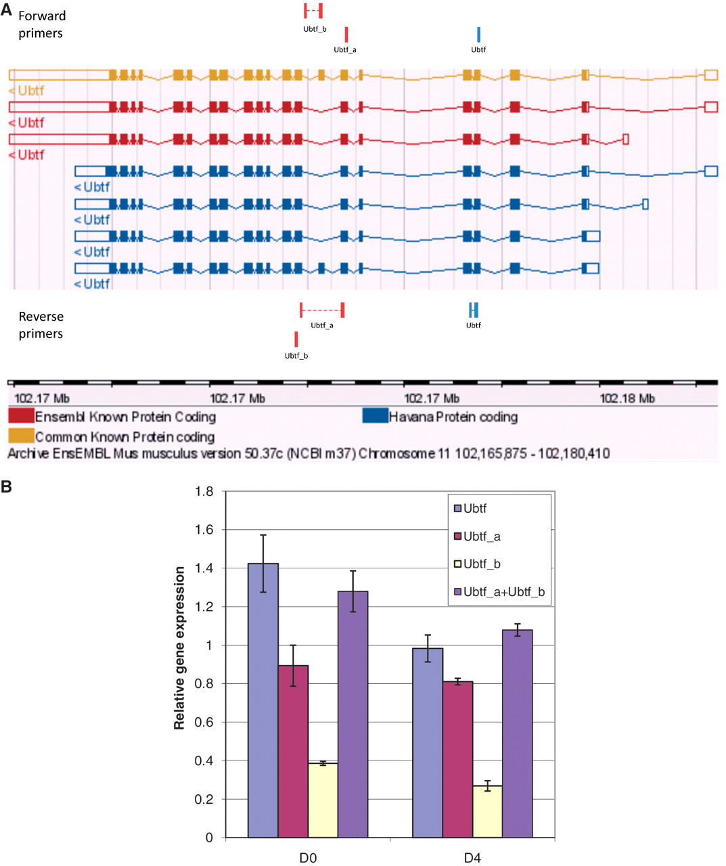
Figure 6. Graphical view and qPCR results to validate Ubtf-targeting primers covering either all or a subset of Ubtf ...
Notes:
Figure 6. Graphical view and qPCR results to validate Ubtf-targeting primers covering either all or a subset of Ubtf transcripts. (A) The ‘Ubtf’ primer pair in blue covers all seven transcripts (gene-specific primers) and the red ‘Ubtf_a’ and ‘Ubtf_b’ primer pairs cover five and two transcripts, respectively (transcript-specific primers). In this example, GETPrime could not find primers differentiating each transcript. (B) The relative gene expression levels before differentiation (D0) and four days after (D4) were normalized to Hprt1 and Tubb2c expression levels. ‘Ubtf’ represents the primer pair covering all seven transcripts, whereas, ‘Ubtf_a’ and ‘Ubtf_b’ are primer pairs specific to a subset of five and two transcripts, respectively. ‘Ubtf_a+Ubtf_b’ represents the sum of relative gene expression of ‘Ubtf_a’ and ‘Ubtf_b’. The data indicate that GETPrime can effectively differentiate distinct transcripts, as the sum of the individual transcript amounts matched the overall gene expression amount.
Unless provided in the caption above, the following copyright applies to the content of this slide: © The Author(s) 2011. Published by Oxford University Press.This is Open Access article distributed under the terms of the Creative Commons Attribution Non-Commercial License (http://creativecommons.org/licenses/by-nc/2.5), which permits unrestricted non-commercial use, distribution, and reproduction in any medium, provided the original work is properly cited.

