Slide 1
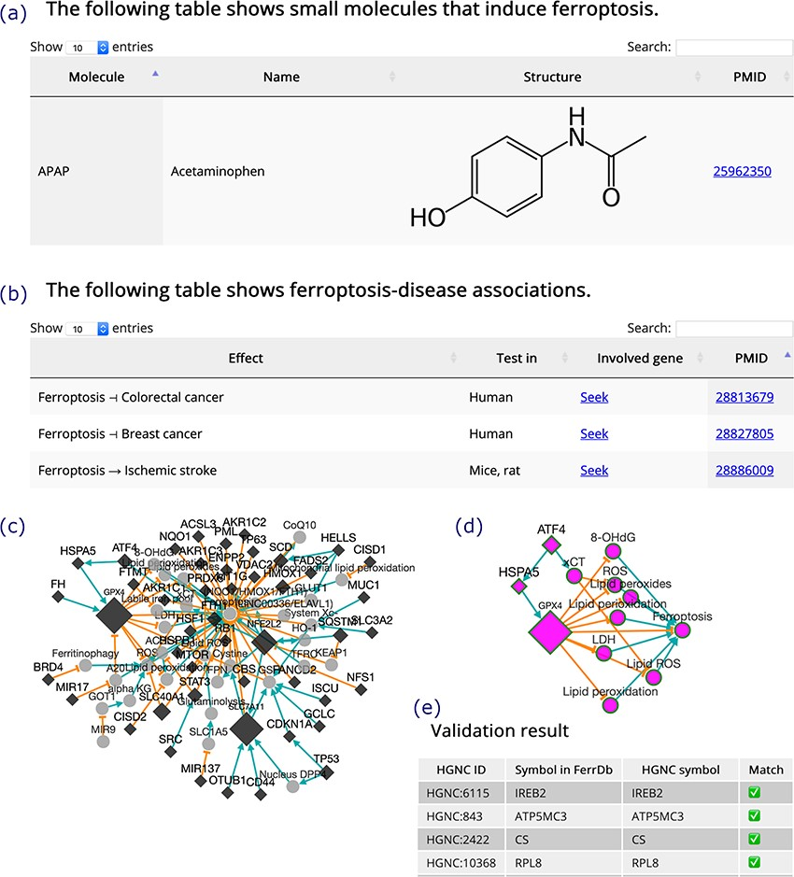
Figure 4 (a) An inducer. (b) Ferroptosis-disease associations. The T-shaped line denotes alleviation, while the arrow ...
Notes:
Figure 4 (a) An inducer. (b) Ferroptosis-disease associations. The T-shaped line denotes alleviation, while the arrow denotes aggravation. (c) Regulation network. Diamonds denote regulators of ferroptosis. Circles denote unclassified regulatory elements. Orange T-shaped lines denote inhibition. Green arrows denote promotion. Node size represents the number of experiments, where larger nodes reflect a greater number of experiments. (d) Sub-network of ATF4, shown as an example. (e) A truncated result table of gene symbol validation. The white check mark in green box indicates success of validation. The red cross indicates failure of validation.
Unless provided in the caption above, the following copyright applies to the content of this slide: © The Author(s) 2020. Published by Oxford University Press.This is an Open Access article distributed under the terms of the Creative Commons Attribution License (http://creativecommons.org/licenses/by/4.0/), which permits unrestricted reuse, distribution, and reproduction in any medium, provided the original work is properly cited.

