Slide 1
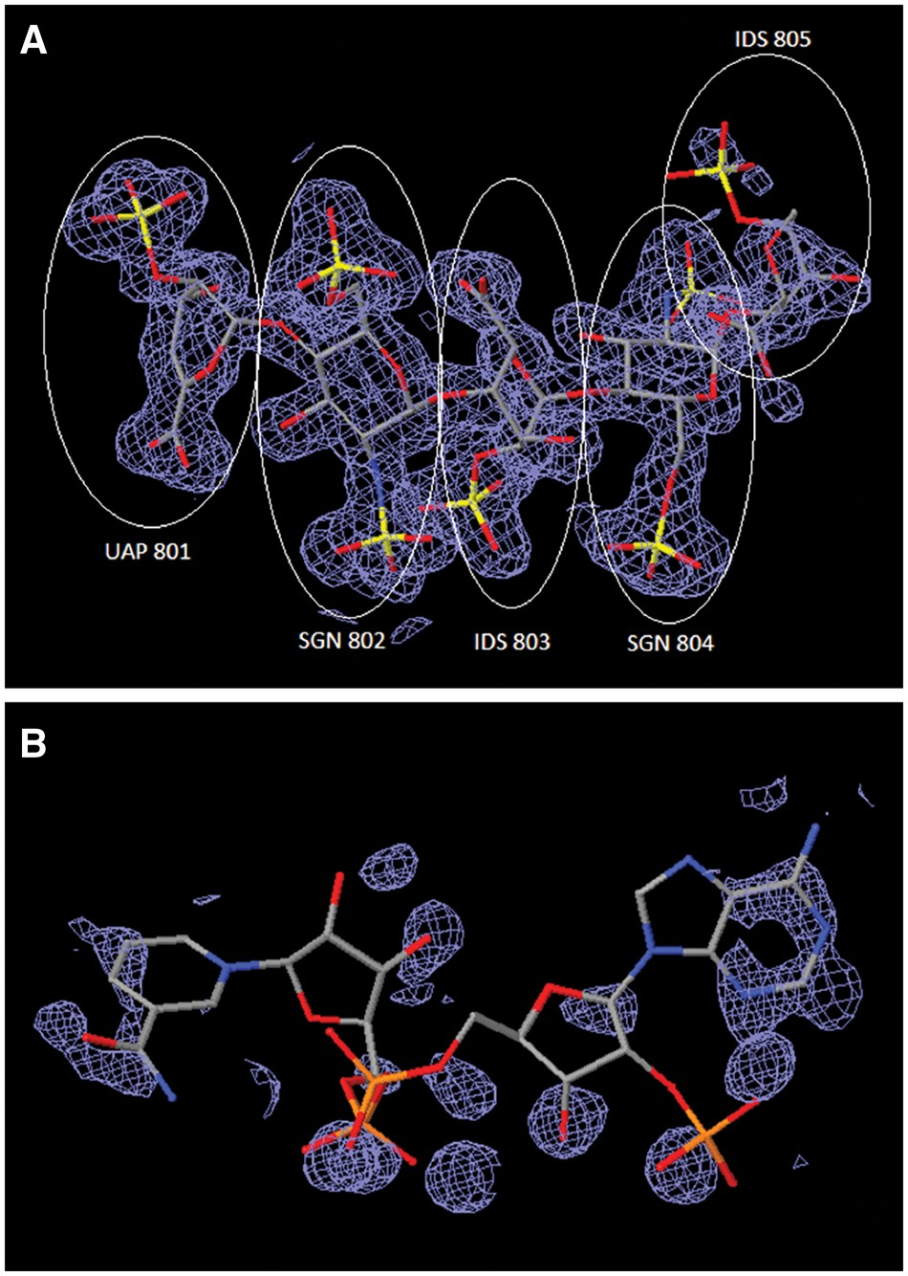
Figure 5. Comparison of ligand structures with 3D electron-density views. The electron-density maps shown in Figure 4A ...
Notes:
Figure 5. Comparison of ligand structures with 3D electron-density views. The electron-density maps shown in Figure 4A and B are 2m|Fo|-D|Fc| maps contoured at 1.0 σ cutoff. (A) Good electron-density fit for heparin oligosaccharide at residues 801–804 bound to annexin in PDB entry 2HYV. (B) Poor electron-density fit for NADP bound to alcohol dehydrogenase in PDB entry 1ZK4.
Unless provided in the caption above, the following copyright applies to the content of this slide: © The Author(s) 2018. Published by Oxford University Press.This is an Open Access article distributed under the terms of the Creative Commons Attribution License (http://creativecommons.org/licenses/by/4.0/), which permits unrestricted reuse, distribution, and reproduction in any medium, provided the original work is properly cited.

