Slide 1
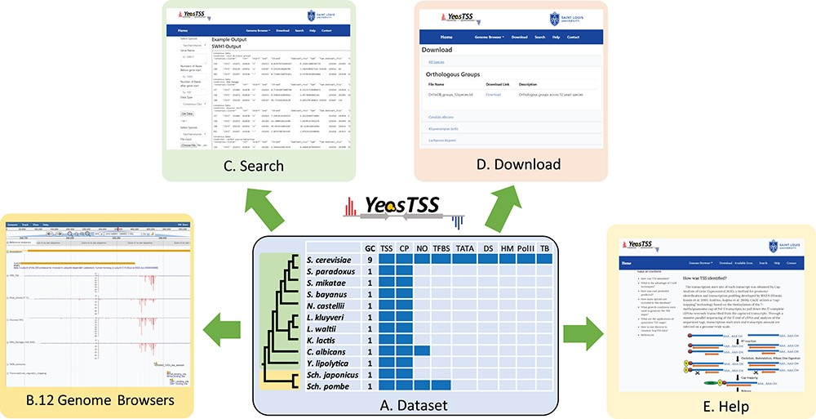
Figure 1 The overall design of YeasTSS. (A) Dataset: The dataset used in YeasTSS is illustrated in this central table. ...
Notes:
Figure 1 The overall design of YeasTSS. (A) Dataset: The dataset used in YeasTSS is illustrated in this central table. Currently, YeasTSS includes 12 yeast species. The evolutionary relationships of these species are demonstrated by the phylogenetic tree on the left side of data table. The clade of 10 budding yeast species is shaded in green, and the clade of 2 fission yeast species is shaded in yellow. The CP and TSS data of each species were generated by this study. NO data are integrated for S. cerevisiae, Sch. pombe and C. albicans. TFBSs are available in S. cerevisiae and Sch. pombe. For S. cerevisiae, several other functional genomic data are also integrated: TATA-box, DS, HMs, Polymerase II binding (PolII) and TBs obtained from 18 different growth conditions. (B) Genome browser: These data are visualized and integrated by dedicated JBrowse genome browser of each species. (C) Search: The `Search’ utility provides search tools in to retrieve TSS and CP information from gene-by-gene analysis or global approaches. (D) Download: The `Download’ utility allows users to download all raw data used in this database through web interface. (E) Help: The `Help’ page provides documentations about of CAGE technique, TSS identification, inferences of CPs and instructions of using genome browsers.
Unless provided in the caption above, the following copyright applies to the content of this slide: © The Author(s) 2019. Published by Oxford University Press.This is an Open Access article distributed under the terms of the Creative Commons Attribution License (http://creativecommons.org/licenses/by/4.0/), which permits unrestricted reuse, distribution, and reproduction in any medium, provided the original work is properly cited.

Slide 2
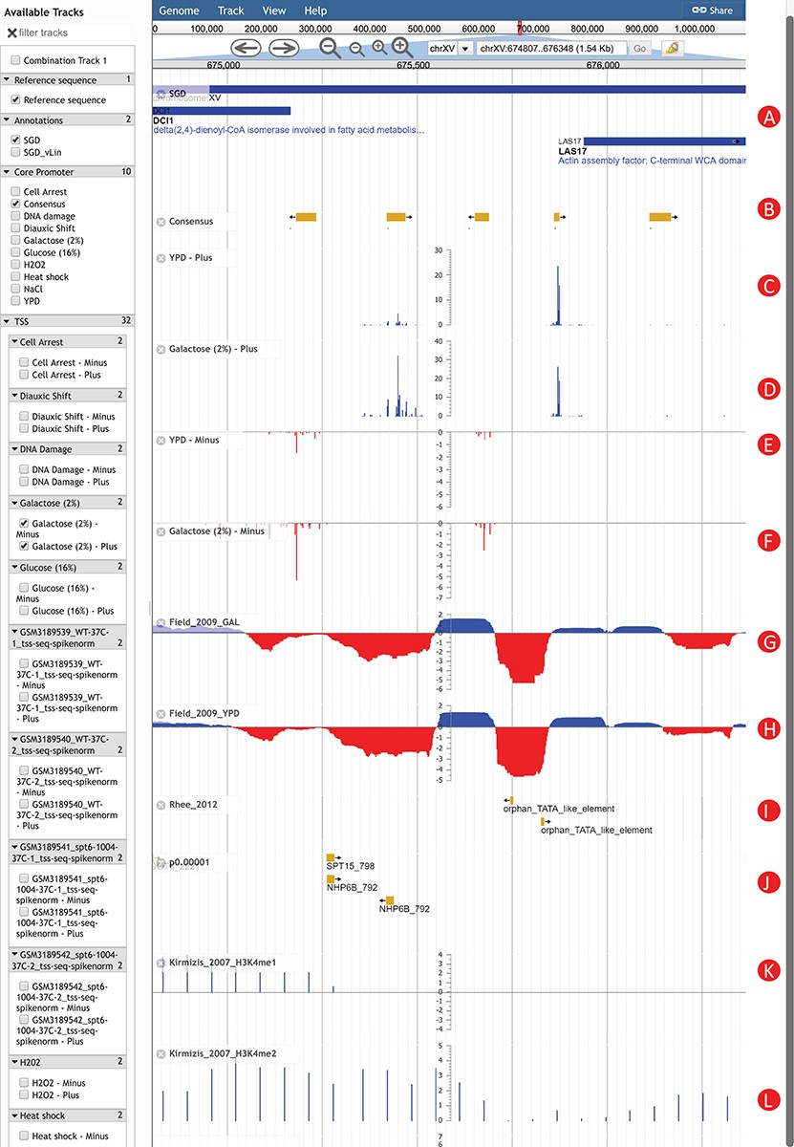
Figure 2 An Example of using YeasTSS Genome Browser to explore transcription initiation landscape. A 1.5 kb region ...
Notes:
Figure 2 An Example of using YeasTSS Genome Browser to explore transcription initiation landscape. A 1.5 kb region around the CP region of LAS17 on chrXV (674 807–676 348). The available tracks in S. cerevisiae are provided in the left panel of genome browser. Two consensus CPs on the forward strand are present within 1000 bp upstream of LAS17 ORF. The transcription activity of each CP can be visualized by the TSS tracks. Different CP activities can be observed between the YPD and YPGal (galactose 2%) growth conditions in S. cerevisiae. Only a few tracks were selected in this case. These tracks include: (A) Genome annotation from SGD; (B) consensus CPs; (C) TSS map on plus strand under YPD condition; (D) TSS map on plus strand under YPGal (galactose 2%) condition; (E) TSS map on minus strand under YPD condition; (F) TSS map on minus strand under YPGal condition; (G) nucleosome occupancy under YPD condition; (H) Nucleosome occupancy under YPGal condition; (I) TATA box; (J) position weight matrix (PWM) predicted binding sites; (K) histone modification H3K4me1; (L) histone modification H3K4me2.
Unless provided in the caption above, the following copyright applies to the content of this slide: © The Author(s) 2019. Published by Oxford University Press.This is an Open Access article distributed under the terms of the Creative Commons Attribution License (http://creativecommons.org/licenses/by/4.0/), which permits unrestricted reuse, distribution, and reproduction in any medium, provided the original work is properly cited.

