Slide 1
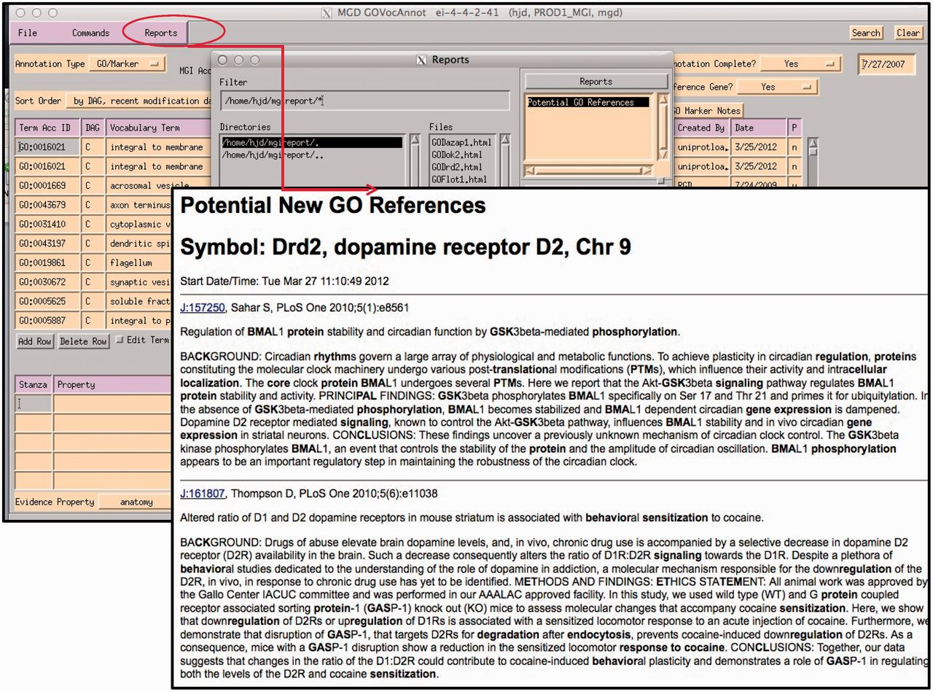
Figure 8. Report generated using the abstracts of papers selected for GO for the gene being annotated within the GO EI. ...
Notes:
Figure 8. Report generated using the abstracts of papers selected for GO for the gene being annotated within the GO EI. Text contained in GO terms in each abstract is highlighted.
Unless provided in the caption above, the following copyright applies to the content of this slide: © The Author(s) 2012. Published by Oxford University Press.This is an Open Access article distributed under the terms of the Creative Commons Attribution License (http://creativecommons.org/licenses/by-nc/3.0/), which permits non-commercial reuse, distribution, and reproduction in any medium, provided the original work is properly cited. For commercial re-use, please contact journals.permissions@oup.com.

