Slide 1
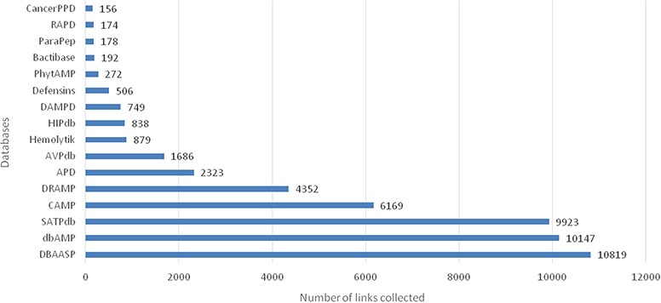
Figure 1 A total of 23 253 entries are distributed in 16 different databases in LAMP2.
Notes:
Figure 1 A total of 23 253 entries are distributed in 16 different databases in LAMP2.
Unless provided in the caption above, the following copyright applies to the content of this slide: © The Author(s) 2020. Published by Oxford University Press.This is an Open Access article distributed under the terms of the Creative Commons Attribution License (http://creativecommons.org/licenses/by/4.0/), which permits unrestricted reuse, distribution, and reproduction in any medium, provided the original work is properly cited.

Slide 2
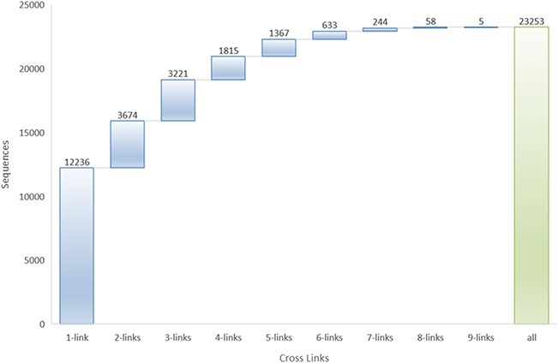
Figure 2 Cross-links to other databases in LAMP2.
Notes:
Figure 2 Cross-links to other databases in LAMP2.
Unless provided in the caption above, the following copyright applies to the content of this slide: © The Author(s) 2020. Published by Oxford University Press.This is an Open Access article distributed under the terms of the Creative Commons Attribution License (http://creativecommons.org/licenses/by/4.0/), which permits unrestricted reuse, distribution, and reproduction in any medium, provided the original work is properly cited.

Slide 3
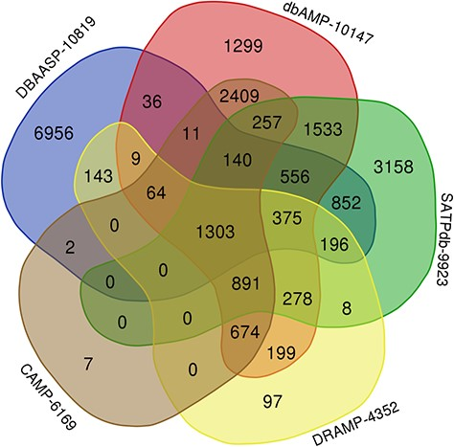
Figure 3 Venn diagram demonstrating peptides cross links among the top 5 databases in LAMP2 (plotted using ...
Notes:
Figure 3 Venn diagram demonstrating peptides cross links among the top 5 databases in LAMP2 (plotted using http://bioinformatics.psb.ugent.be/webtools/Venn/).
Unless provided in the caption above, the following copyright applies to the content of this slide: © The Author(s) 2020. Published by Oxford University Press.This is an Open Access article distributed under the terms of the Creative Commons Attribution License (http://creativecommons.org/licenses/by/4.0/), which permits unrestricted reuse, distribution, and reproduction in any medium, provided the original work is properly cited.

Slide 4
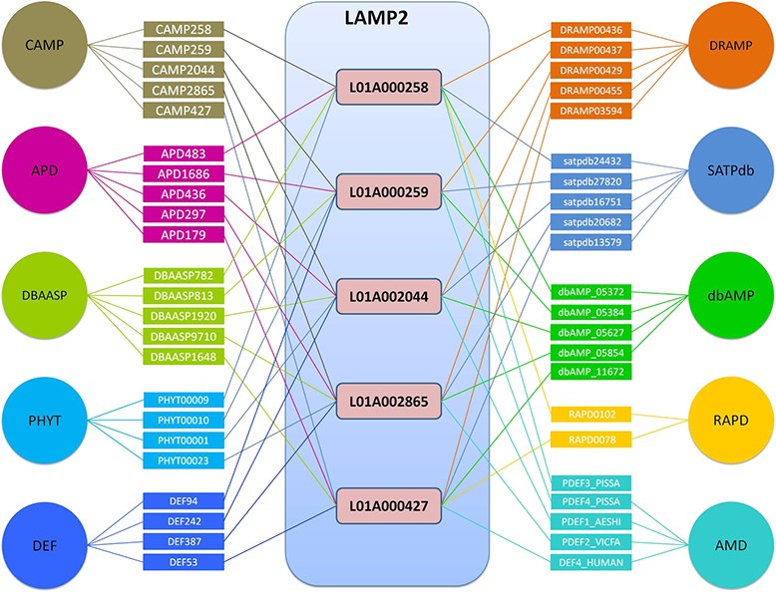
Figure 4 Top 5 AMPs in the number of cross-links in LAMP2.
Notes:
Figure 4 Top 5 AMPs in the number of cross-links in LAMP2.
Unless provided in the caption above, the following copyright applies to the content of this slide: © The Author(s) 2020. Published by Oxford University Press.This is an Open Access article distributed under the terms of the Creative Commons Attribution License (http://creativecommons.org/licenses/by/4.0/), which permits unrestricted reuse, distribution, and reproduction in any medium, provided the original work is properly cited.

