Slide 1
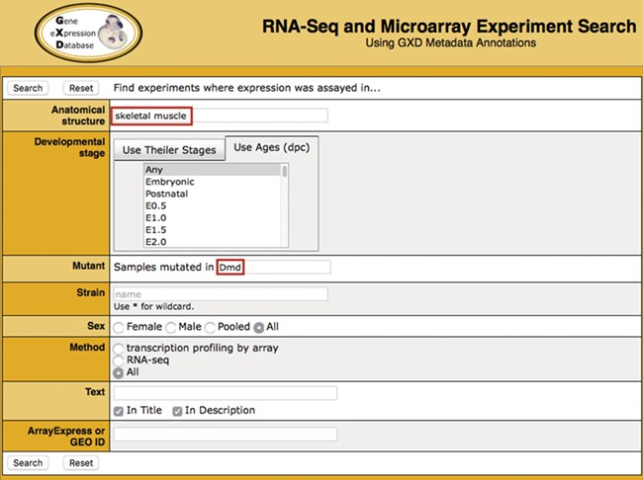
Figure 1 Search. Illustrated is a search for experiments studying gene expression in the skeletal muscle of dystrophin ...
Notes:
Figure 1 Search. Illustrated is a search for experiments studying gene expression in the skeletal muscle of dystrophin (Dmd) mutants. It takes advantage of two of the curated sample attribute fields: anatomical structure (‘skeletal muscle’) and mutant gene (‘Dmd’). Additional curated fields available for searching are developmental stage, strain and sex. Users can also do free text searching of experiment titles and descriptions, as well as search by ArrayExpress or GEO id.
Unless provided in the caption above, the following copyright applies to the content of this slide: © The Author(s) 2020. Published by Oxford University Press.This is an Open Access article distributed under the terms of the Creative Commons Attribution License (http://creativecommons.org/licenses/by/4.0/), which permits unrestricted reuse, distribution, and reproduction in any medium, provided the original work is properly cited.

