Slide 1
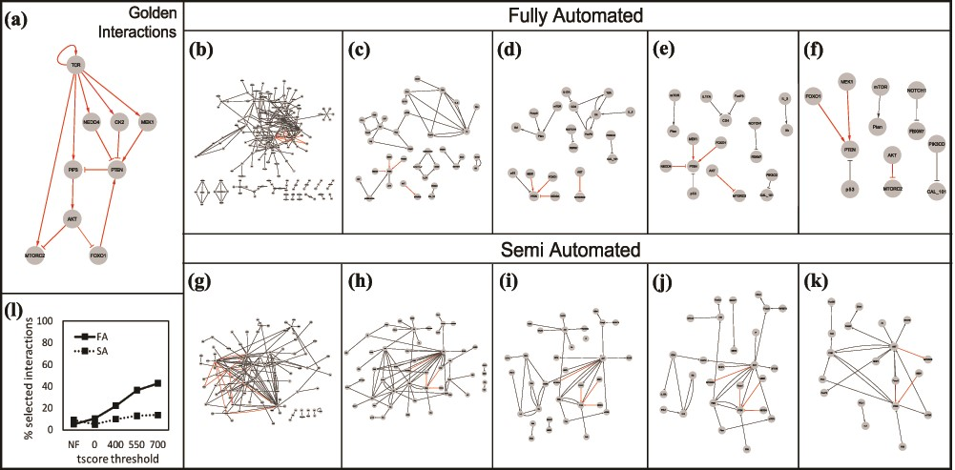
Figure 10 (a) The golden set of interactions from (27). The gray box in the right-hand corner shows the number of ...
Notes:
Figure 10 (a) The golden set of interactions from (27). The gray box in the right-hand corner shows the number of golden interactions present in each set in red. Interactions obtained using the Fully Automated (FA) approach: (b) unfiltered, (c) filtered without thresholds, (d) tscore > 400, (e) tscore > 550, (f) tscore > 700. Interactions obtained using the Semi Automated (SA) approach: (g) unfiltered, (h) filtered, no thresholds, (i) tscore > 400, (j) tscore > 550, (k) tscore > 700. (l) Comparison of the two approaches: % of selected interactions in each approach as a function of a tscore threshold.
Unless provided in the caption above, the following copyright applies to the content of this slide: © The Author(s) 2020. Published by Oxford University Press.This is an Open Access article distributed under the terms of the Creative Commons Attribution License (http://creativecommons.org/licenses/by/4.0/), which permits unrestricted reuse, distribution, and reproduction in any medium, provided the original work is properly cited.

