Slide 1
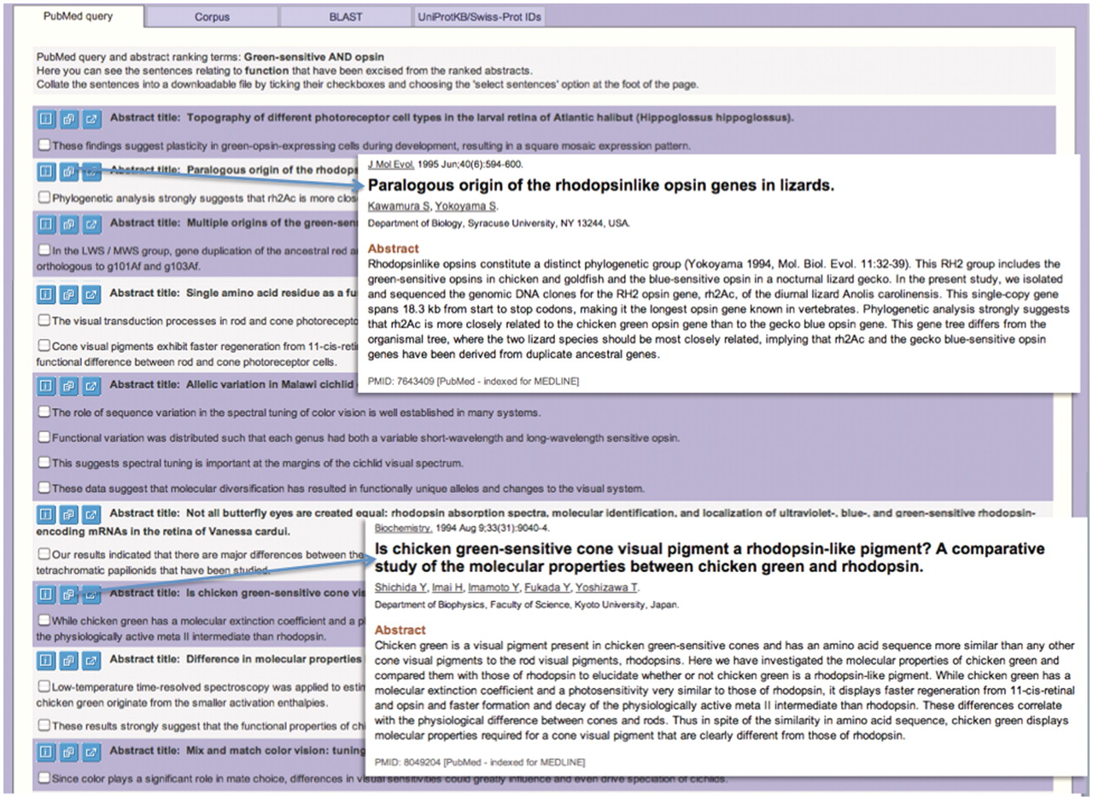
Figure 4. Using MINOTAUR to select function-related sentences relevant to query sequence, Q30HW6_9CICH. The top ...
Notes:
Figure 4. Using MINOTAUR to select function-related sentences relevant to query sequence, Q30HW6_9CICH. The top sentences are shown, following use of the search options illustrated in Figure 3. The parent abstracts for each group of sentences may be quickly viewed by clicking on the appropriate icon (inset). In the examples highlighted, a set of green-sensitive opsins is noted to belong to a distinct ‘rhodopsin-like’ phylogenetic group, being more similar to rhodopsins than they are to other green pigments. This helps to resolve the apparent ambiguity in the PRINTS cross-reference to rhodopsins rather than to green-sensitive opsins: sequences in this group clearly have a rhodopsin-like sequence signature and not a ‘green’ one.
Unless provided in the caption above, the following copyright applies to the content of this slide: © The Author(s) 2012. Published by Oxford University Press.This is an Open Access article distributed under the terms of the Creative Commons Attribution Non-Commercial License (http://creativecommons.org/licenses/by-nc/3.0), which permits unrestricted non-commercial use, distribution, and reproduction in any medium, provided the original work is properly cited.

