Slide 1
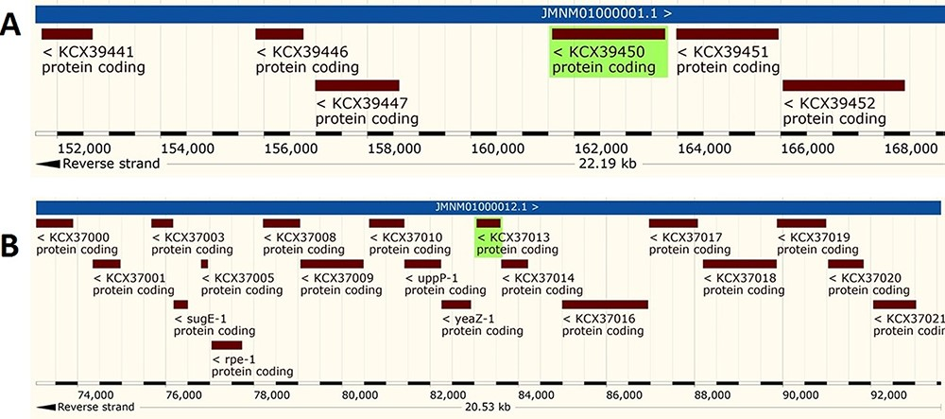
Figure 4. Genomic analysis of β- and γ-CA sequences from putative contaminants associated with Acinetobacter spp. The ...
Notes:
Figure 4. Genomic analysis of β- and γ-CA sequences from putative contaminants associated with Acinetobacter spp. The analysis shows the presence of coding genes for (A) β-CA from Acinetobacter sp. 263903-1 (UniProt ID: A0A062C2I7) and (B) γ-CA from Acinetobacter sp. 263903-1 (UniProt ID: A0A062BNN8).
Unless provided in the caption above, the following copyright applies to the content of this slide: © The Author(s) 2021. Published by Oxford University Press.This is an Open Access article distributed under the terms of the Creative Commons Attribution License (http://creativecommons.org/licenses/by/4.0/), which permits unrestricted reuse, distribution, and reproduction in any medium, provided the original work is properly cited.

