Slide 1
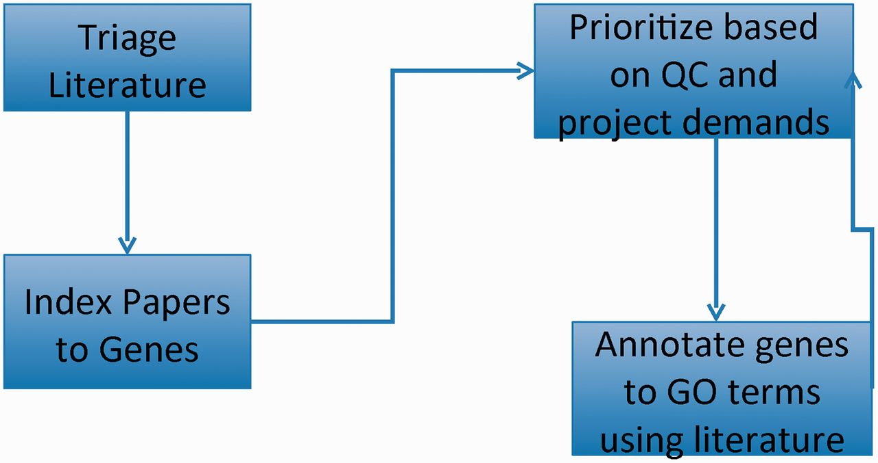
Figure 1. GO curation workflow: papers of interest are identified and entered into the database system (triage) and ...
Notes:
Figure 1. GO curation workflow: papers of interest are identified and entered into the database system (triage) and associated with genes (indexed). GO annotations are made using papers selected based on quality control reports and projects. The quality control reports in turn are revised daily based on added annotation.
Unless provided in the caption above, the following copyright applies to the content of this slide: © The Author(s) 2012. Published by Oxford University Press.This is an Open Access article distributed under the terms of the Creative Commons Attribution License (http://creativecommons.org/licenses/by-nc/3.0/), which permits non-commercial reuse, distribution, and reproduction in any medium, provided the original work is properly cited. For commercial re-use, please contact journals.permissions@oup.com.

