Slide 1
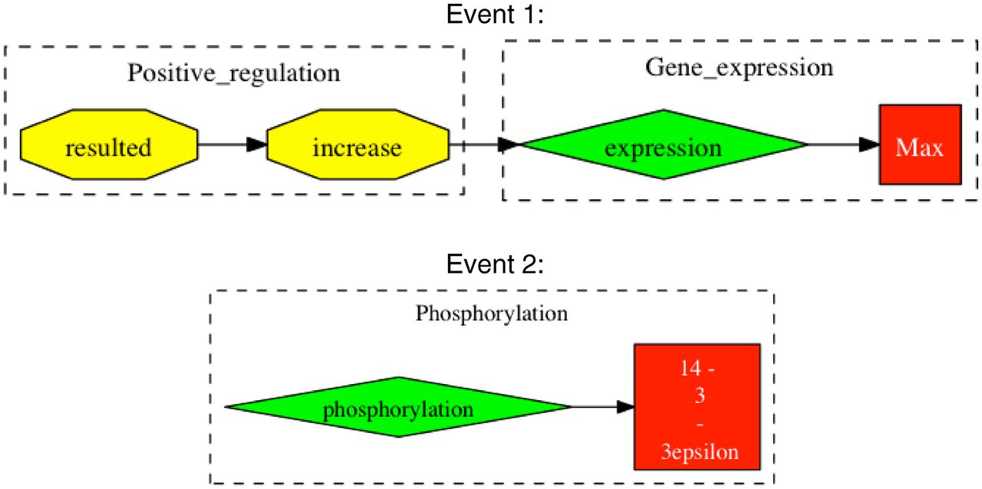
Figure 3. Examples of falsely reported event chains. Events are extracted from the sentence “In parallel to the ...
Notes:
Figure 3. Examples of falsely reported event chains. Events are extracted from the sentence “In parallel to the modulation of cell growth, gp 120 at low concentrations resulted in an increase in the expression of c-Myc, Max, and 14–3-3epsilon proteins and phosphorylation of ATP-dependent tyrosine kinases (Akt) at Ser (473)”. Taken from Ref. (20). Event 1 shows an example of an incomplete event chain, where gp120 is missing as the cause for positive regulation. In Event 2, there is falsely reported information in that 14-3-3epsilon is expressed and not phosphorylated.
Unless provided in the caption above, the following copyright applies to the content of this slide: © The Author(s) 2012. Published by Oxford University Press.This is an Open Access article distributed under the terms of the Creative Commons Attribution Non-Commercial License (http://creativecommons.org/licenses/by-nc/3.0), which permits unrestricted non-commercial use, distribution, and reproduction in any medium, provided the original work is properly cited.

