Slide 1
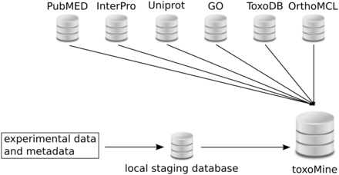
Figure 1. Layout of toxoMine setup and building process. All high-throughput experimental data and metadata is ...
Notes:
Figure 1. Layout of toxoMine setup and building process. All high-throughput experimental data and metadata is populated in the local PostgreSQL database for staging purposes. Subsequently, organized data is integrated into toxoMine along with data from third-party databases.
Unless provided in the caption above, the following copyright applies to the content of this slide: © The Author(s) 2015. Published by Oxford University Press. This is an Open Access article distributed under the terms of the Creative Commons Attribution License ( http://creativecommons.org/licenses/by/4.0/ ), which permits unrestricted reuse, distribution, and reproduction in any medium, provided the original work is properly cited.

Slide 2
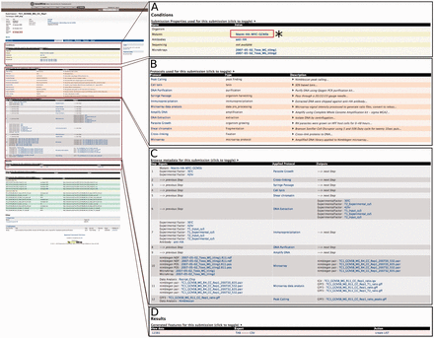
Figure 2. An example of the Report page. Here, we focus on submission ‘TC1’ to illustrate that a customized report page ...
Notes:
Figure 2. An example of the Report page. Here, we focus on submission ‘TC1’ to illustrate that a customized report page contains information from a range of associated data sets. (A) (*) Users can click on the Mutants link to seek additional experiments or projects that used this mutant. This will lead users to a report page for that particular data entry. (B) List of all protocols involved in this submission with type and description of protocol displayed. (C) Report page lists all of the data generated and detailed applied protocol information including antibody, mutant and the type of software used to generate the data. (D) The resulting data for the submission can be exported into a number of different formats, e.g. TAB and CSV. Additionally, result data can be exported as a ‘list’ for further analysis.
Unless provided in the caption above, the following copyright applies to the content of this slide: © The Author(s) 2015. Published by Oxford University Press. This is an Open Access article distributed under the terms of the Creative Commons Attribution License ( http://creativecommons.org/licenses/by/4.0/ ), which permits unrestricted reuse, distribution, and reproduction in any medium, provided the original work is properly cited.

Slide 3
Figure 3. An example of using the ‘Keyword Search’ tool to query toxoMine. We searched toxoMine using the keyword ...
Notes:
Figure 3. An example of using the ‘Keyword Search’ tool to query toxoMine. We searched toxoMine using the keyword ‘gcn5b’ to find all relevant data objects. The search result shows that a total of 10 data objects contained the search term. (*) The results are sorted based on a score indicative of how closely the keyword correlates to the saved search index.
Unless provided in the caption above, the following copyright applies to the content of this slide: © The Author(s) 2015. Published by Oxford University Press. This is an Open Access article distributed under the terms of the Creative Commons Attribution License ( http://creativecommons.org/licenses/by/4.0/ ), which permits unrestricted reuse, distribution, and reproduction in any medium, provided the original work is properly cited.

Slide 4
Figure 4. An example of the ‘Templates’ search tool. Here, we demonstrate the usage of the ‘ChIP target(s) → Binding ...
Notes:
Figure 4. An example of the ‘Templates’ search tool. Here, we demonstrate the usage of the ‘ChIP target(s) → Binding sites’ template to find all of the binding sites that are targeted by a specific antibody’s ChIP target. (*) Users have the option to choose the antibody’s target name, provide a list of ChIP targets, or turn the filter off altogether to broaden the search criteria.
Unless provided in the caption above, the following copyright applies to the content of this slide: © The Author(s) 2015. Published by Oxford University Press. This is an Open Access article distributed under the terms of the Creative Commons Attribution License ( http://creativecommons.org/licenses/by/4.0/ ), which permits unrestricted reuse, distribution, and reproduction in any medium, provided the original work is properly cited.

Slide 5
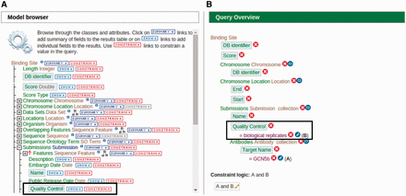
Figure 5. An example of modifying a template using the ‘QueryBuilder’ tool. An existing ‘ChIP target(s) → Binding ...
Notes:
Figure 5. An example of modifying a template using the ‘QueryBuilder’ tool. An existing ‘ChIP target(s) → Binding sites’ template is being modified to display an additional attribute and limit the output by applying a filter. (A) Using the ‘Model browser’ on the left, we enable the attribute ‘quality control’ by clicking the ‘SHOW’ button. This will display quality control attributes in the final result. We can also limit the results by applying a constraint value of ‘biological replicates’ to the quality control attribute by clicking the ‘CONSTRAIN’ button. (B) The ‘Query Overview’ to the right shows that the filter ‘biological replicates’ has been applied to the attribute quality control.
Unless provided in the caption above, the following copyright applies to the content of this slide: © The Author(s) 2015. Published by Oxford University Press. This is an Open Access article distributed under the terms of the Creative Commons Attribution License ( http://creativecommons.org/licenses/by/4.0/ ), which permits unrestricted reuse, distribution, and reproduction in any medium, provided the original work is properly cited.

Slide 6
Figure 6. An example of the ‘Regions’ tool showing the result of all applicable genomic features. Here, we provided the ...
Notes:
Figure 6. An example of the ‘Regions’ tool showing the result of all applicable genomic features. Here, we provided the chromosome coordinates of 10 MB, both directions, flanking the gene ‘TGME49_317280’. The results are presented as a table with each selected genomic feature listed with links to individual report pages for more details. (*) The results can be transformed into a ‘list’ for further analysis or downloaded into a number of different formats, which include TAB, CSV, GFF3, FASTA and BED.
Unless provided in the caption above, the following copyright applies to the content of this slide: © The Author(s) 2015. Published by Oxford University Press. This is an Open Access article distributed under the terms of the Creative Commons Attribution License ( http://creativecommons.org/licenses/by/4.0/ ), which permits unrestricted reuse, distribution, and reproduction in any medium, provided the original work is properly cited.

Slide 7
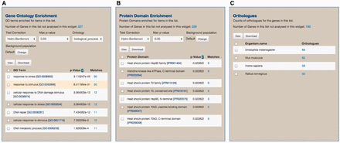
Figure 7. An example of the ‘List analysis’ page showing outputs of graphical and statistical analysis widgets. We used ...
Notes:
Figure 7. An example of the ‘List analysis’ page showing outputs of graphical and statistical analysis widgets. We used 30 genes annotated with the GO term ‘response to stress’ along with 270 randomly selected genes to generate the result. (A) As anticipated, GO enrichment analysis shows that the GO term ‘response to stress’, among other GO terms, is statistically significant. (B) Protein Domain enrichment analysis shows that many enriched domains were found including ‘Heat shock protein HSP90 family’ domain. (C) Numerous orthologs, including 59 Human genes, were found among 300 uploaded genes. These orthologous gene lists can be used for further analysis via MOD compliant InterMine variants.
Unless provided in the caption above, the following copyright applies to the content of this slide: © The Author(s) 2015. Published by Oxford University Press. This is an Open Access article distributed under the terms of the Creative Commons Attribution License ( http://creativecommons.org/licenses/by/4.0/ ), which permits unrestricted reuse, distribution, and reproduction in any medium, provided the original work is properly cited.

