Slide 1
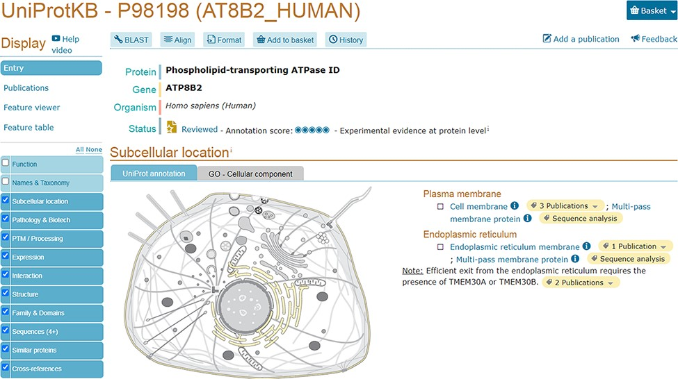
Figure 3. UniProtKB entry AT8B2_ HUMAN (P98198) shows an embedded SwissBioPics image: The generic animal cell ...
Notes:
Figure 3. UniProtKB entry AT8B2_ HUMAN (P98198) shows an embedded SwissBioPics image: The generic animal cell (Eumetazoa) is selected based on organism taxonomy; the cell membrane and endoplasmic reticulum are highlighted using annotations from the UniProt entry.
Unless provided in the caption above, the following copyright applies to the content of this slide: © The Author(s) 2022. Published by Oxford University Press.This is an Open Access article distributed under the terms of the Creative Commons Attribution License (https://creativecommons.org/licenses/by/4.0/), which permits unrestricted reuse, distribution, and reproduction in any medium, provided the original work is properly cited.

