Slide 1
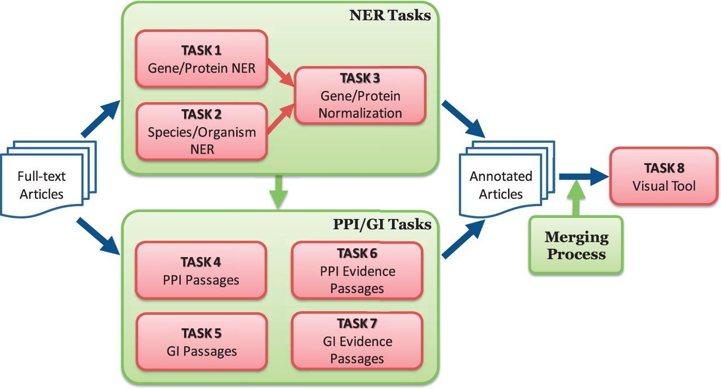
Figure 1. Overview of BioCreative V BioC track. The track consists of named entity recognition (NER), protein–protein ...
Notes:
Figure 1. Overview of BioCreative V BioC track. The track consists of named entity recognition (NER), protein–protein interaction (PPI), genetic interaction (GI) and visual tool tasks. The NER tasks include gene/protein NER, species/organism NER and gene/protein normalization. The PPI/GI tasks include finding passages with PPI/GI information (PPI/GI Passages), passages with PPI experimental methods (PPI Evidence Passages) and passages with GI types (GI Evidence Passages).
Unless provided in the caption above, the following copyright applies to the content of this slide: Published by Oxford University Press 2016. This work is written by US Government employees and is in the public domain in the US.

