Slide 1
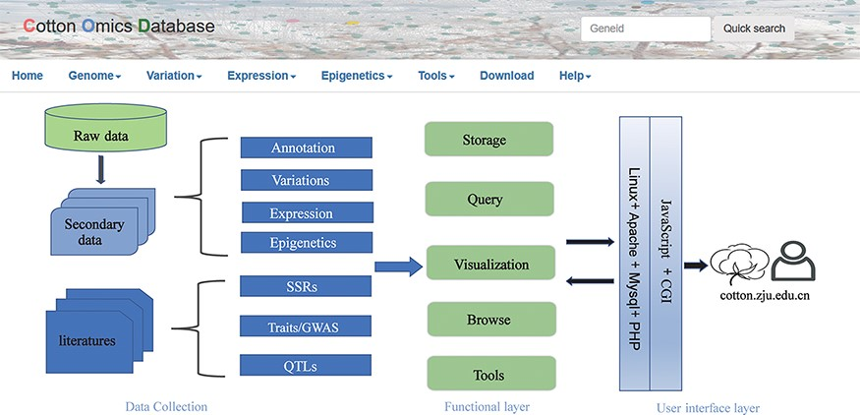
Figure 1. Summary of COTTONOMICS data collection and construction. COTTONOMICS is an easily accessible web database ...
Notes:
Figure 1. Summary of COTTONOMICS data collection and construction. COTTONOMICS is an easily accessible web database that integrates 32.5 TB of omics data including seven assembled genomes, resequencing data from 1180 allotetraploid cotton accessions and multi-omics data; detailed data information is found in Table 1
Unless provided in the caption above, the following copyright applies to the content of this slide: © The Author(s) 2022. Published by Oxford University Press.This is an Open Access article distributed under the terms of the Creative Commons Attribution-NonCommercial License (https://creativecommons.org/licenses/by-nc/4.0/), which permits non-commercial re-use, distribution, and reproduction in any medium, provided the original work is properly cited. For commercial re-use, please contact journals.permissions@oup.com

