Slide 1
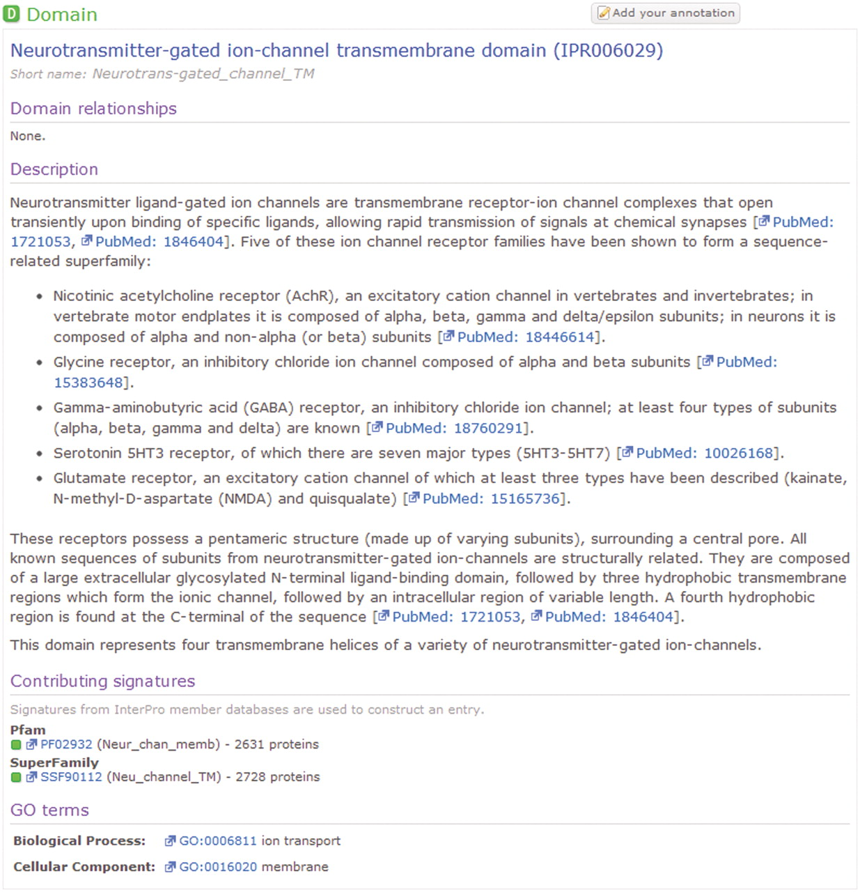
Figure 1. An example human-curated InterPro entry, illustrating the detailed description provided for the entry and ...
Notes:
Figure 1. An example human-curated InterPro entry, illustrating the detailed description provided for the entry and cross references to the GO and the member database signatures from which the entry is composed.
Unless provided in the caption above, the following copyright applies to the content of this slide: © The Author(s) 2011. Published by Oxford University Press.This is Open Access article distributed under the terms of the Creative Commons Attribution Non-Commercial License (http://creativecommons.org/licenses/by-nc/2.5), which permits unrestricted non-commercial use, distribution, and reproduction in any medium, provided the original work is properly cited.

Slide 2
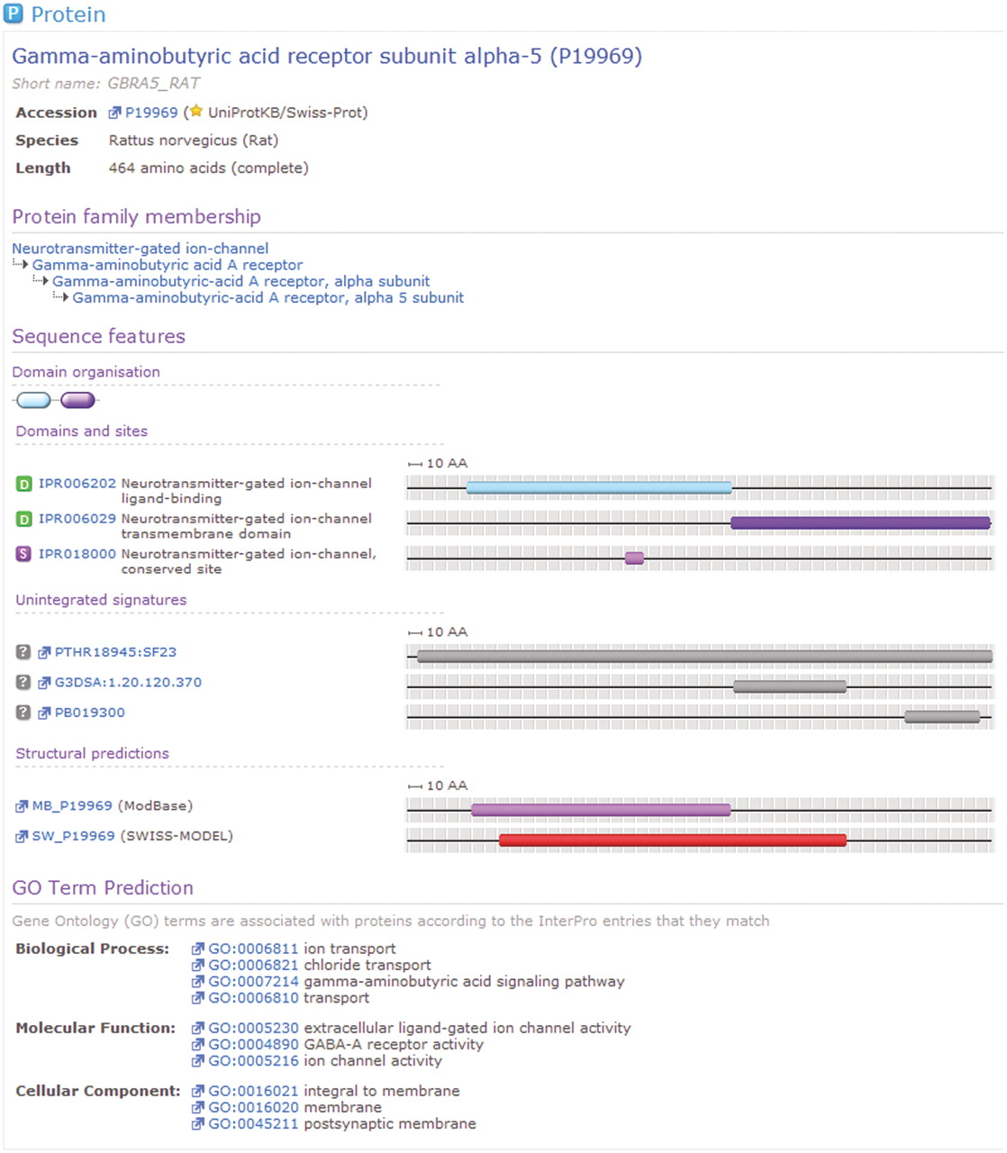
Figure 2. A protein for which matches have been calculated by InterPro. For this sequence, InterPro provides a ...
Notes:
Figure 2. A protein for which matches have been calculated by InterPro. For this sequence, InterPro provides a prediction of protein family membership, an overview of the domain organization and the details of matches to member database signatures. At the foot of the view can be seen associated GO terms, based upon the calculated matches to InterPro entries.
Unless provided in the caption above, the following copyright applies to the content of this slide: © The Author(s) 2011. Published by Oxford University Press.This is Open Access article distributed under the terms of the Creative Commons Attribution Non-Commercial License (http://creativecommons.org/licenses/by-nc/2.5), which permits unrestricted non-commercial use, distribution, and reproduction in any medium, provided the original work is properly cited.

Slide 3
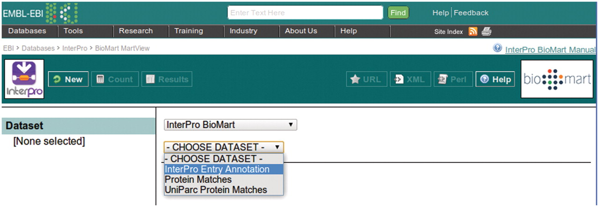
Figure 3. Selecting a dataset in the InterPro BioMart.
Notes:
Figure 3. Selecting a dataset in the InterPro BioMart.
Unless provided in the caption above, the following copyright applies to the content of this slide: © The Author(s) 2011. Published by Oxford University Press.This is Open Access article distributed under the terms of the Creative Commons Attribution Non-Commercial License (http://creativecommons.org/licenses/by-nc/2.5), which permits unrestricted non-commercial use, distribution, and reproduction in any medium, provided the original work is properly cited.

Slide 4
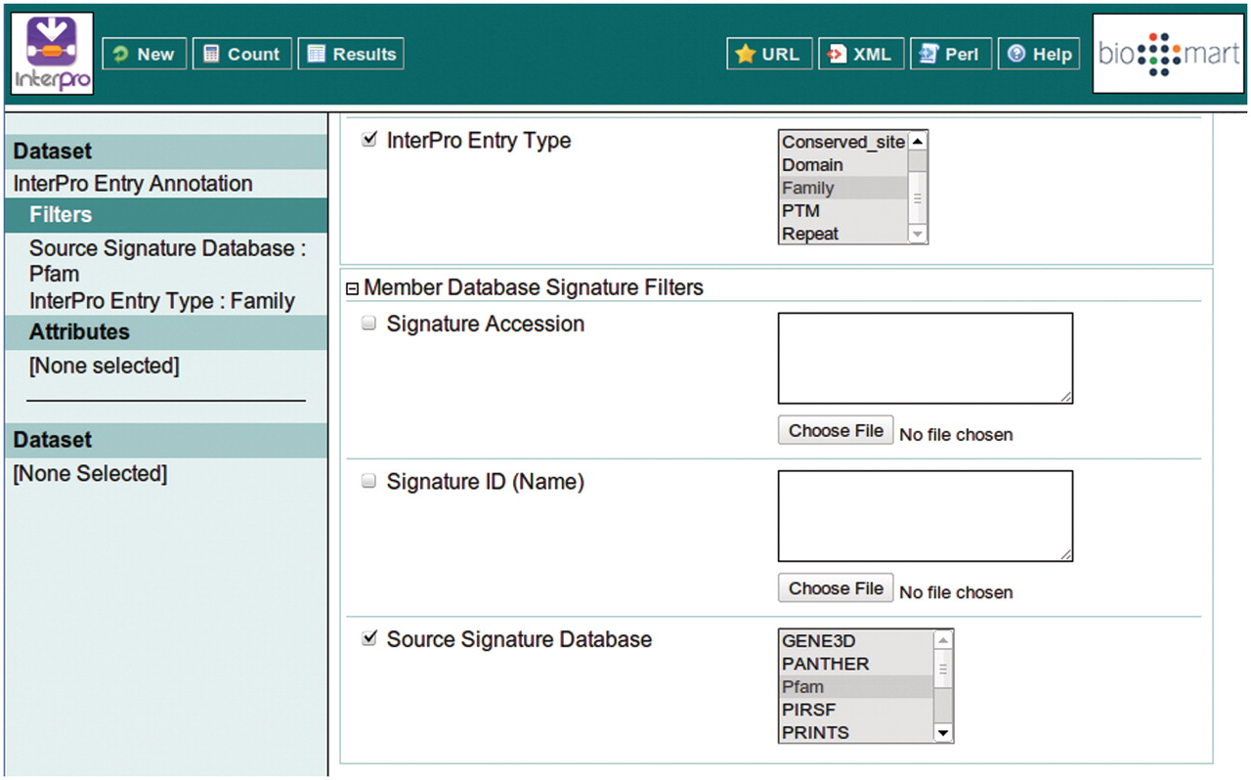
Figure 4. Building a filter with two components: include results for ‘Family’ entry types that comprise signatures from ...
Notes:
Figure 4. Building a filter with two components: include results for ‘Family’ entry types that comprise signatures from Pfam.
Unless provided in the caption above, the following copyright applies to the content of this slide: © The Author(s) 2011. Published by Oxford University Press.This is Open Access article distributed under the terms of the Creative Commons Attribution Non-Commercial License (http://creativecommons.org/licenses/by-nc/2.5), which permits unrestricted non-commercial use, distribution, and reproduction in any medium, provided the original work is properly cited.

Slide 5
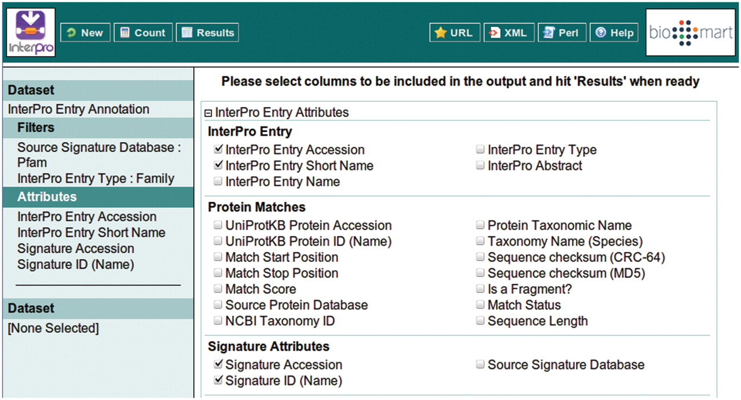
Figure 5. Selecting the attributes to be included in the BioMart output (equivalent to the columns of a spreadsheet). ...
Notes:
Figure 5. Selecting the attributes to be included in the BioMart output (equivalent to the columns of a spreadsheet). The ordering of the columns is determined by the order in which the attributes are selected.
Unless provided in the caption above, the following copyright applies to the content of this slide: © The Author(s) 2011. Published by Oxford University Press.This is Open Access article distributed under the terms of the Creative Commons Attribution Non-Commercial License (http://creativecommons.org/licenses/by-nc/2.5), which permits unrestricted non-commercial use, distribution, and reproduction in any medium, provided the original work is properly cited.

Slide 6
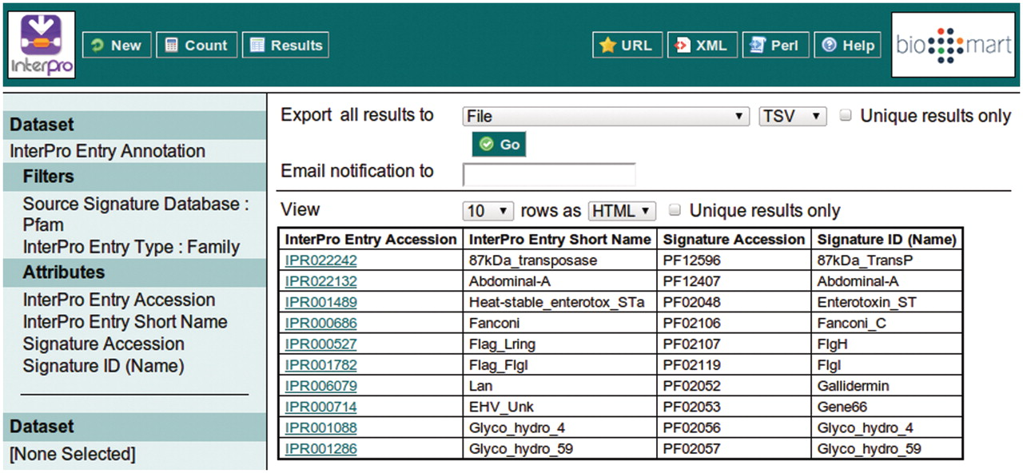
Figure 6. Clicking the ‘Results’ button at the top of the interface provides the first 10 results matching the query, ...
Notes:
Figure 6. Clicking the ‘Results’ button at the top of the interface provides the first 10 results matching the query, to allow the query to be modified or improved.
Unless provided in the caption above, the following copyright applies to the content of this slide: © The Author(s) 2011. Published by Oxford University Press.This is Open Access article distributed under the terms of the Creative Commons Attribution Non-Commercial License (http://creativecommons.org/licenses/by-nc/2.5), which permits unrestricted non-commercial use, distribution, and reproduction in any medium, provided the original work is properly cited.

