Slide 1
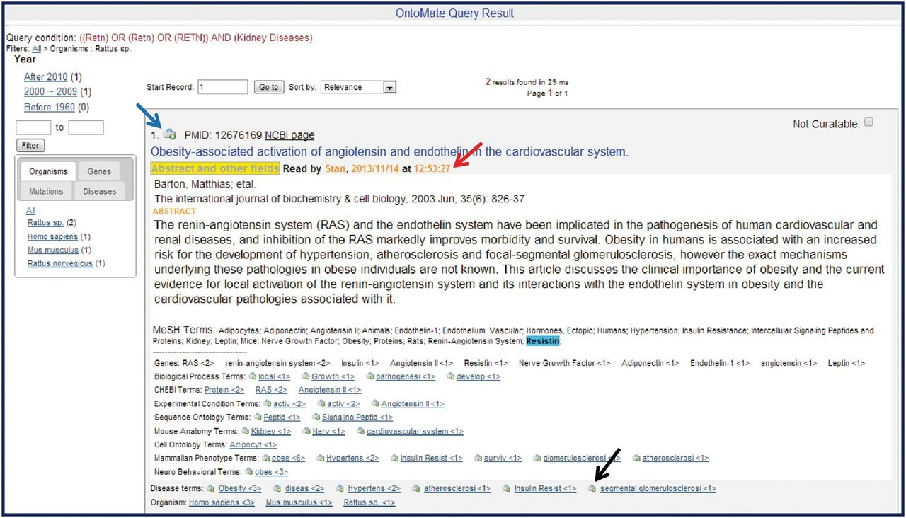
Figure 4. Sample OntoMate abstract entry. The abstract has been opened by clicking on the ‘Abstract and other fields’ ...
Notes:
Figure 4. Sample OntoMate abstract entry. The abstract has been opened by clicking on the ‘Abstract and other fields’ button underneath the title. A ‘Read by’ (red arrow) note shows that the abstract has been accessed by another user sometime before. The abstract can be entered into the main RGD database and into the curation tool interface by clicking on the bucket icon (blue arrow) above the title. Any of the hyperlinked terms can be placed in the curation tool term bucket by clicking the bucket icon (example at black arrow) to the left of the appropriate term. Terms may also be displayed in the term browser in the curation tool interface by clicking the hyperlinked term. Corresponding terms in the abstract are highlighted if the user ‘mouses over’ any of the terms listed below the abstract.
Unless provided in the caption above, the following copyright applies to the content of this slide: © The Author(s) 2015. Published by Oxford University Press.This is an Open Access article distributed under the terms of the Creative Commons Attribution License (http://creativecommons.org/licenses/by/4.0/), which permits unrestricted reuse, distribution, and reproduction in any medium, provided the original work is properly cited.

