Slide 1
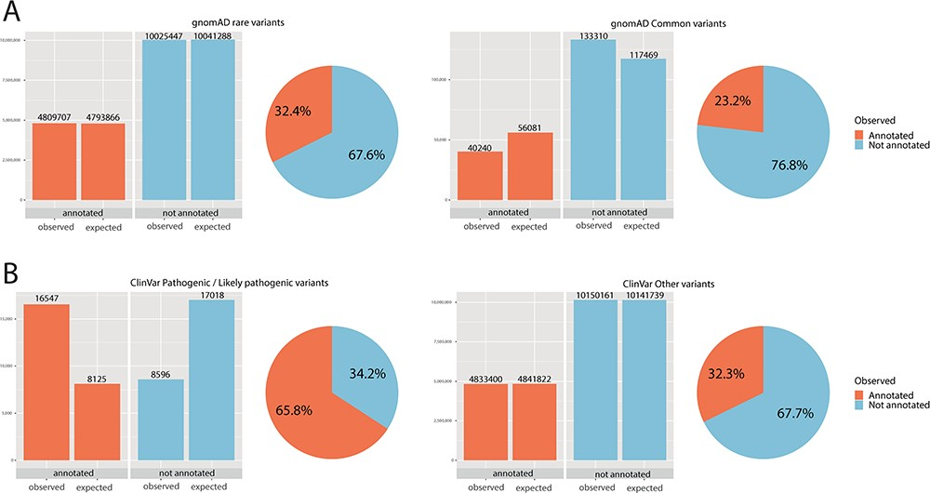
Figure 2 Chi-square statistics. From observed (real) data, we were able to calculate the expected data distribution. ...
Notes:
Figure 2 Chi-square statistics. From observed (real) data, we were able to calculate the expected data distribution. The difference between the two columns (observed vs. expected) is proportional to the dependence of the data and accordingly statistical significance. The difference is also proportional to the odds ratio. The pie chart is calculated from observed (real) data only. (A) For rare variants, 32% were annotated, while only 23% of common variants fall onto a conserved protein domain. The results show the dependence of distribution, and the difference was evaluated as significant with P < 0.01 and odds ratio of 1.59. (B) For ClinVar, the difference was even more obvious: 66% of pathogenic/likely pathogenic variants were annotated, while only 32% of other ClinVar variants fall onto a domain. The results show the dependence of distribution, and the difference was evaluated as significant with P < 0.01 and odds ratio of 4.04.
Unless provided in the caption above, the following copyright applies to the content of this slide: © The Author(s) 2020. Published by Oxford University Press.This is an Open Access article distributed under the terms of the Creative Commons Attribution License (http://creativecommons.org/licenses/by/4.0/), which permits unrestricted reuse, distribution, and reproduction in any medium, provided the original work is properly cited.

