Slide 1
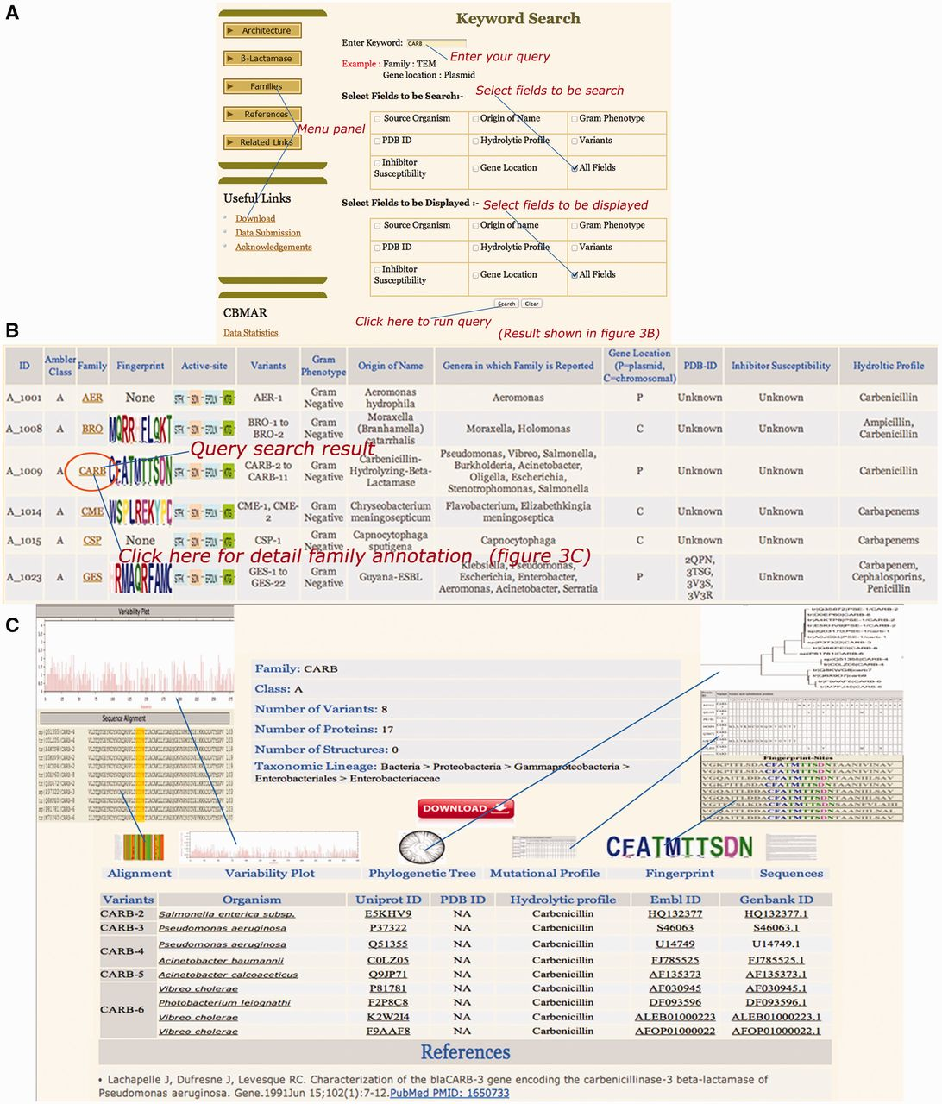
Figure 4. Snapshots of ‘CARB’ keyword search (A), result page (B) and family details (C). The search interface allows ...
Notes:
Figure 4. Snapshots of ‘CARB’ keyword search (A), result page (B) and family details (C). The search interface allows for the query search over one or multiple fields. Similarly, the display of result can also be limited to one or multiple fields. The result displays the search results along with appropriate hyperlinks for detailed family annotation, fingerprint and active site residues.
Unless provided in the caption above, the following copyright applies to the content of this slide: © The Author(s) 2014. Published by Oxford University Press.This is an Open Access article distributed under the terms of the Creative Commons Attribution License (http://creativecommons.org/licenses/by/4.0/), which permits unrestricted reuse, distribution, and reproduction in any medium, provided the original work is properly cited.

