Slide 1
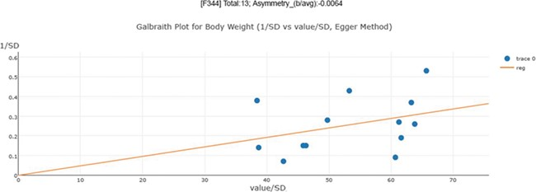
Figure 3 Publication bias examination demonstrations for body weight. The regression test is a linear regression of ...
Notes:
Figure 3 Publication bias examination demonstrations for body weight. The regression test is a linear regression of normalized effect size estimate (value/SD) against precision(1/SD). When the regression line runs through the origin, it indicates a symmetrical funnel plot. An asymmetry score is calculated as the ratio of intercept for the regression line to average value for the measurements in the group under analysis.
Unless provided in the caption above, the following copyright applies to the content of this slide: © The Author(s) 2019. Published by Oxford University Press.This is an Open Access article distributed under the terms of the Creative Commons Attribution License (http://creativecommons.org/licenses/by/4.0/), which permits unrestricted reuse, distribution, and reproduction in any medium, provided the original work is properly cited.

