Slide 1
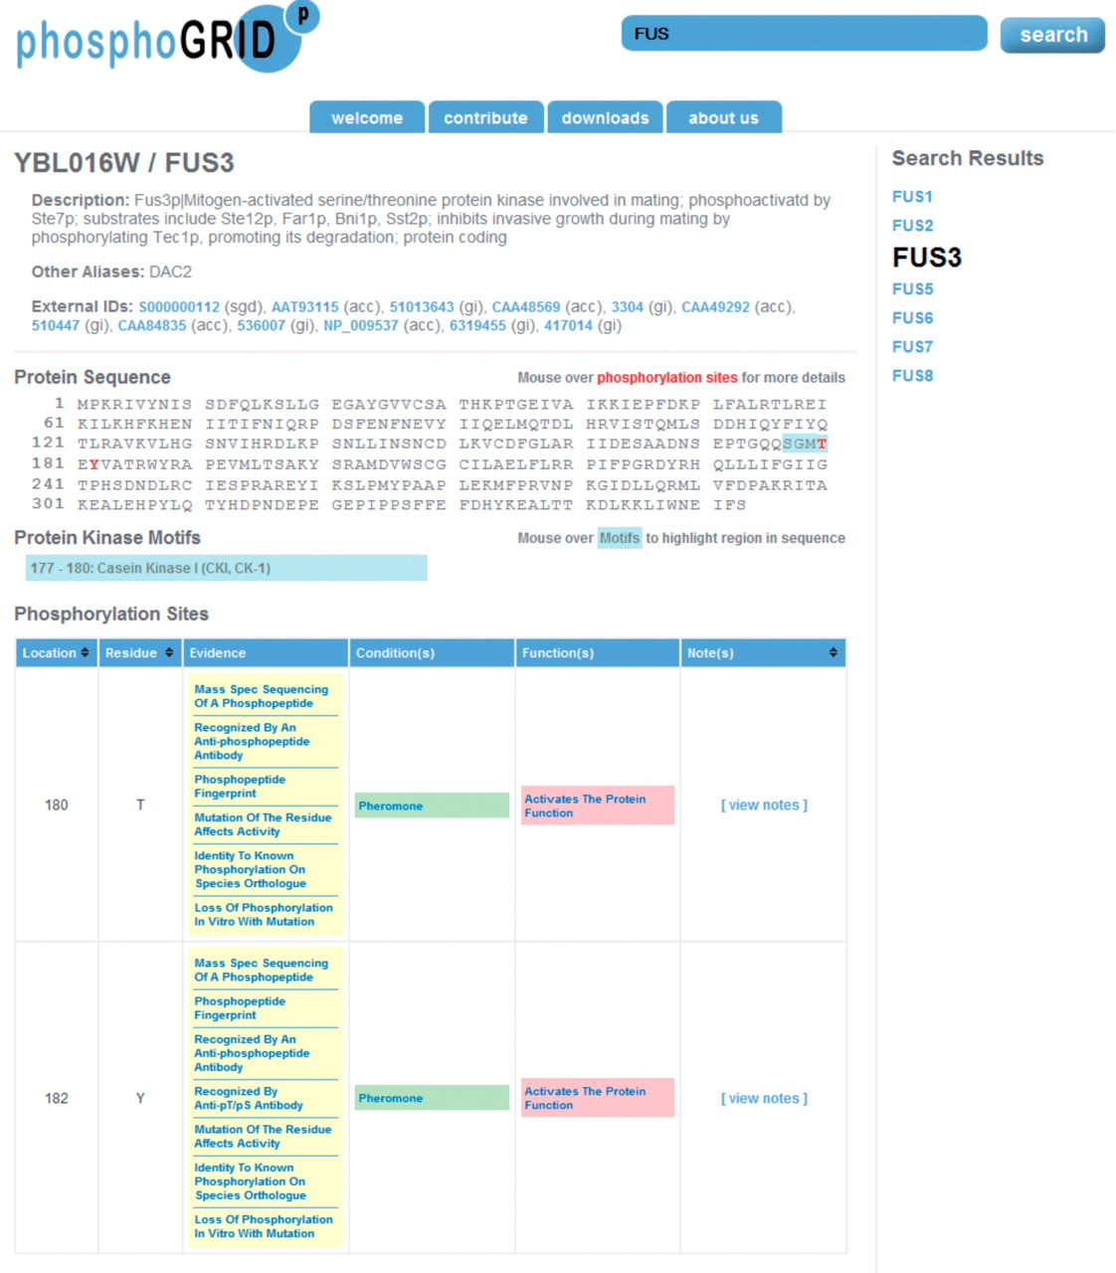
Figure 1. Screen shot of PhosphoGRID webpage produced by a search for the mating pheromone MAPK Fus3. Phosphorylated ...
Notes:
Figure 1. Screen shot of PhosphoGRID webpage produced by a search for the mating pheromone MAPK Fus3. Phosphorylated amino acids are indicated on the protein sequence in red. Consensus sites for known protein kinases overlapping phosphosites are indicated in blue. Detailed information relating to each identified phosphosite is presented in table form below, with links to PubMED references for the evidence of phosphorylation, conditions under which phosphorylation occurs and effects on protein function.
Unless provided in the caption above, the following copyright applies to the content of this slide: © The Author(s) 2010. Published by Oxford University Press.This is Open Access article distributed under the terms of the Creative Commons Attribution Non-Commercial License (http://creativecommons.org/licenses/by-nc/2.5), which permits unrestricted non-commercial use, distribution, and reproduction in any medium, provided the original work is properly cited.

