Slide 1
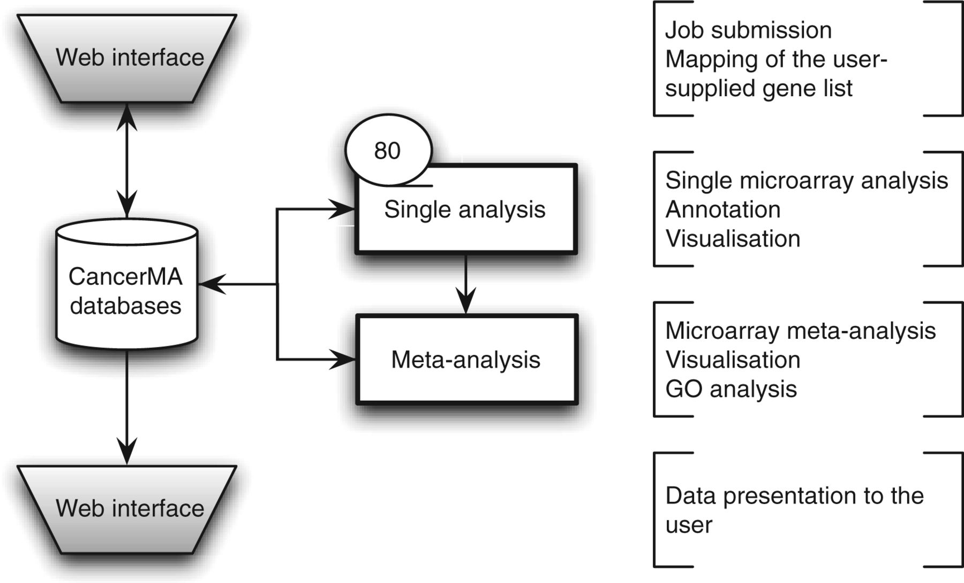
Figure 1 CancerMA workflow. The web interface box indicates the areas where the user provides input and/or can view ...
Notes:
Figure 1 CancerMA workflow. The web interface box indicates the areas where the user provides input and/or can view the mapping or analysis results. The analysis is carried out automatically without any user input. The single analysis determines the differential expression for 80 cancer microarray datasets individually, whereas the meta-analysis combines the results form the individual analyses to a differential meta-expression profile.
Unless provided in the caption above, the following copyright applies to the content of this slide: © The Author(s) 2012. Published by Oxford University Press.This is an Open Access article distributed under the terms of the Creative Commons Attribution Non-Commercial License (http://creativecommons.org/licenses/by-nc/3.0/), which permits unrestricted non-commercial use, distribution, and reproduction in any medium, provided the original work is properly cited.

