Slide 1
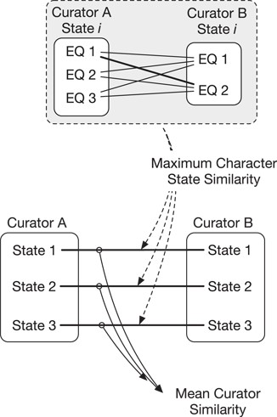
Figure 1 Similarity of annotations between two curators is calculated across multiple character states (e.g. states ...
Notes:
Figure 1 Similarity of annotations between two curators is calculated across multiple character states (e.g. states 1–3, bottom). First, the maximum character state similarity is calculated at the level of a single character state and is the best match (maximum score) in pairwise comparisons across that state’s EQ annotations. Mean curator similarity is then calculated as the mean of the maximum similarities across all character state pairs.
Unless provided in the caption above, the following copyright applies to the content of this slide: © The Author(s) 2018. Published by Oxford University Press.This is an Open Access article distributed under the terms of the Creative Commons Attribution License (http://creativecommons.org/licenses/by/4.0/), which permits unrestricted reuse, distribution, and reproduction in any medium, provided the original work is properly cited.

