Slide 1
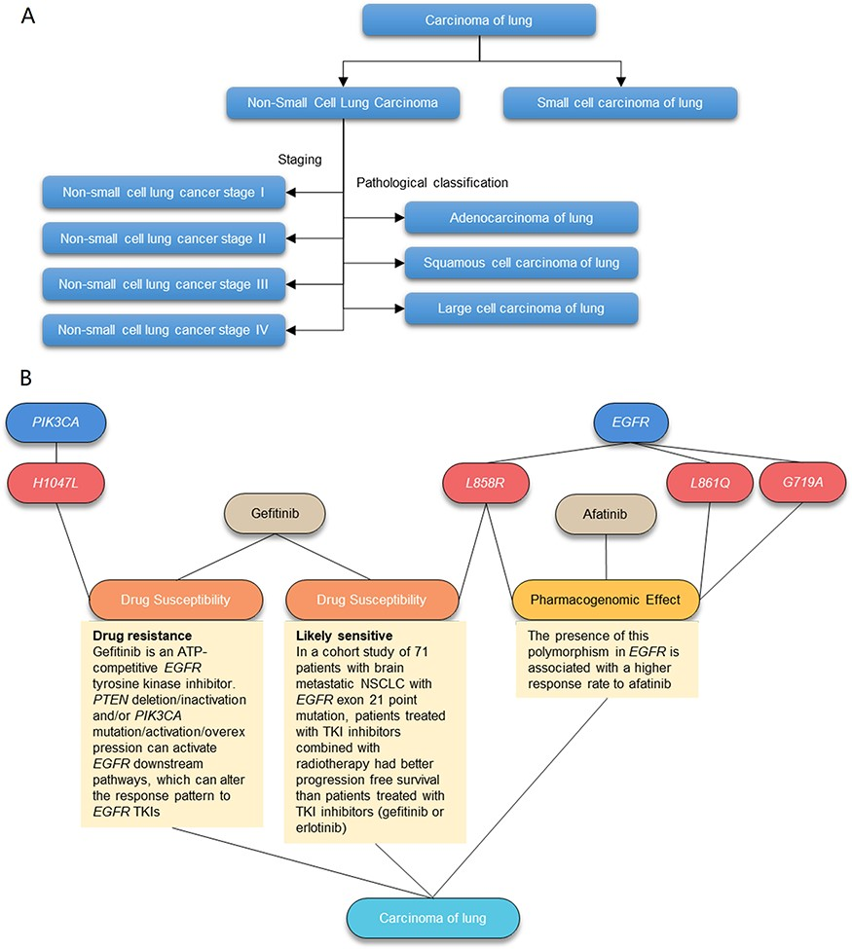
Figure 2. Illustration of the AIMedGraph relation graph. (A) Example of the disease classification tree. (B) Example of ...
Notes:
Figure 2. Illustration of the AIMedGraph relation graph. (A) Example of the disease classification tree. (B) Example of the relation graph between genes, variants, drugs and diseases.
Unless provided in the caption above, the following copyright applies to the content of this slide: © The Author(s) 2023. Published by Oxford University Press.This is an Open Access article distributed under the terms of the Creative Commons Attribution License (https://creativecommons.org/licenses/by/4.0/), which permits unrestricted reuse, distribution, and reproduction in any medium, provided the original work is properly cited.

Slide 2
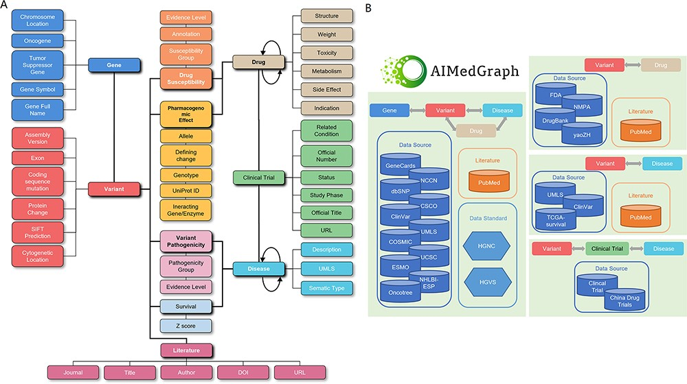
Figure 1. The AIMedGraph knowledge graph. (A) Simplified AIMedGraph architectures; (B) AIMedGraph data sources.
Notes:
Figure 1. The AIMedGraph knowledge graph. (A) Simplified AIMedGraph architectures; (B) AIMedGraph data sources.
Unless provided in the caption above, the following copyright applies to the content of this slide: © The Author(s) 2023. Published by Oxford University Press.This is an Open Access article distributed under the terms of the Creative Commons Attribution License (https://creativecommons.org/licenses/by/4.0/), which permits unrestricted reuse, distribution, and reproduction in any medium, provided the original work is properly cited.

Slide 3
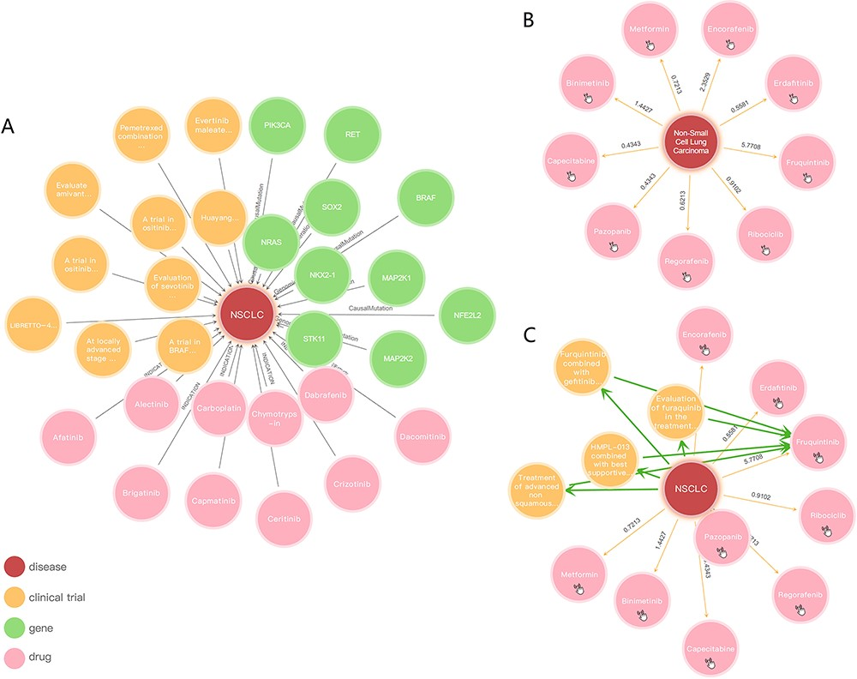
Figure 4. Knowledge graph presentation of NSCLC: (A) NSCLC relationships between genes, drugs and clinical trials, ...
Notes:
Figure 4. Knowledge graph presentation of NSCLC: (A) NSCLC relationships between genes, drugs and clinical trials, respectively; (B) inferred relationships of NSCLC; (C) reasoning between NSCLC and Fruquintinib.
Unless provided in the caption above, the following copyright applies to the content of this slide: © The Author(s) 2023. Published by Oxford University Press.This is an Open Access article distributed under the terms of the Creative Commons Attribution License (https://creativecommons.org/licenses/by/4.0/), which permits unrestricted reuse, distribution, and reproduction in any medium, provided the original work is properly cited.

Slide 4
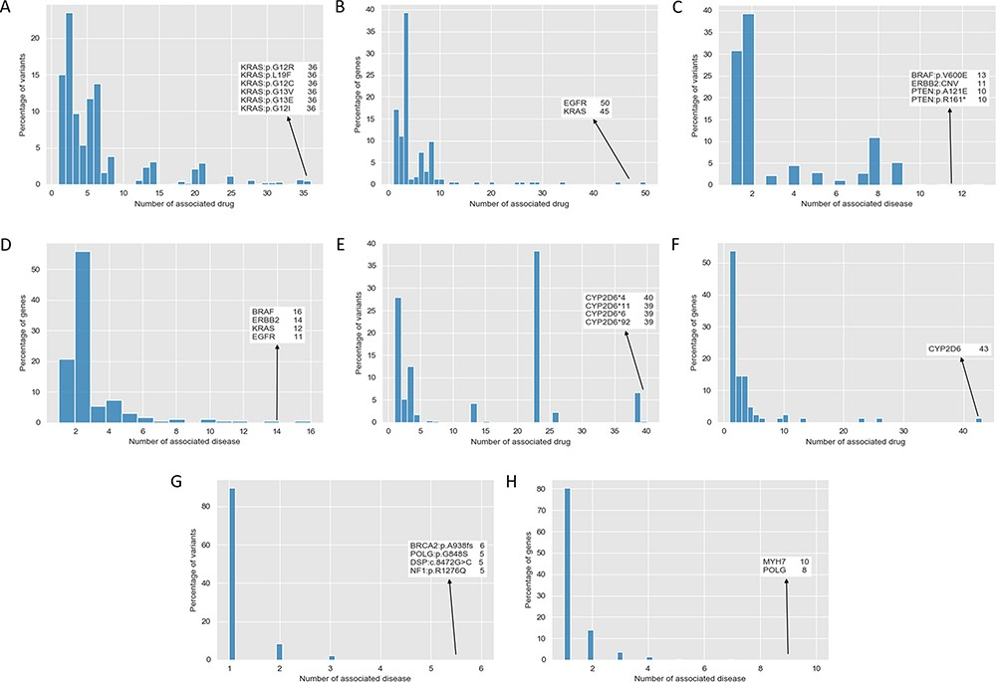
Figure 3. Distribution of drug susceptibility, pharmacogenomics effect and variant pathogenicity. (A) Distribution of ...
Notes:
Figure 3. Distribution of drug susceptibility, pharmacogenomics effect and variant pathogenicity. (A) Distribution of the number of associated drugs per variant with drug susceptibility impacts. (B) Distribution of the number of associated drugs per gene with drug susceptibility impacts. (C) Distribution of the number of associated diseases per variant with drug susceptibility impacts. (D) Distribution of the number of associated diseases per gene with drug susceptibility impacts. (E) Distribution of the number of associated drugs per variant with pharmacogenomics effects. (F) Distribution of the number of associated drugs per variant with pharmacogenomics effects. (G) Distribution of the number of associated diseases per variant with pathogenicity. (H) Distribution of the number of associated diseases per gene with pathogenicity.
Unless provided in the caption above, the following copyright applies to the content of this slide: © The Author(s) 2023. Published by Oxford University Press.This is an Open Access article distributed under the terms of the Creative Commons Attribution License (https://creativecommons.org/licenses/by/4.0/), which permits unrestricted reuse, distribution, and reproduction in any medium, provided the original work is properly cited.

