Slide 1
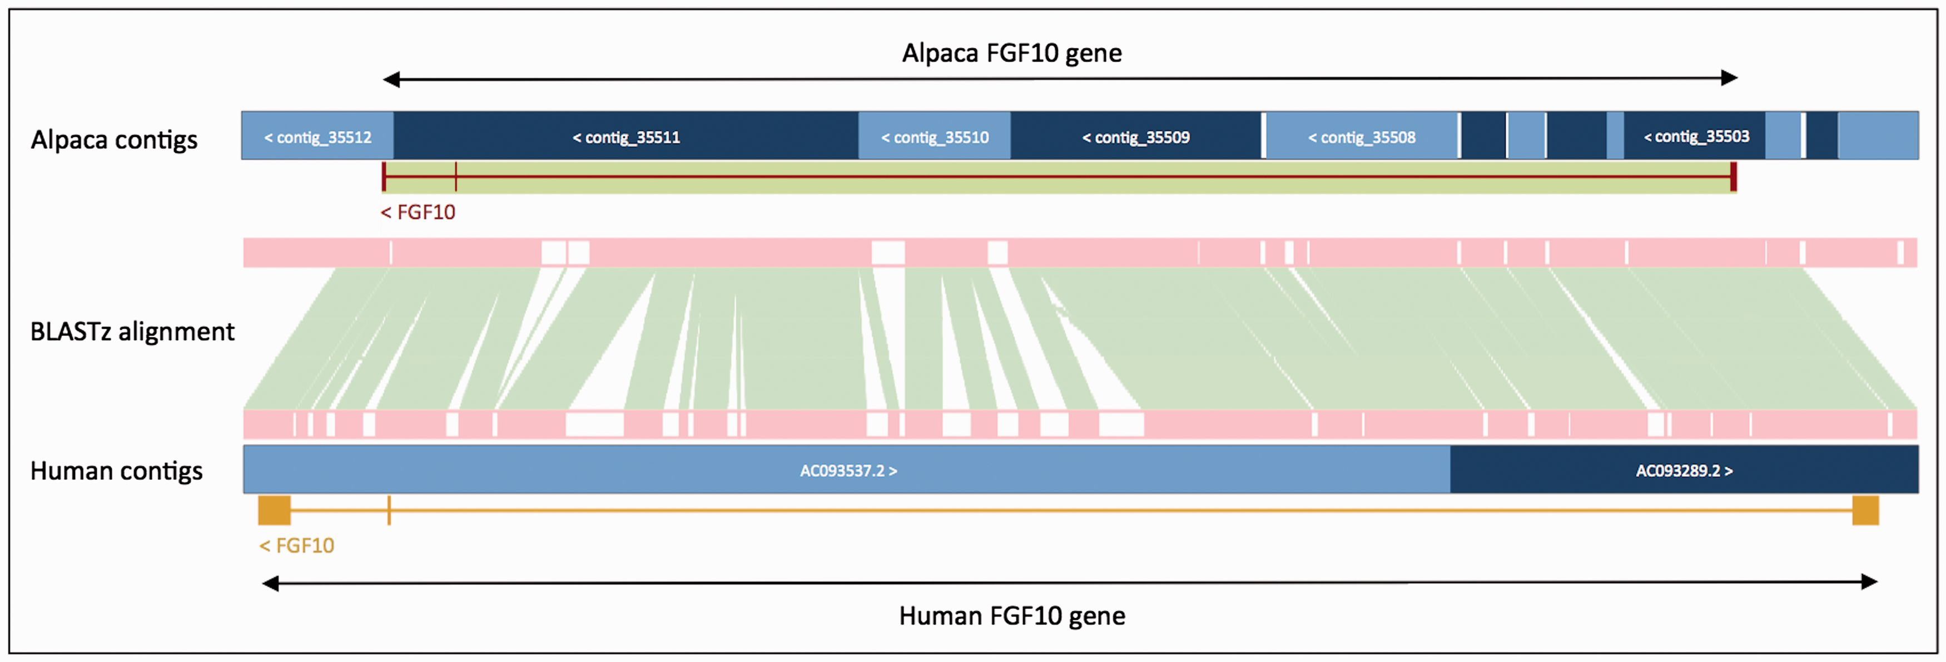
Figure 3. Projection of human FGF10 to alpaca. The FGF10 gene in alpaca was annotated by aligning the human and alpaca ...
Notes:
Figure 3. Projection of human FGF10 to alpaca. The FGF10 gene in alpaca was annotated by aligning the human and alpaca assemblies using BLASTz, and then projecting (copying) the human gene onto the alpaca genome. A novel structure, GeneScaffold_2975, was generated in the alpaca assembly by bringing together the shorter scaffolds that aligned to the human region containing the FGF10 gene.
Unless provided in the caption above, the following copyright applies to the content of this slide: © The Author(s) 2016. Published by Oxford University Press. This is an Open Access article distributed under the terms of the Creative Commons Attribution License ( http://creativecommons.org/licenses/by/4.0/ ), which permits unrestricted reuse, distribution, and reproduction in any medium, provided the original work is properly cited.

