Slide 1
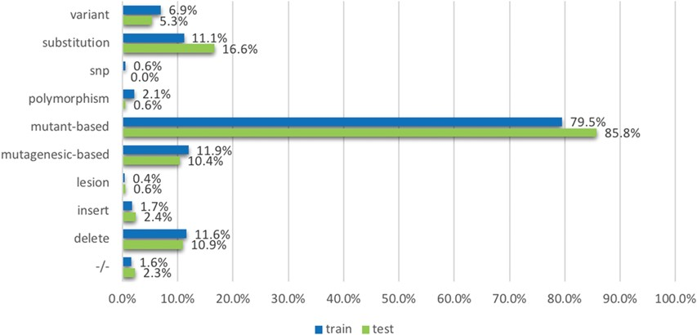
Figure 6 The proportion of relevant documents containing individual mutation terms, across training and testing data ...
Notes:
Figure 6 The proportion of relevant documents containing individual mutation terms, across training and testing data sets. The terms (or the groups of terms) are mentioned in the model development section.
Unless provided in the caption above, the following copyright applies to the content of this slide: © The Author(s) 2018. Published by Oxford University Press.This is an Open Access article distributed under the terms of the Creative Commons Attribution License (http://creativecommons.org/licenses/by/4.0/), which permits unrestricted reuse, distribution, and reproduction in any medium, provided the original work is properly cited.

