Slide 1
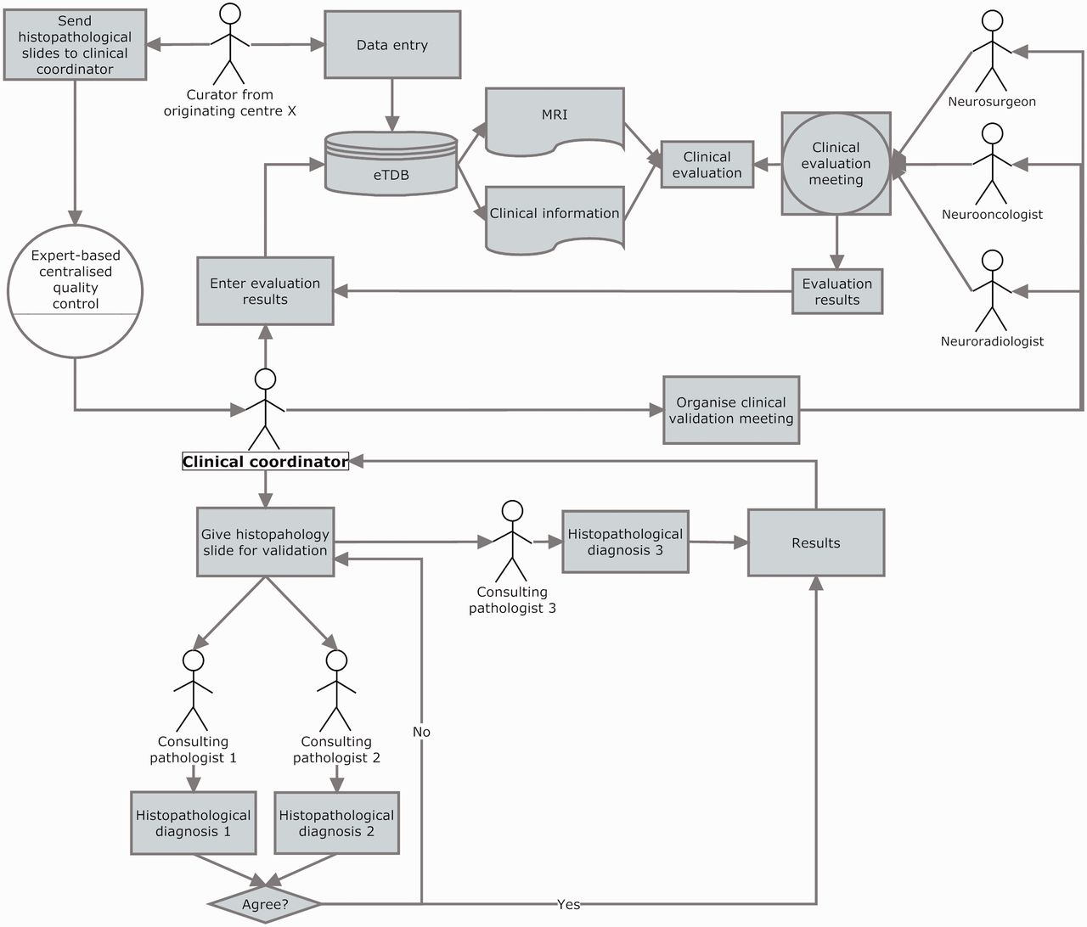
Figure 6 Clinical data validation. The review was internally coordinated by a clinical coordinator that collected all ...
Notes:
Figure 6 Clinical data validation. The review was internally coordinated by a clinical coordinator that collected all the results and entered them into the eTDB. This person was in charge of gathering the results of the clinical meetings, organizing the slides distribution among neuropathologists, collecting their diagnoses and entering all this meta-data for all the centres into the eTDB. In this case, the permission schema for this user was that of a senior curator and specifically tailored for this sole purpose.
Unless provided in the caption above, the following copyright applies to the content of this slide: © The Author(s) 2012. Published by Oxford University Press.This is an Open Access article distributed under the terms of the Creative Commons Attribution License (http://creativecommons.org/licenses/by-nc/3.0/), which permits non-commercial reuse, distribution, and reproduction in any medium, provided the original work is properly cited. For commercial re-use, please contact journals.permissions@oup.com.

