Slide 1
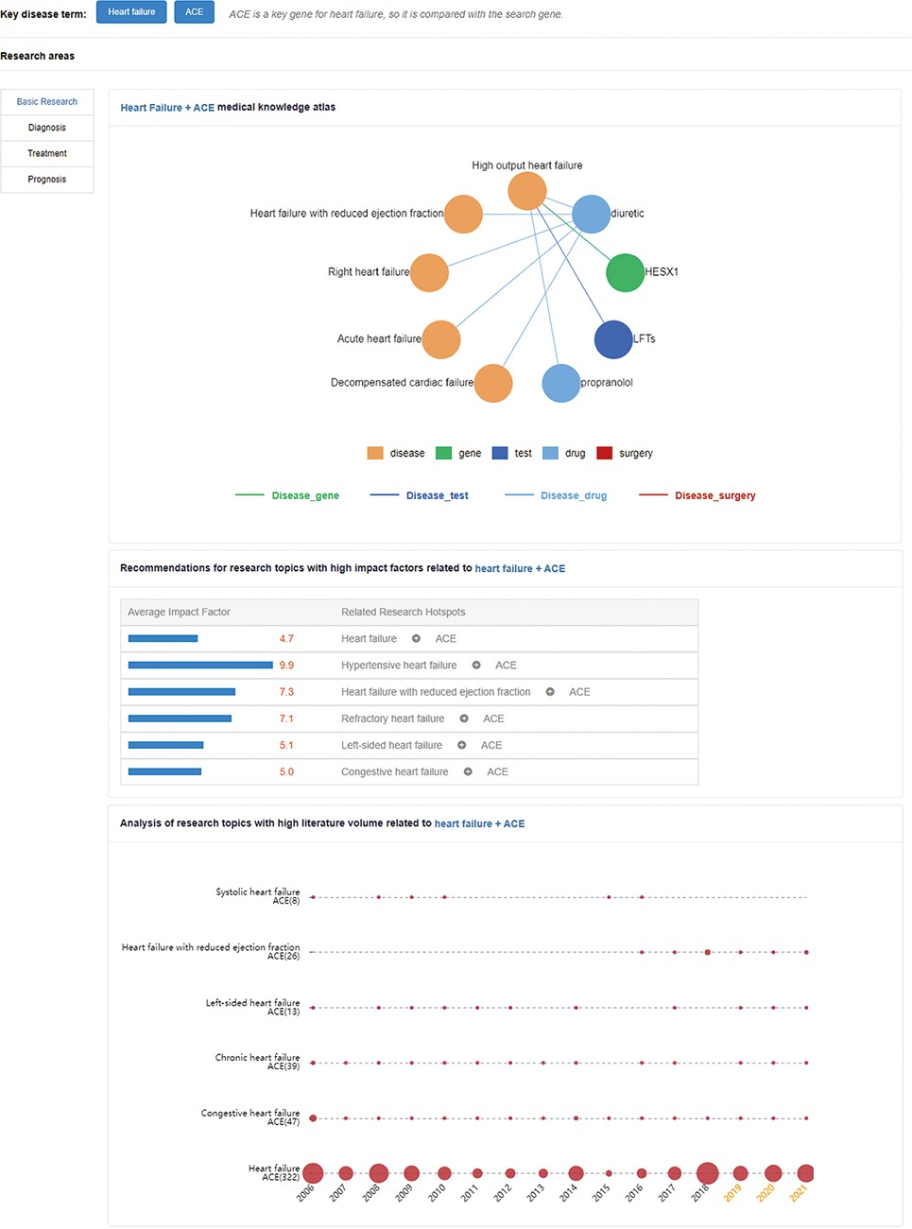
Figure 5. Research hotspots and future research trends of an angiotensin-converting enzyme (ACE) gene in HF. The upper ...
Notes:
Figure 5. Research hotspots and future research trends of an angiotensin-converting enzyme (ACE) gene in HF. The upper network diagram is the medical knowledge map. The middle part is recommendations for high-impact-factor research topics related to HF + ACE. These numbers indicate the average impact factor of related literature. The lower part is the research topic analysis, and the area of the circle represents the heat of the relation.
Unless provided in the caption above, the following copyright applies to the content of this slide: © The Author(s) 2021. Published by Oxford University Press.This is an Open Access article distributed under the terms of the Creative Commons Attribution License (https://creativecommons.org/licenses/by/4.0/), which permits unrestricted reuse, distribution, and reproduction in any medium, provided the original work is properly cited.

