Slide 1
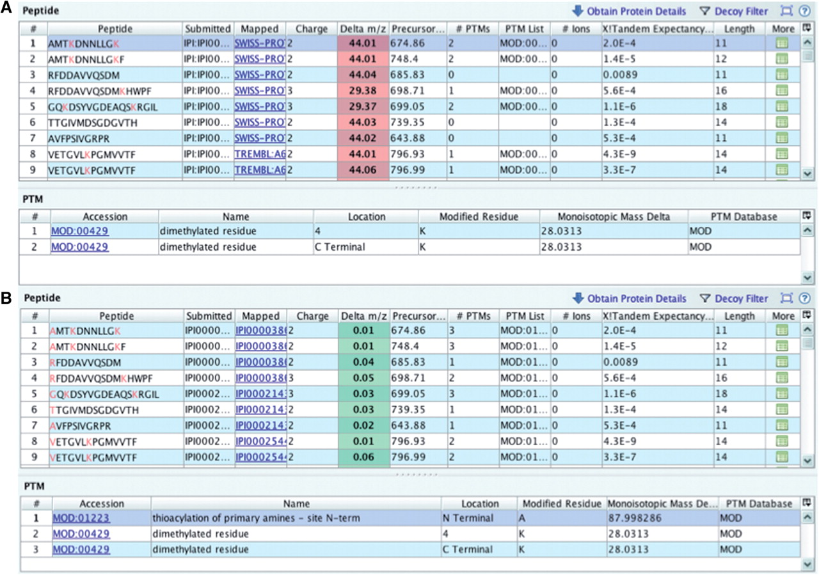
Figure 6. Checking delta m/z values with PRIDE Inspector peptide view: Example 2: missing modification (A) systematic ...
Notes:
Figure 6. Checking delta m/z values with PRIDE Inspector peptide view: Example 2: missing modification (A) systematic outlier delta m/z values highlighted in red indicates a potential problem due to the lack of a fixed protein modification. (B) A PSI-MOD term was added that gives the expected delta m/z values for all peptides.
Unless provided in the caption above, the following copyright applies to the content of this slide: © The Author(s) 2012. Published by Oxford University Press.This is an Open Access article distributed under the terms of the Creative Commons Attribution Non-Commercial License (http://creativecommons.org/licenses/by-nc/3.0), which permits unrestricted non-commercial use, distribution, and reproduction in any medium, provided the original work is properly cited.

